Slide 1
Large ENERGY USERS AND THE ENERGY TRANSITION
Andrew Richards
October 2023

Slide 2





































MEMBERS
GRENNING
CONSULTING
PTY LTD

Slide 3
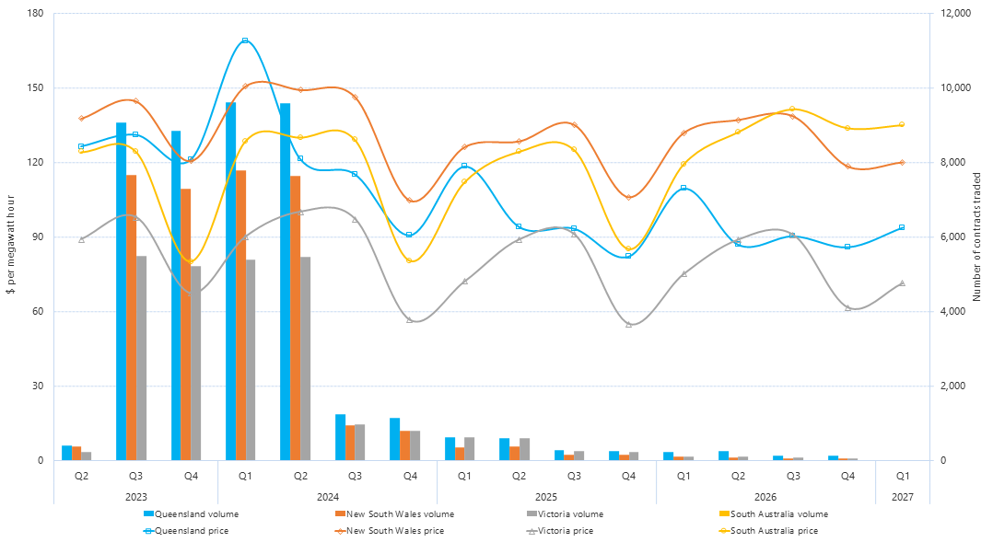
Future Electricity prices
Source: AER quarterly-base-futures-prices-and-volume-traded

Slide 4
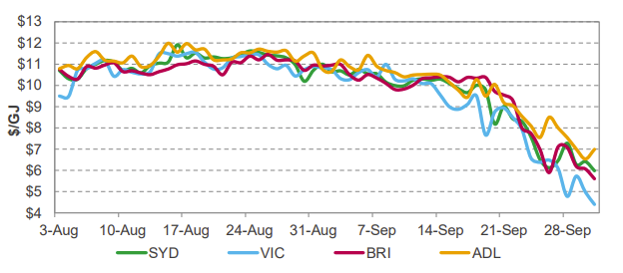
gas prices
ACCC reporting provides data based on executed GSA’s as reported to them by sellers. Recent retailer range substantially higher than producers.
Spot markets tend to be very thinly
traded and therefore may not be a good indicator of contract prices.

Slide 5
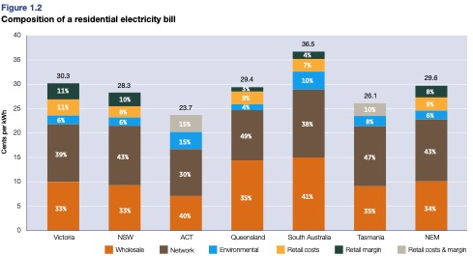
Evolution of the bill stack
We are beginning to watch the trends in the composition of the residential bill stack* (large C&I is very difficult to track and is not reported by the AER).
You can start to see some movement in the composition of the bill stack between the 2018 AER State Of The Markets Report (top) and the 2022 report (bottom).
  Wholesale was 34% now 33%.
  Network was 43% now 48%.
  Enviro was 6% now 8%.
  Retail was 17% now 11%.
Most of the cost and relative movement is yet to come.
  i.e. ISP, REZ & firming costs are still to be included
*Composition of the retail bill is influenced by many things, therefore we will be looking for broad trends over an extended period

Slide 6
THE ENERGY TRANSITION
The energy transition is not really a transition at all, rather it’s a complete re-build of the energy system in a relatively short period of time.
  In excess of $200B will need to be spent over the next 15 years including 10,000KM of new transmission lines and a 300% increase in generation capacity to achieve a near zero carbon energy system.
This paradigm shift creates significant challenges for host communities and energy consumers alike.
  Community social license (not in my backyard)
  Customer social license (bills going up and reliability going down)
82% renewable energy by 2030.
  Is a tough ask to achieve this amidst a global (and local) infrastructure boom.
  It’s more than just renewable energy: storage, system strength, transmission, CER orchestration.
The future of gas is under a growing cloud.
  High temperature heat and feedstock still requires traditional methane.
  Green gas: big question marks on hydrogen (cost and timeframe) and biomethane (feedstock).
  Electrification of what we can as soon as we can.
Energy users can no longer afford to be spectators; a level of involvement is required.

Slide 7
The energy transition – the first 25 years

Slide 8
We are still much closer to the start than we are to the finish

Slide 9
barriers to a net zero energy system
Supply chain constraints:
  We are in the middle of a global (and local) infrastructure boom that is soaking up people and materials.
  Key equipment (everything from transformers and cable to wind turbines) is difficult to source and delivery dates are measured in years, not months.
Escalating costs:
  Like the mining boom, the infrastructure boom is driving costs ever higher.
  The sent out cost of energy from VRE is largely driven by cap-ex so projects built at the top of the cycle will need higher energy prices for 20 years to support them, or they go broke.
Lack of skilled workforce:
  We have dropped the ball on developing a skilled workforce to deliver the transition.
Volatile market environment:
  Energy prices are volatile, increasing risk for contracting parties.
Social license (or lack thereof):
  Cumulative impacts are starting to take a toll on communities.

Slide 10
Gas market reforms
Recent government gas market reforms are hard but necessary; gas industry only have themselves to blame. They could have been heroes but they chose to be villains.
ACCC has identified serious issues with the gas market:
  Lack of competition and concentration of market power
  Declining supply
  Pipeline access and pricing
We need more supply but it must be priced at a fair and reasonable level:
  Government underwriting of new supply from new participants
  Prospective reservation on both on-shore and off-shore resources (code of conduct may negate the need for this)
  Ongoing oversight/governance role for both ACCC and AEMO
Gas will still have a significant role to play in a net zero energy system and will be needed in many high temperature industrial processes for many decades.
EUAA and it’s members are also investigating “green gas” options, especially bio-methane. This is becoming an active space.

Slide 11
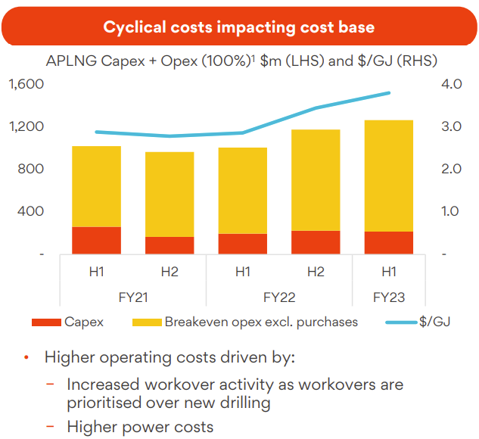
Gas prices, what is fair and reasonable?
APPEA Op Ed, 8 December 2022:
  “Prices agreed for supply by producers under contract to customers in southern states for 2023 averaged $12.38 per gigajoule”.
APPEA Op Ed, 7 November 2022:
  “While commentators lined up to call for gas price caps – some even suggesting a limit of $10/GJ – several east coast gas producers reported results with average realised prices between $8.50/GJ and $13/GJ.”
  “For example, Beach Energy said its September quarter price was down 3% to $8.50/GJ.”
  “Earlier, Senex Energy, in its last report before delisting, reported a price of $7.60/GJ.”
Origin’s costs went up to a bit under $4/GJ
Source: Origin Results Presentation 16 February 2023

Slide 12
Mandatory gas industry Code
Key aspects of the code that AFI members should be aware of:
  The code applies to gas producers only. However, retailers are “on notice”.
  $12Gj ”price anchor” is designed to be a reference point for negotiations. The ACCC sets the ‘price anchor’ based on a cost build-up using producer data – the link to LNG netback explicitly broken.
  All parties have to act in good faith.
  Obligation has changed from “offer gas” to “provide gas”.
  Suppliers can apply for an exemption from the price anchor. Exemptions are conditional on suppliers acting in good faith and demonstrating they have provided gas to the market. If they can’t demonstrate that or you believe they haven’t acted in good faith, the exemption can be withdrawn.
  The code will be reviewed in 2 years and would only be withdrawn if the ACCC and Government are convinced that a “workably competitive market” has evolved.
  The ACCC can review the price anchor every year if they deem necessary.
Know your rights under the code of conduct and report unsatisfactory behavior to the ACCC.

Slide 13
Gas and Intergenerational equity
Future of gas (methane) highly uncertain.
Networks looking for either:
  Replacement product such as bio-methane or hydrogen.
  Accelerated depreciation to reduce tail risk.
AER beginning to lean-in to accelerated depreciation, but are wary of running too hard to early.
Large and small gas users who don’t have alternatives face being stuck with the bill when everyone else leaves the party.
Need to consider tools beyond AD to help manage this risk.
Governments may have to lean in more:
  Fund customer transition
  Assist with the “balloon payment” in 2050

Slide 14
What can we (EUAA) do?
Electricity
  Seek to achieve net zero at least cost, not at any cost.
  Ensure policy and regulation is designed and implemented with a consumer first approach. We must focus our policy efforts on solving real problems, not just continue to expand existing subsidy schemes.
  Work to minimise costs of the entire bill stack.
  Working with networks and peak market institutions like the AER, ensure network investment continues to be prudent and efficient and that large transmission projects undergo a thorough evaluation of consumer benefits.
Gas
  Closely monitor the gas industry code of conduct.
  Closely monitor pipeline tariffs and continue reforms focused on transparency and efficiency.
  Seek to accelerate market maturity; improved transparency, more gas provided by more gas suppliers.
  Look at “green gas” such as bio-methane.

Slide 15
What can you do?
Ensure you understand the key energy challenges and become more connected to the policy and regulatory environment. You can’t be a spectator.
There are lots of government (state and federal) sources of industry funding (i.e. ARENA, CEFC and NRF). Don’t let it go to waste.
Understand what you can do on your side of the meter (i.e. energy efficiency, co-generation, demand response) as you could get paid by the market (i.e. RERT).
Think about a renewable energy PPA, but ensure you are well informed on the opportunities and threats before taking the plunge.
Know your rights under the gas industry code of conduct. The ACCC is your friend and they want to hear your stories.
While we don’t provide financial advice, the EUAA can help you with all of the above while providing a combined, powerful voice for energy users.

