Slide 1
Australian Foundries Institute Conference
Melbourne October 2023
Respirable Crystalline Silica Risk in Foundries
Jeremy Trotman FAIOH CIH COH
Certified Occupational Hygienist
AIOH President Elect
Notes:
Front page

Slide 2
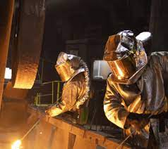
Silica Risk in Foundries
Hazards
Risk Assessment
Controls
AFI 2023 Conference
Jeremy Trotman AIOH President-Elect Respirable Crystalline Risk in Foundries

Slide 3
Respirable Crystalline Silica (RCS) Silicosis and Cancer
AFI 2023 Conference
Jeremy Trotman AIOH President-Elect Crystalline Silica Risk

Slide 4
SWA: Work activities that can generate respirable crystalline silica (RCS)
Engineered stone processes
Excavation, earth moving and drilling plant operations
Clay and stone processing machine operations
Paving and surfacing
Mining, quarrying and mineral ore-treating processes
Tunnelling
Construction labouring activities
Brick, concrete or stone cutting, especially using dry methods
Abrasive blasting (blasting agent must not contain greater than 1% crystalline silica)
Foundry casting
Angle grinding, jackhammering and chiselling of concrete or masonry
Hydraulic fracturing of gas and oil wells, and
Pottery making.
AFI 2023 Conference

Slide 5
Pub Med Search Results: Silicosis AND Foundries
1: Zhang M, Zheng YD, Du XY, Lu Y, Li WJ, Qi C, Wu ZL. Silicosis in automobile foundry workers: a 29-year cohort study. Biomed Environ Sci. 2010 Apr;23(2):121-9. doi: 10.1016/S0895-3988(10)60041-4. PMID: 20514987.
2: Lenander-Ramirez A, Bryngelsson IL, Vihlborg P, Westberg H, Andersson L. Respirable Dust and Silica: Respiratory Diseases Among Swedish Iron Foundry Workers. J Occup Environ Med. 2022 Jul 1;64(7):593-598. doi:10.1097/JOM.0000000000002533. Epub 2022 Mar 11. PMID: 35275887; PMCID: PMC9301988.
3: Sherson D, Svane O, Lynge E. Cancer incidence among foundry workers in Denmark. Arch Environ Health. 1991 Mar-Apr;46(2):75-81. doi: 10.1080/00039896.1991.9937432. PMID: 2006897.
4: Rosenman KD, Reilly MJ, Rice C, Hertzberg V, Tseng CY, Anderson HA. Silicosis among foundry workers. Implication for the need to revise the OSHA standard. Am J Epidemiol. 1996 Nov ;144(9):890-900. doi: 10.1093/oxfordjournals.aje.a009023. PMID: 8890667.
5: Sherson D, Lander F. Morbidity of pulmonary tuberculosis among silicotic and nonsilicotic foundry workers in Denmark. J Occup Med. 1990 Feb;32(2):110-3. PMID: 2303918.
18: Finkelstein MM. Silicosis surveillance in Ontario: detection rates, modifying factors, and screening intervals. Am J Ind Med. 1994 Feb;25(2):257-66. doi:10.1002/ajim.4700250212. PMID: 8147398.
9: Lynge E, Kurppa K, Kristofersen L, Malker H, Sauli H. Silica dust and lung cancer: results from the Nordic occupational mortality and cancer incidence registers. J Natl Cancer Inst. 1986 Oct;77(4):883-9. PMID: 3020298.
12: Schüler G, Wälchi P, Rüttner JR, Delmore M, Taylor M, Schnieper R. Lungenkrebshäufigkeit und Todesalter bei den Silikosetodesfällen der SUVA, 1960-1978 [Incidence of lung cancer and age at death in silicosis deaths of the Swiss National Accident Insurance Fund, Soz .
AFI 2023 Conference

Slide 6
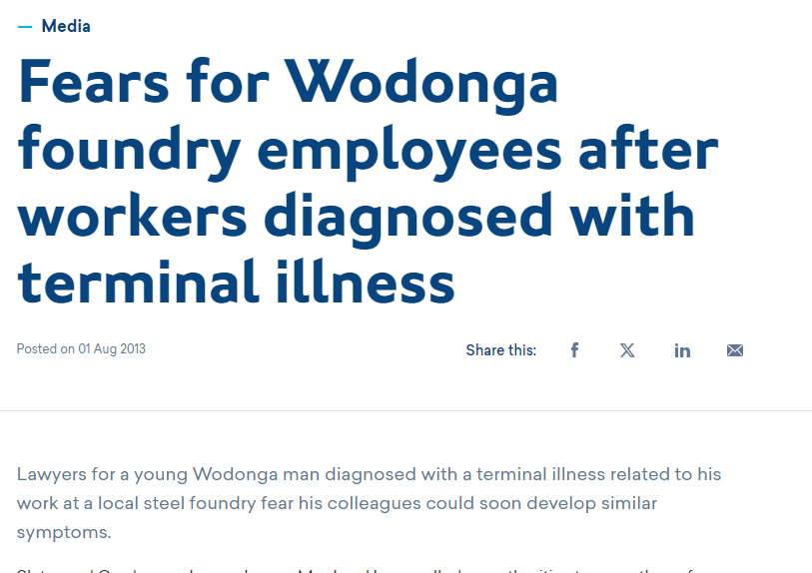
AFI 2023 Conference

Slide 7
Silicosis Cases
AFI 2023 Conference

Slide 8
Lung Foundation - 2023–2028 Report
Silicosis in Australia
Crude mortality rate down: 1.8/m to 0.5/m 1997-1999.
9 to 107 increase in cases 2015-20 (ES processes?).
Half of cases reported to June 30 2021 unrelated to ES
Screening shows 238 (23%) of 1053 QLD workers had confirmed silicosis. Similar results in VIC
AFI 2023 Conference

Slide 9
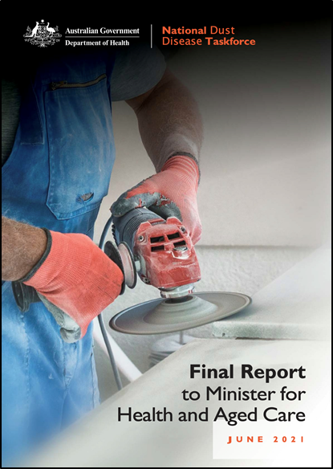
Silica Exposure Risks - Products and Processes
Crystalline (not amorphous) silica containing products/compounds
Very fine (respirable) particles (< 4um AD) i.e. RCS
Machining of products – freshly cut surfaces more toxic
Additive/synergistic reactions with other toxic compounds (e.g. engineered stone resins)
AFI 2023 Conference

Slide 10
VIC OHS Regs - 'crystalline silica (CS) process
cut, grind, polish or crush material containing CS
activity involving CS material generating CS dust
a process exposing a person to CS dust from . . . handling of material that contains CS
the mechanical screening of crushed material containing crystalline silica

Slide 11
High risk crystalline silica work
Work performed in connection with a crystalline silica process that is reasonably likely to result in:
an airborne concentration of RCS that exceeds half the WES, or
a risk to the health of a person at the workplace

Slide 12
High Risk CS process assessment & control
High risk CS work assessment must include:
Specific CS tasks or processes
Form of CS used and proportion of CS in the material
Atmospheric monitoring results
Frequency and duration of exposure to crystalline silica dust
CS related incidents, illnesses or diseases
A crystalline silica hazard control statement (CSHCS) must be prepared for high risk CS work and the work must be performed in accordance with the CSHCS

Slide 13
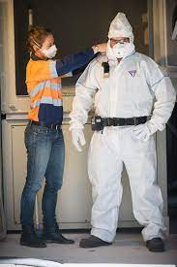
RCS Exposure Risk & Risk Assessment
Respirable versus inhalable dust
Measurement/exposure assessment
Implications of current (0.05 mg/m3) and proposed (0.025 mg/m3) WES
Role of the occupational hygienist & AIOH
AFI 2023 Conference

Slide 14
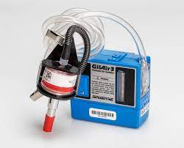
Air & Health Monitoring
Air monitoring required:
if there is (reasonable) uncertainty re: WES compliance
if necessary to determine a risk to health
Health monitoring is required if exposure is likely to adversely effect worker health
AFI 2023 Conference

Slide 15
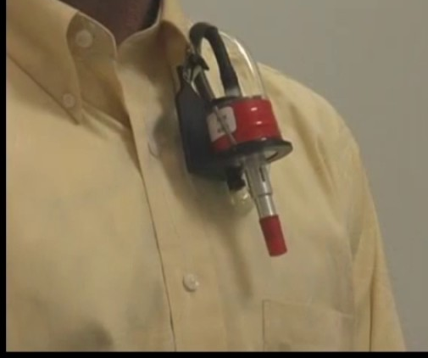
RCS Monitoring
RCS & resp. dust monitoring with :
Compliant equipment (cyclone)
Standard method (AS 2985)
Adequate sample volume
Representative sample
Appropriate analysis (NATA)
Shift adjustment
Readable report
Competent person (e.g. AIOH Member, Certified OH)
Image from NIOSH UTube
AFI 2023 Conference

Slide 16
Air Monitoring Requirements for RCS
Letter from the Chief Inspector of mines and Quarries re: OH Sampling not meeting AS 2985 requirements for:
pre and post shift calibration,
representative sampling,
sample cross contamination.
AIOH/WSVIC Breakfast on RCS Monitoring practices reports and measurement uncertainty (9%)
Dropping off (unsupervised) samplers is not compliant
AFI 2023 Conference

Slide 17
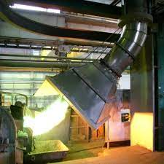
RCS Control Hierarchy
Elimination and substitution with alternative products,
Engineering: local or dilution ventilation systems, water suppression
Procedures limiting worker proximity to elevated RCS
RPE and other PPE to minimise worker and incidental exposures
Inside Construction Expo 20-21 September 2023
Melbourne Convention and Exhibition Centre
AFI 2023 Conference

Slide 18
Respiratory Protection
disposable half face
reusable half face & full face
powered air purifying respirators (PAPR)
AFI 2023 Conference

Slide 19
Powered air purifying respirator (PAPR)
Positive pressure reduces inward leaks.
Assigned protection factors:
Half facepiece 50,
Full facepiece 1,000.
AFI 2023 Conference

Slide 20
AFI 2023 Conference

Slide 21
Is silica the next asbestos?
Toxicity:
silicosis/asbestosis
carcinogenicity
WES 0.05/0.025 mg/m3
Disease incidence
Recent and historic exposures
Notoriety
Risk based management

Slide 22
???????????????????
?????Questions?????
???????????????????

