Slide 1
Tomorrow’s Castings
AFI Melbourne 2023
John Campbell
University of Birmingham UK

Slide 2
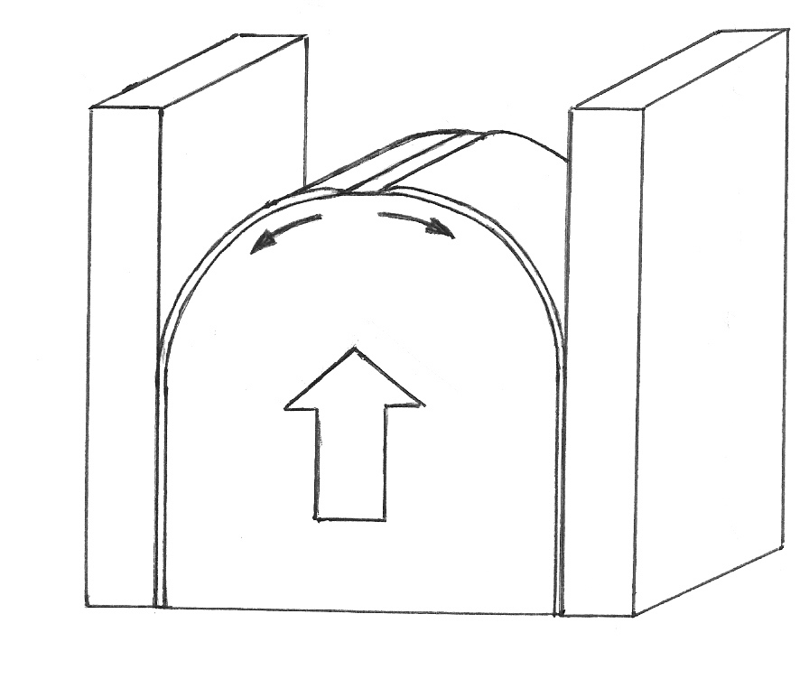
Bottom gated laminar filling

Slide 3
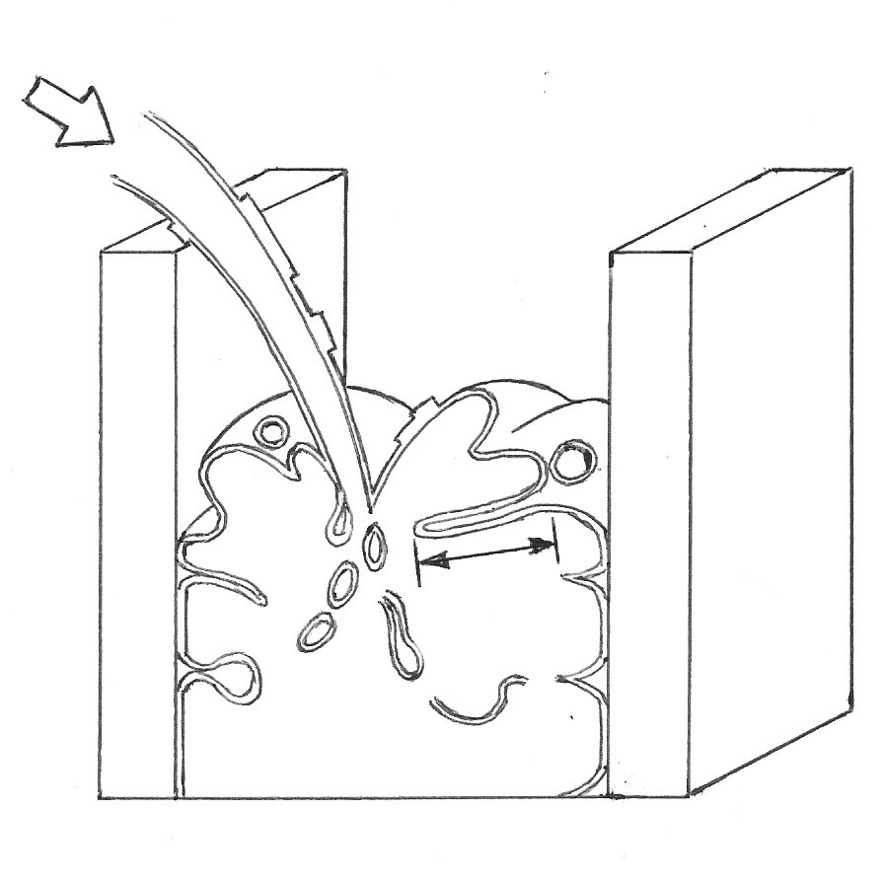
Top gated turbulent filling

Slide 4
Turbulent Surface Entrainment
Bifilms + Bubbles

Slide 5
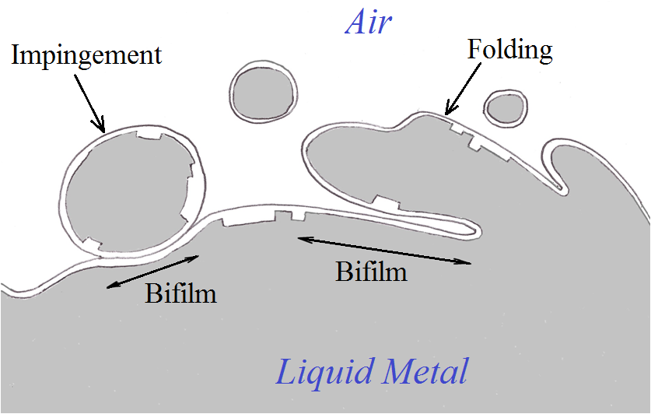
Surface Turbulence forming
Bifilm Cracks

Slide 6
RPT Before and After Reduced Pressure

Slide 7
Microstructure and Property
Control by Bifilms

Slide 8
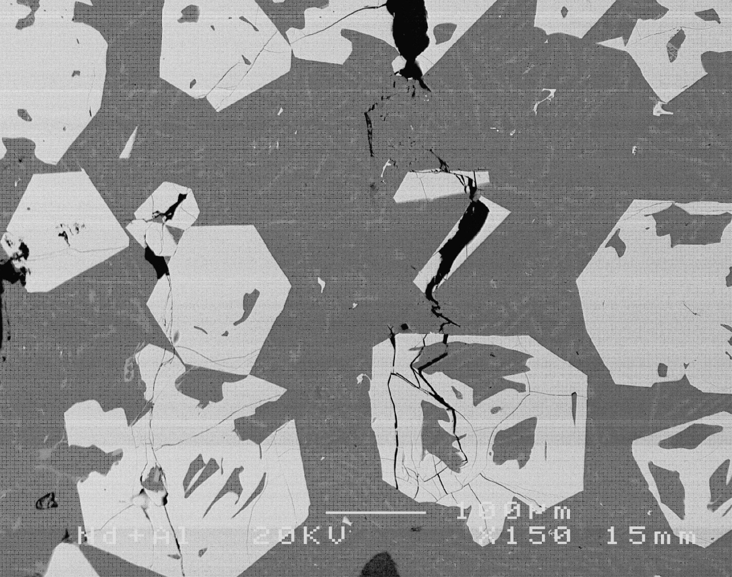
αFe + βFe formed on bifilms

Slide 9
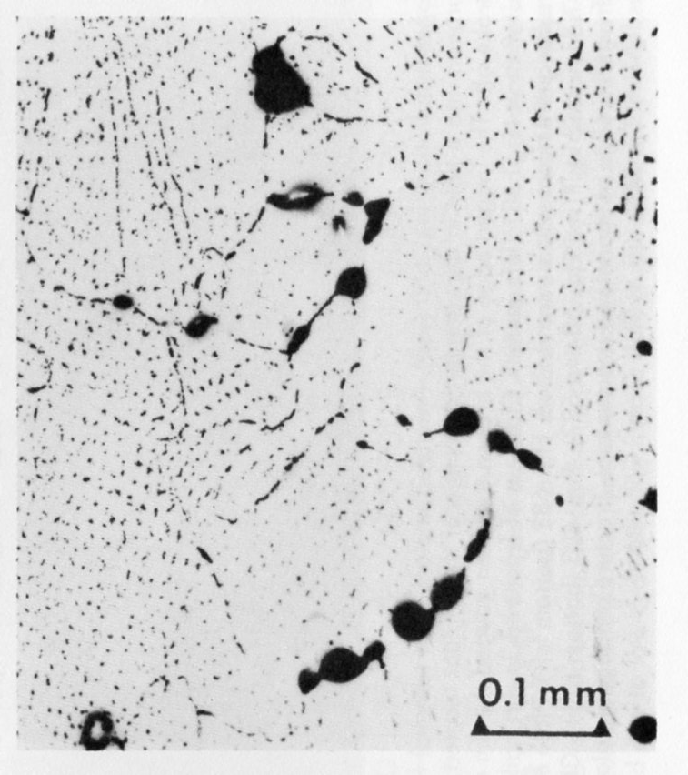

Slide 10
The Origin of Fracture
Failure modes from Pre-Existing Cracks

Slide 11
Theoretical Basis of Crack Formation
1920
Griffith: An Energy criterion
No specified geometry
1959
Barenblatt: A geometrical model
A region of zero cohesion edged by strong cohesion

Slide 12
Tensile Properties

Slide 13
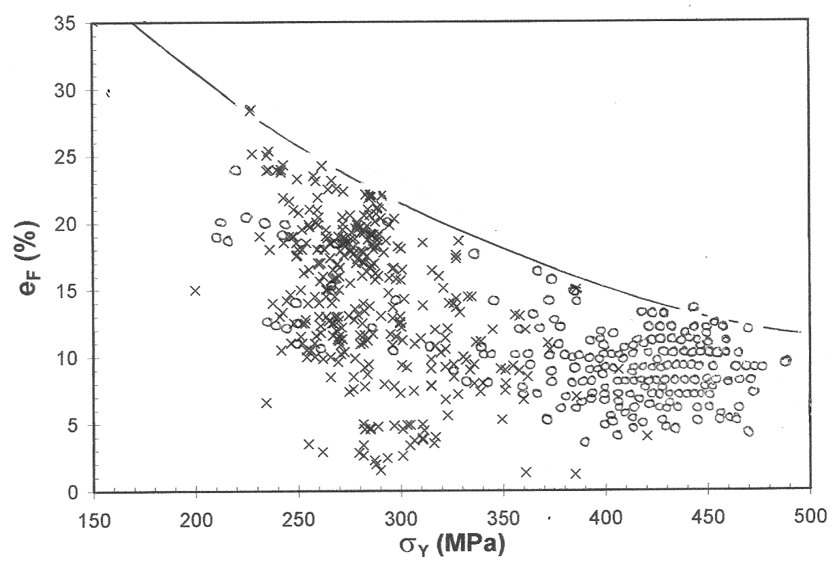
Elongation and Yield Strength of A201/6

Slide 14
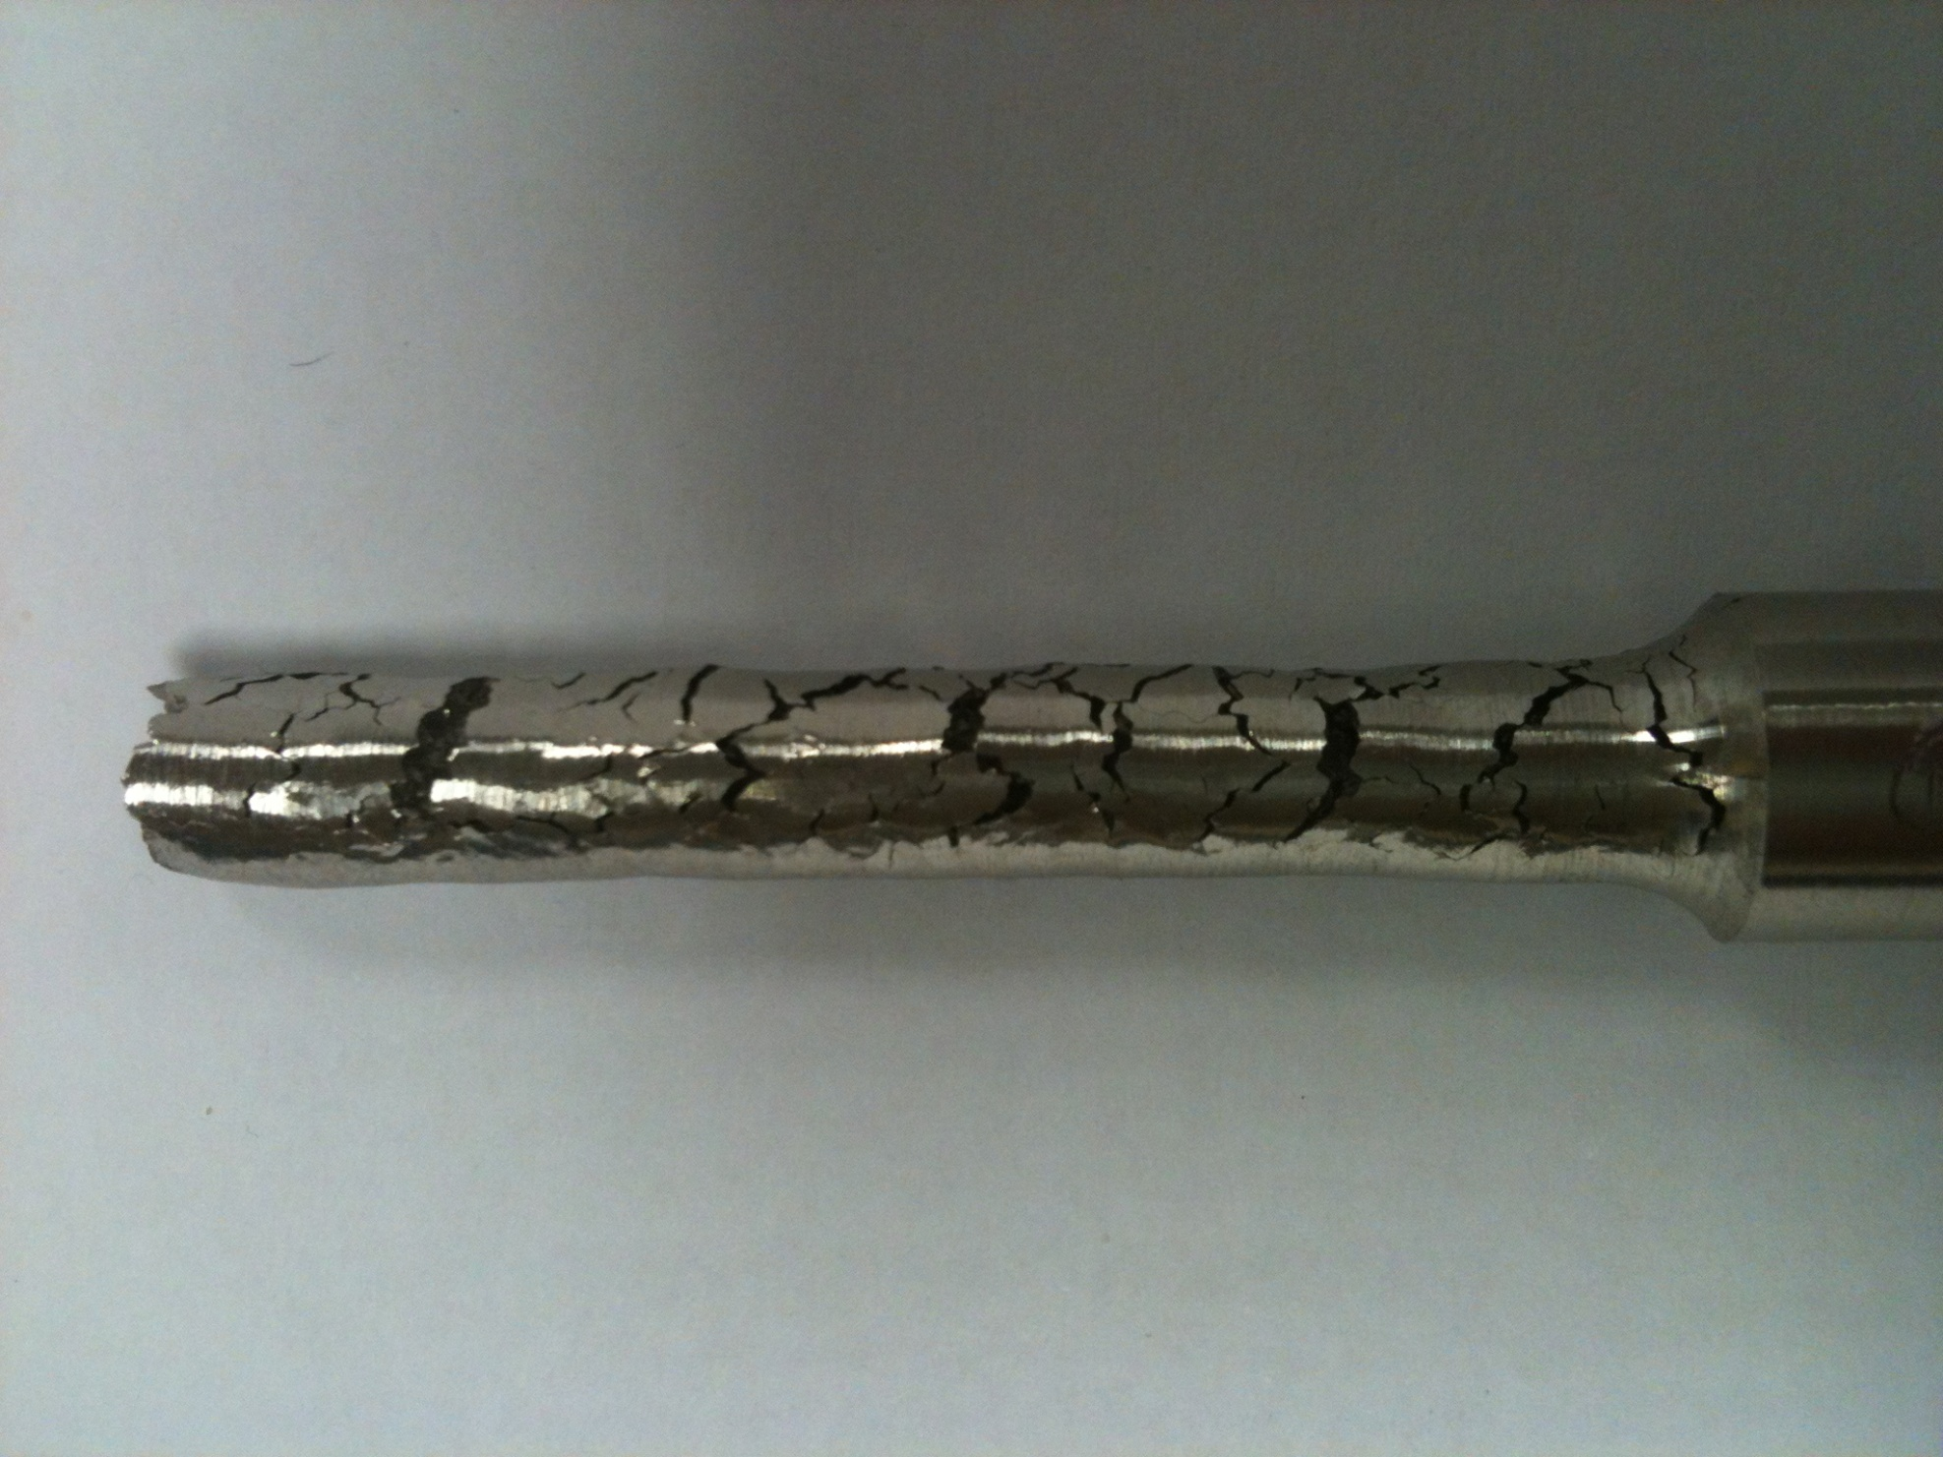
Highly ductile Ni-base alloy CY40 tensile test piece
(with bifilms!)

Slide 15
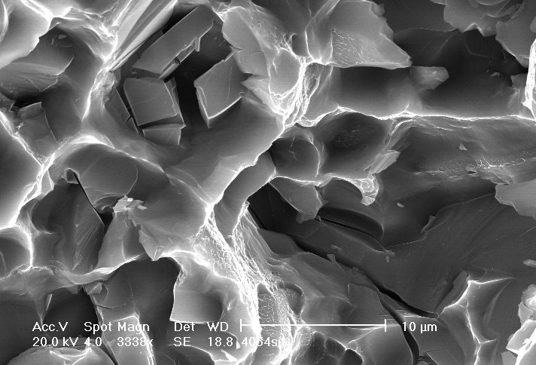
Ductile Dimple Fracture
Al-Si alloy (Courtesy Zhu Zhang 2007).

Slide 16
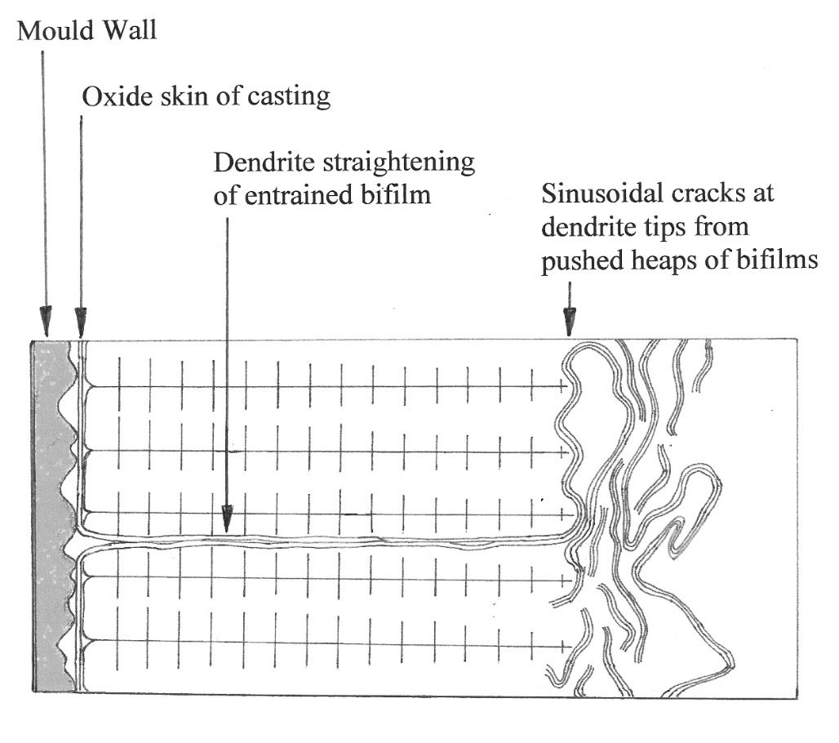
Dendrite straightening of bifilms

Slide 17
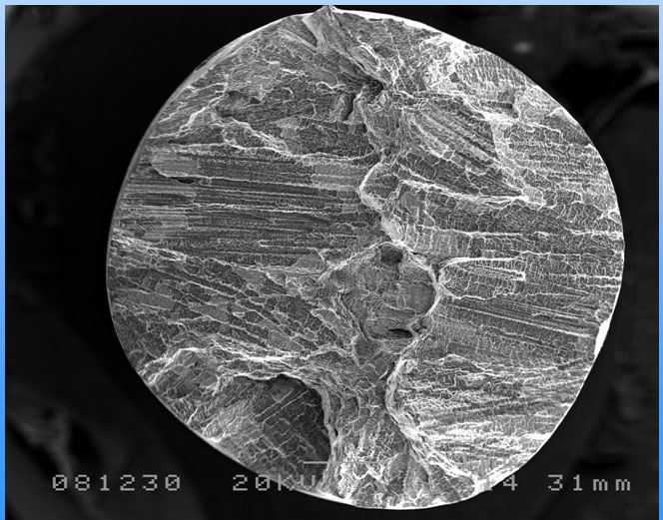
Fracture surfaces from parts of the same Al-4.5Cu alloy casting with and without an entrainment event

Slide 18
Fatigue
A failure mode dominated by pre-existing cracks but only marginally by fatigue

Slide 19
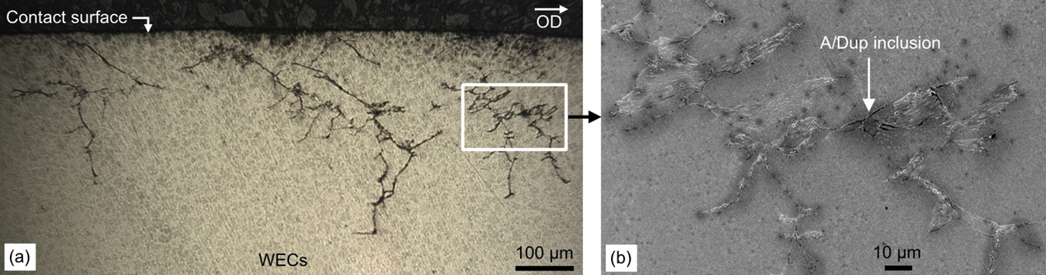
Wind Turbine Main Bearing
Fatigue Failure
Martin Evans et al 2012

Slide 20
Bearing steel fatigue failure
Martin Evans et al 2012

Slide 21
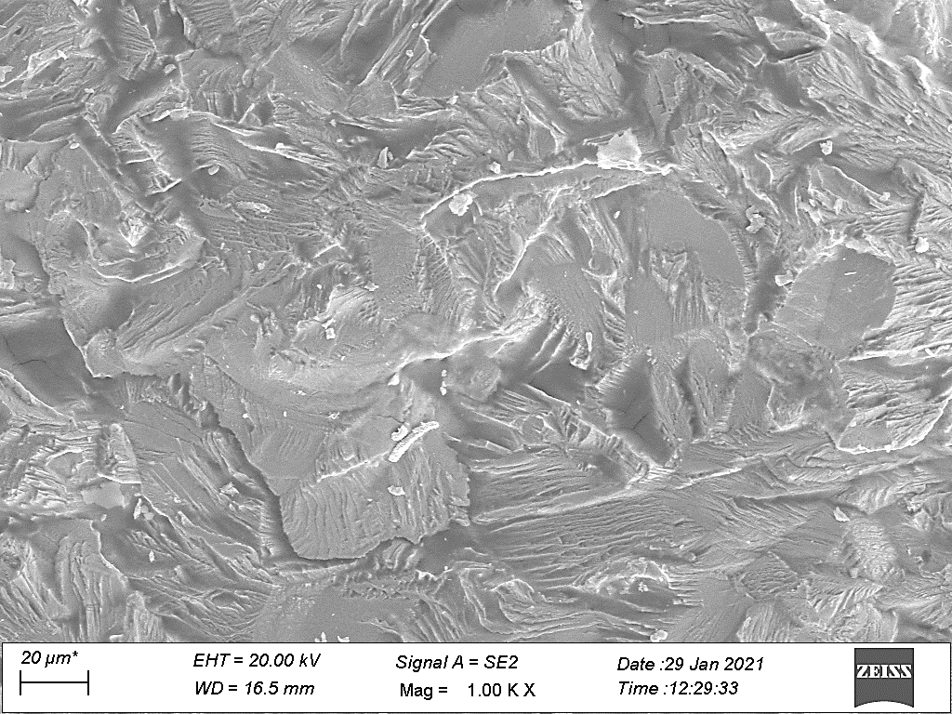
facet
Shear lips
Striations
Duraipandi, Babu and Moitra (2023). 316 Stainless Steel

Slide 22
Compressor Failure
Sessna 208B
21 Jan 2006

Slide 24
Creep
A failure mode due to stress at high temperature dominated by pre-existing cracks

Slide 25
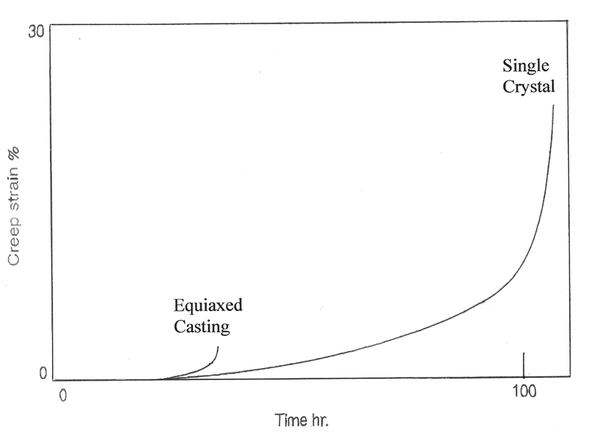
Creep of
Ni-Base Superalloy

Slide 26
Stress Corrosion Cracking (SCC)
A failure mode due to corrodent penetration into pre-existing cracks. Opened by tensile stress.
Stopped by compressive stress.

Slide 27
Hydrogen Embrittlement
+
Hydrogen Blistering
A failure mode from a
pre-existing crack population
1. Opened by pptn of inclusions, and
2. Pressurized by hydrogen.

Slide 28
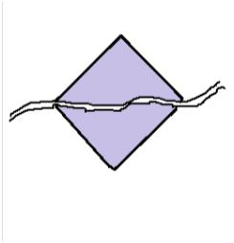
Cracked inclusion and associated crack
Inclusion
Crack
(Matrix)

Slide 29
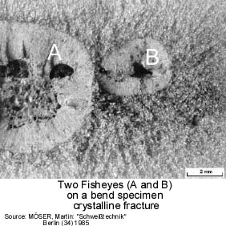

Slide 30
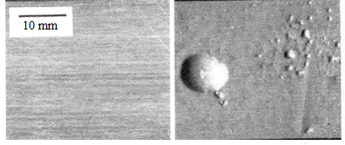
Stretched sheet 7475 (Al-Zn-Mg-Cu) Alloy
Heated to 515 C
in Air + NaBF4 in Air

Slide 31
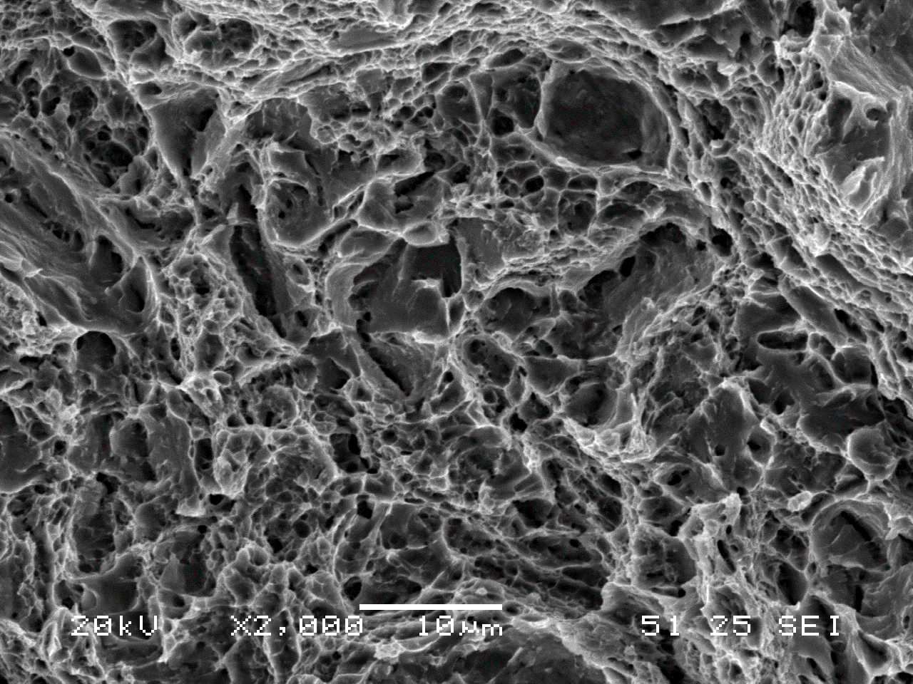
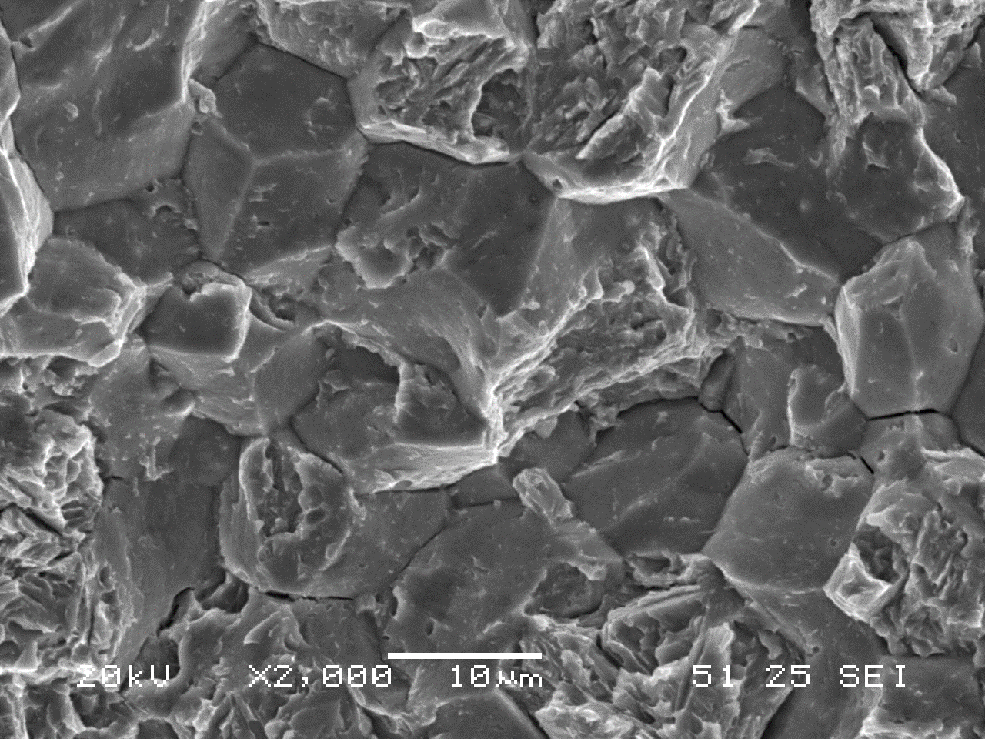
42CrMo4 Steel
(before and after 2h at 450C in hydrogen
at 19.5MPa pressure)
Courtesy E Martinez-Paneda 2022.

Slide 32
Secondary Refining Processes

Slide 33
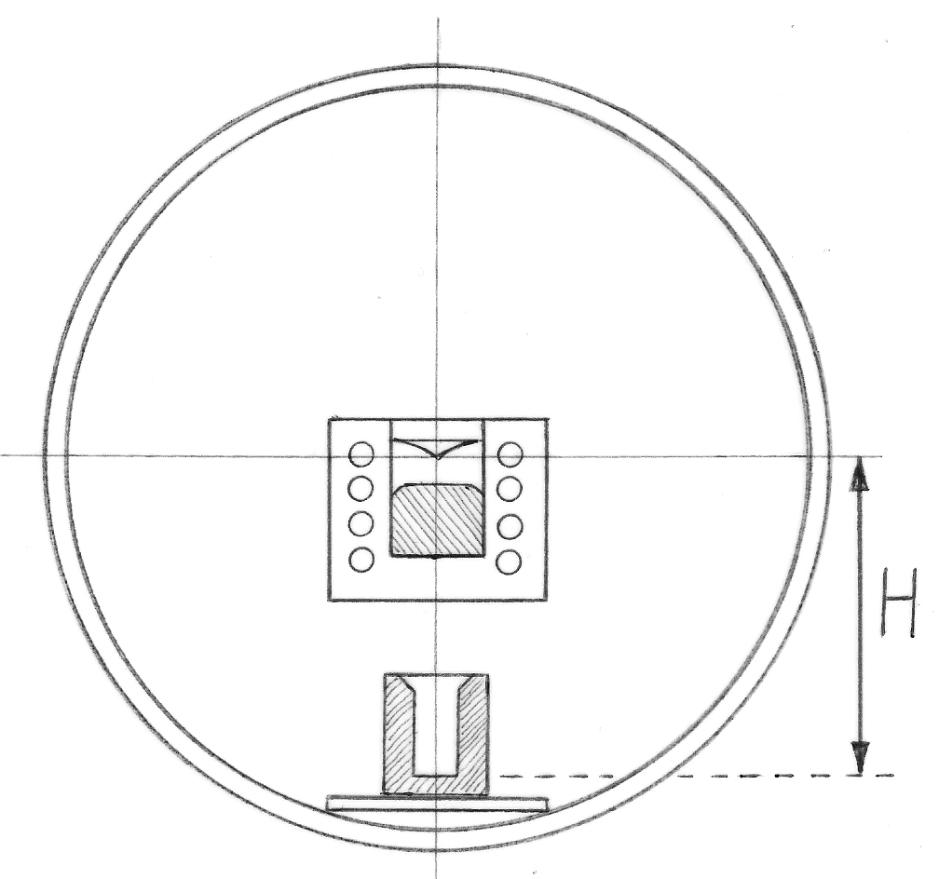
Vacuum Induction Melting
VIM

Slide 34
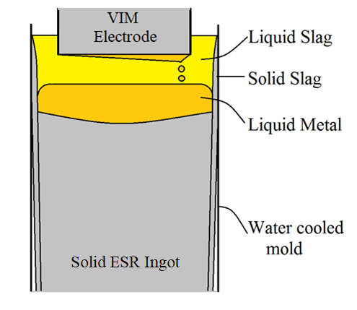
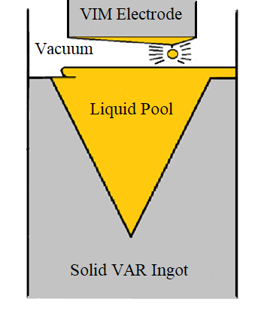
Secondary Refining Processes
Electroslag Remelting
ESR
Vacuum Arc Remelting
VAR

Slide 35
Vacuum Arc
Remelting
(Dangerous Metallurgy)

Slide 36
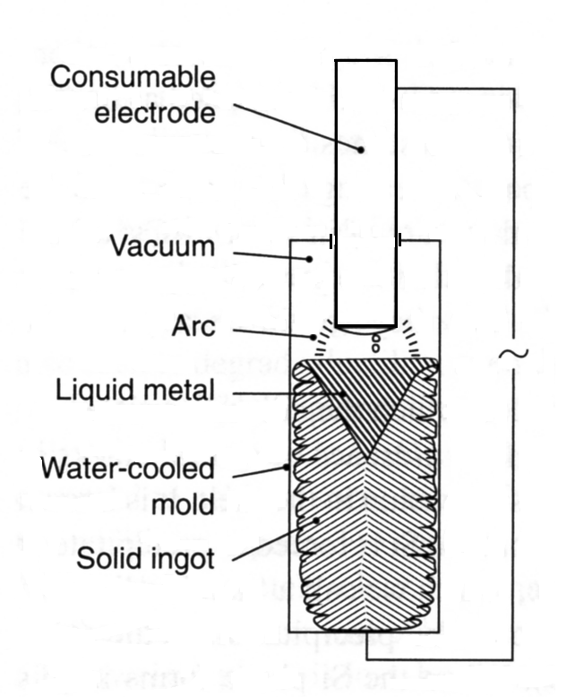

Slide 37
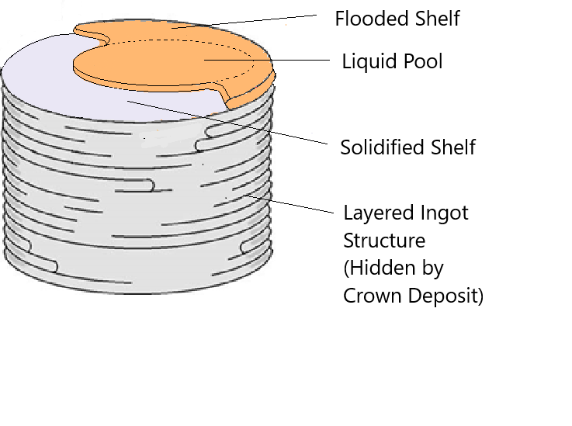
Build-up of VAR Ingot

Slide 38
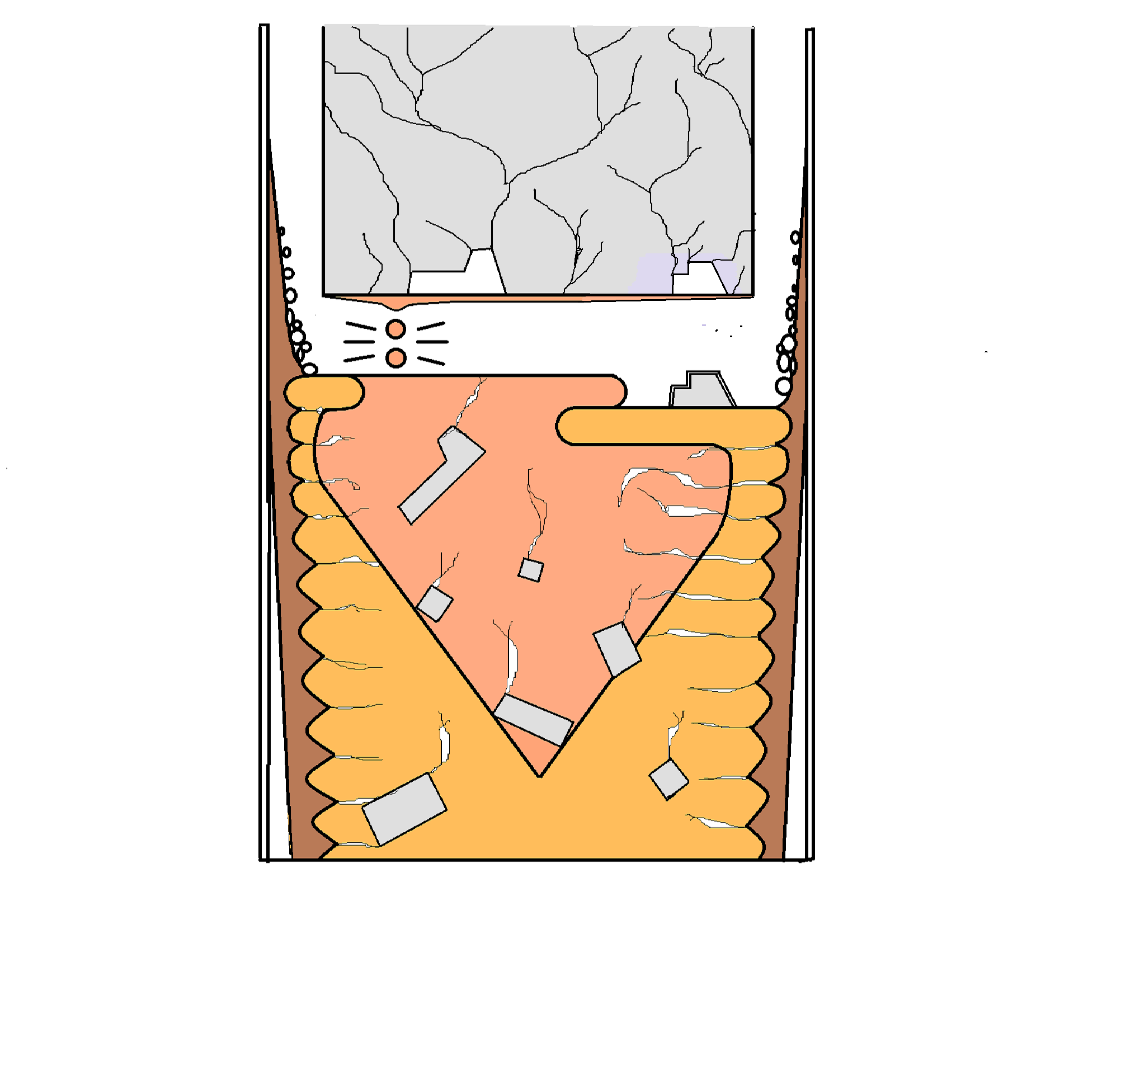
VAR
1

Slide 39
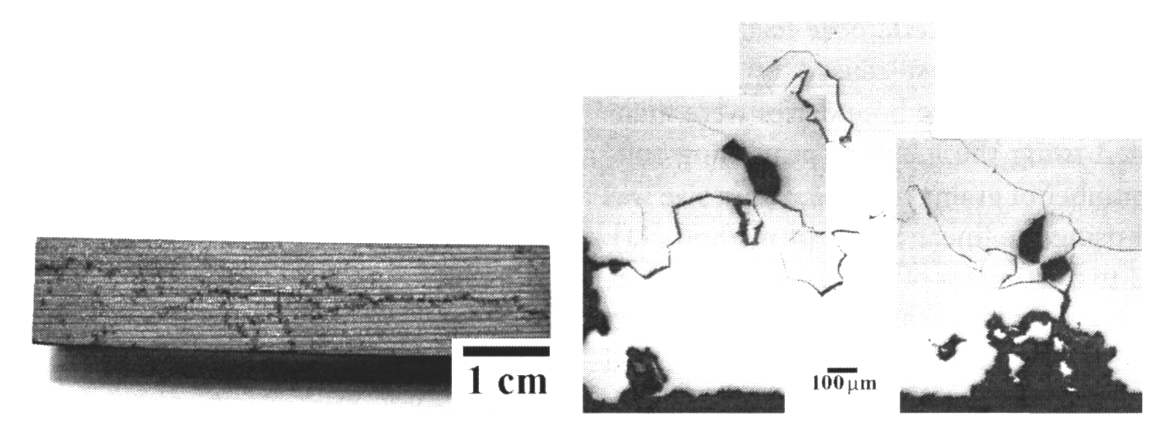
60 mm
Crack in VAR ingot
observed after salt bath heat treatment.
Peet & Bhadeshia 2017

Slide 40
VAR Historical Failures
1. Commercial Jets

Slide 41
19 July 1989
United Airlines Flight 232
DC10 crash landed at Sioux City
Ti disc failure due to a hard alpha defect
112 Fatalities
Triple VAR
Hard defect fell out during forging

Slide 42

United Airlines Flight 232
DC10 Sioux City 1989

Slide 43
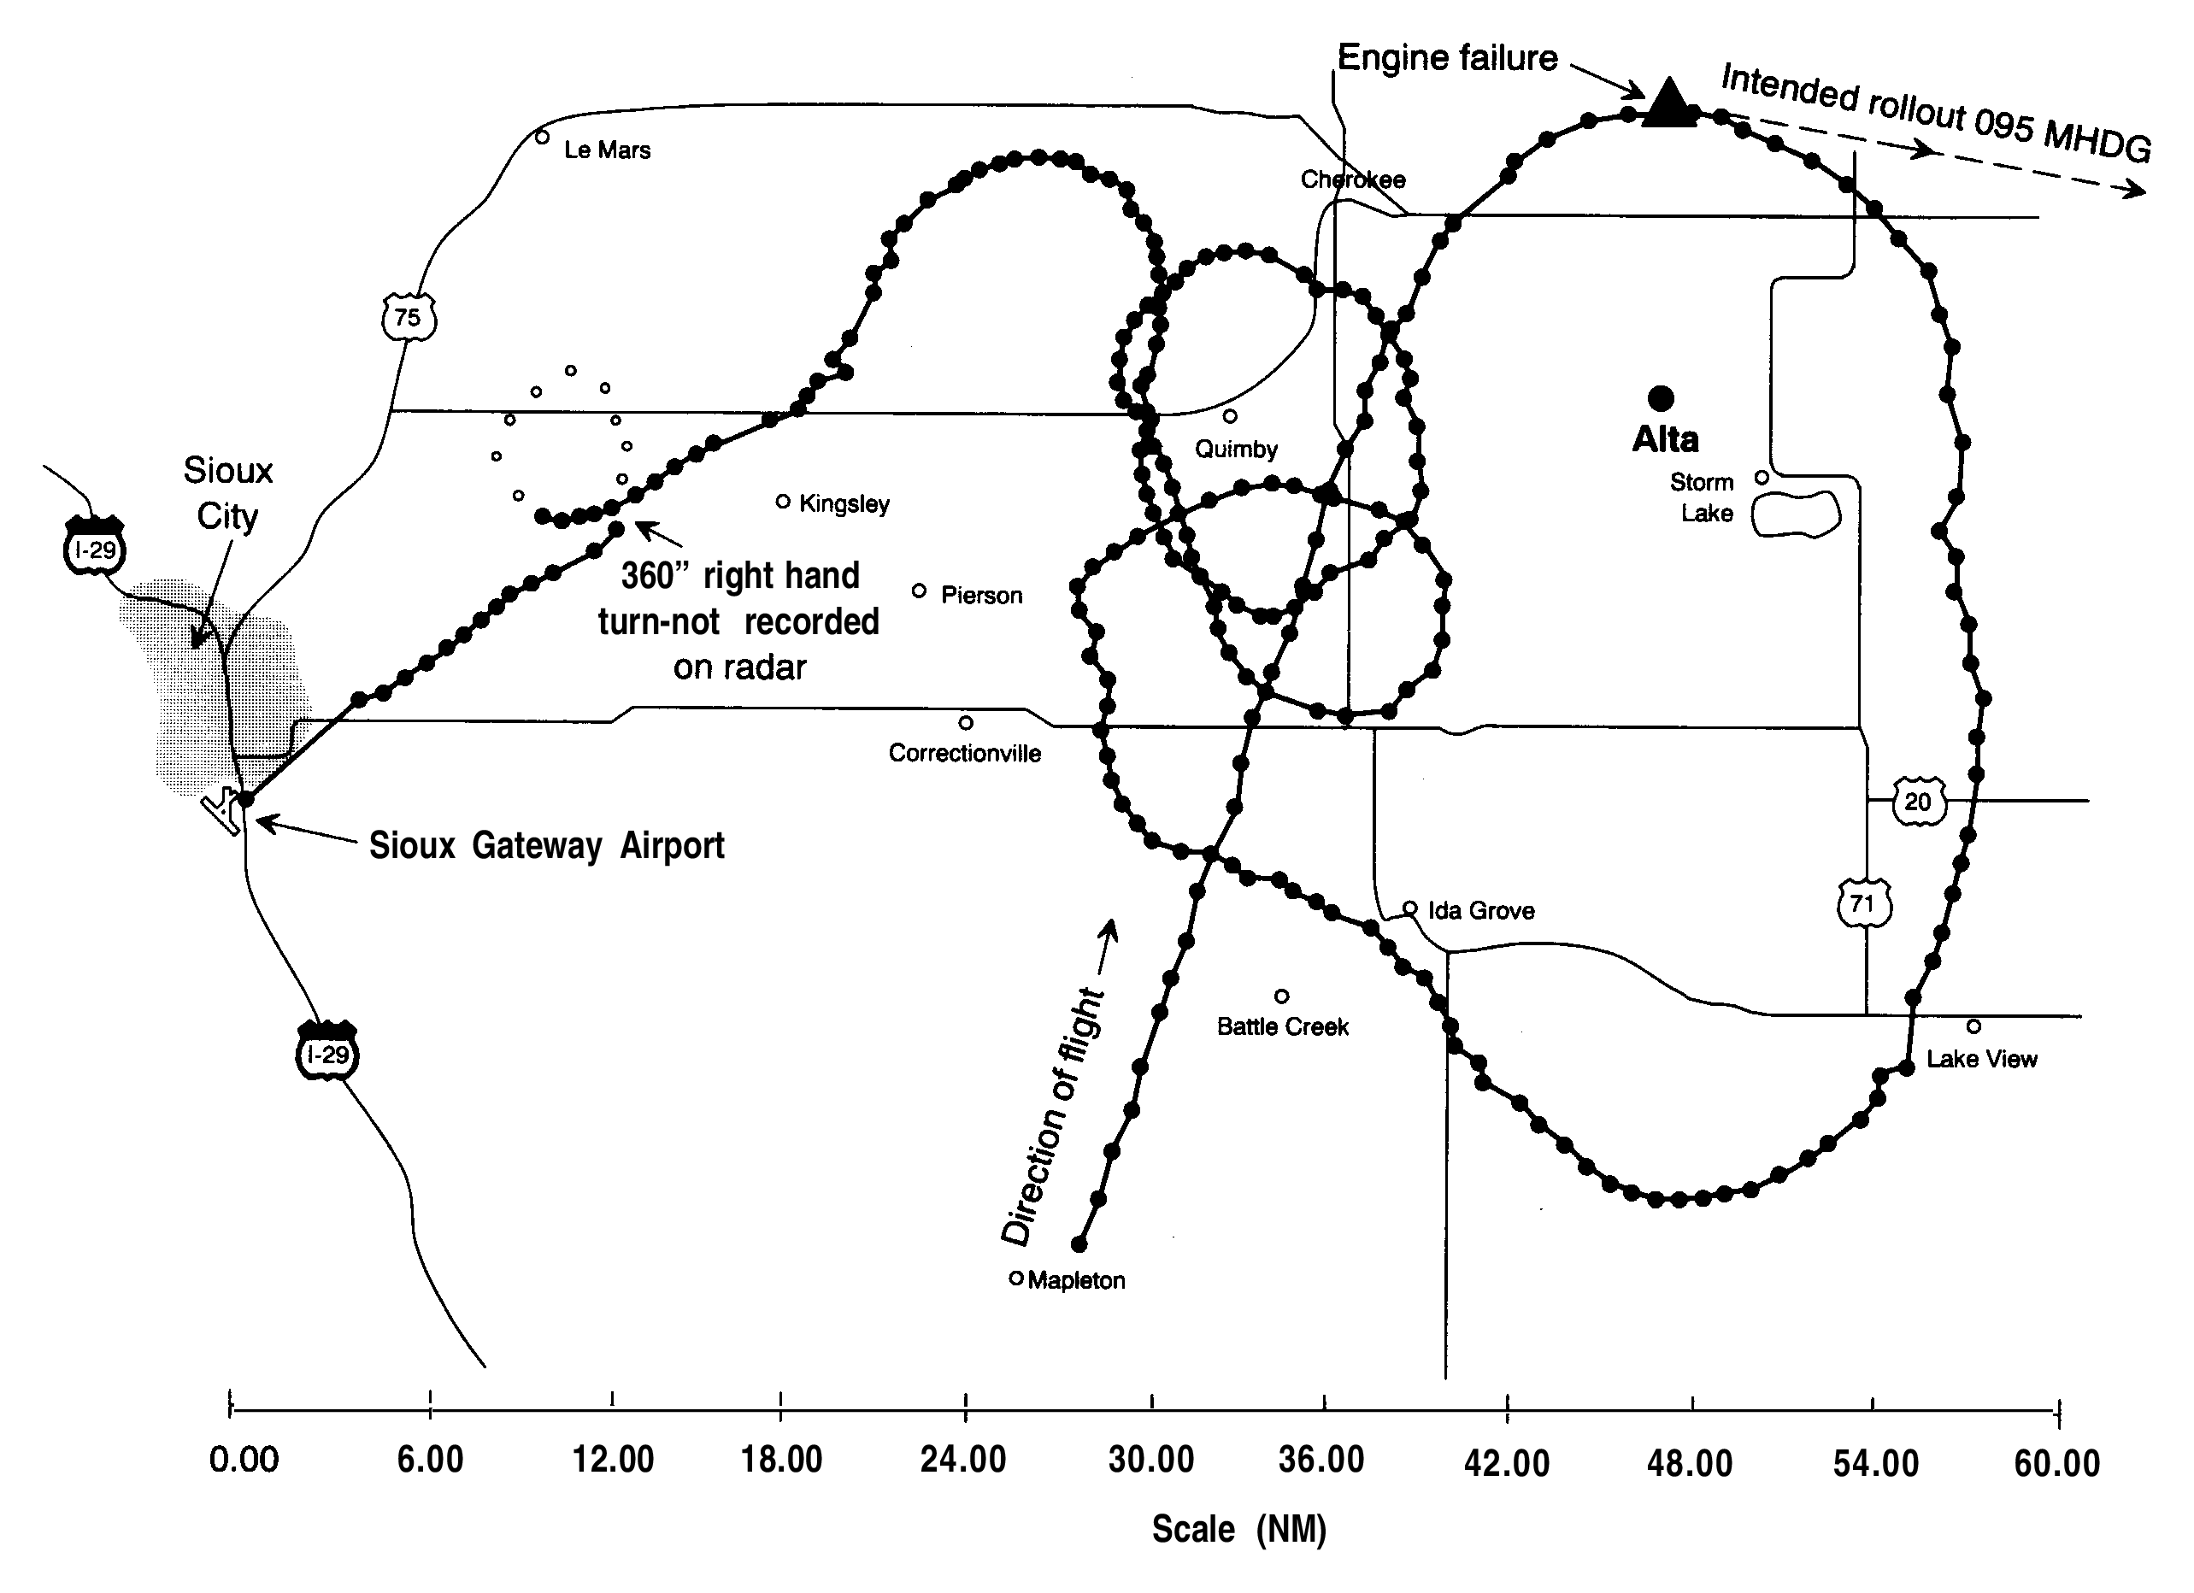

Slide 44
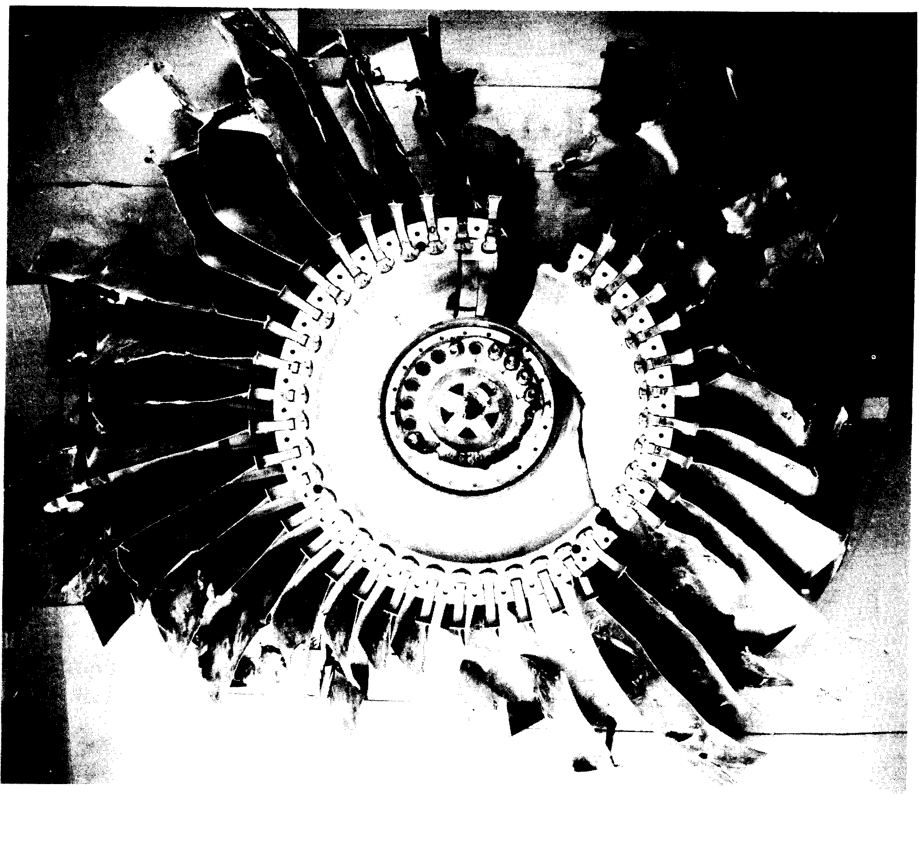

Slide 45

American Airlines 383 2016

Slide 46
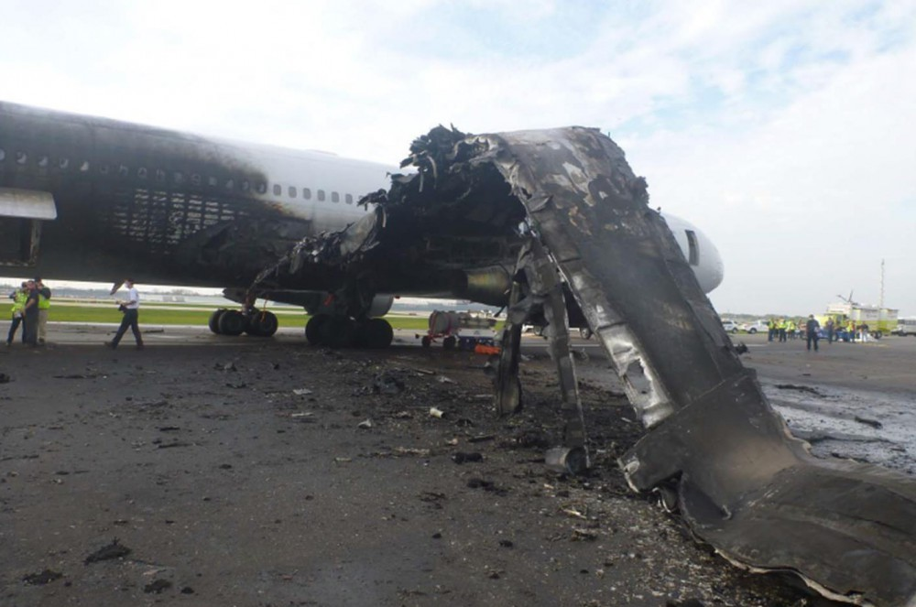
American Airlines 383 Ohare 2016

Slide 47
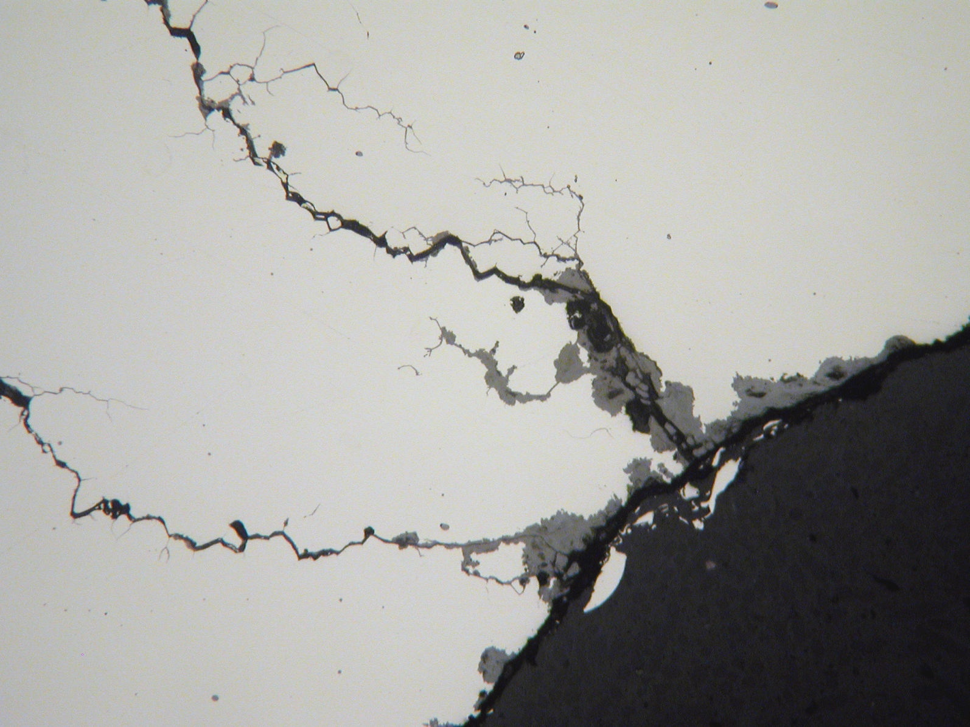
ETCH PIT
(formed where bifilm intersects surface)
Image courtesy Metallurgical Associates Inc 2015

Slide 48
VAR Historical Failures
2. Helicopters

Slide 49
Year | Flight | Location | Helicopter Type | Fatalities | Cause
1977 | Service flight 451 | Norway Norwegian Sea | Eurocopter AS 332L1 Super Puma | 12 | Fatigue crack in the spline which caused the power transmission shaft to fail.
1978 | Service flight 165 | Norway North Sea | Sikorsky S-61 | 18 | Rotor blade loosened after fatigue to the knuckle joint
2009 | Service flight | North Sea | Super Puma | 14 | Gearbox failure
2012 May | Service flight | North Sea | Bond Super Puma Eurocopter EC255 | 0 | Gearbox cracks due to corrosion
2012 October | Service flight | North Sea | Bond Super Puma Eurocopter EC255 | 0 | Gearbox cracks due to corrosion
2016 | Service flight | Norway coast | Eurocopter EC255 | 13 | Fatigue of rotor shaft and loss of rotor
2018 | Military test | Korea | Marineon MUH-1 | 5 fatalities 1 injured | Fatigue of rotor shaft (plus defective Airbus spares)

Slide 50
A History of Metallurgy
Atoms
1900
Strength,
Rigidity of Solids

Slide 51
A History of Metallurgy
Atoms
1900
Strength,
Rigidity of Solids
Vacancies
1900
Point Defects
0-D
Diffusion

Slide 52
A History of Metallurgy
Atoms
1900
Strength,
Rigidity of Solids
Vacancies
1900
Point Defects
0-D
Diffusion
Dislocations
1950
Line Defects
1-D
Plasticity

Slide 53
A History of Metallurgy
Atoms
1900
Strength,
Rigidity of Solids
Vacancies
1900
Point Defects
0-D
Diffusion
Dislocations
1950
Line Defects
1-D
Control Plasticity
Bifilms
2000
Planar Defects
2-D
Control Fracture

Slide 54
The End

Slide 55
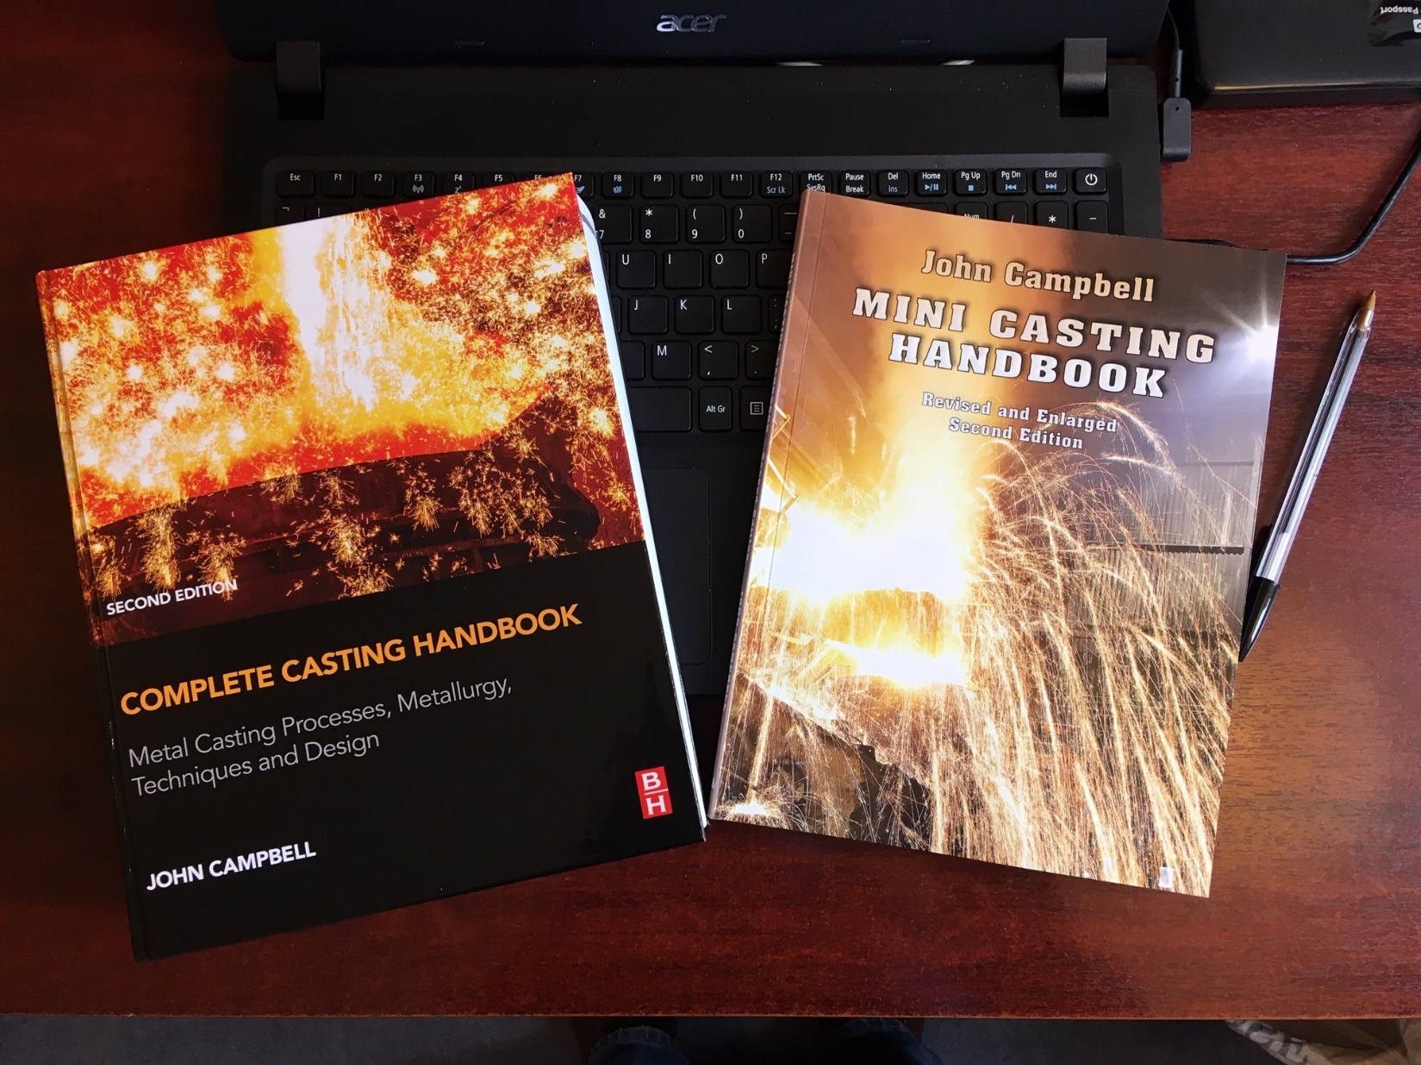

Slide 56
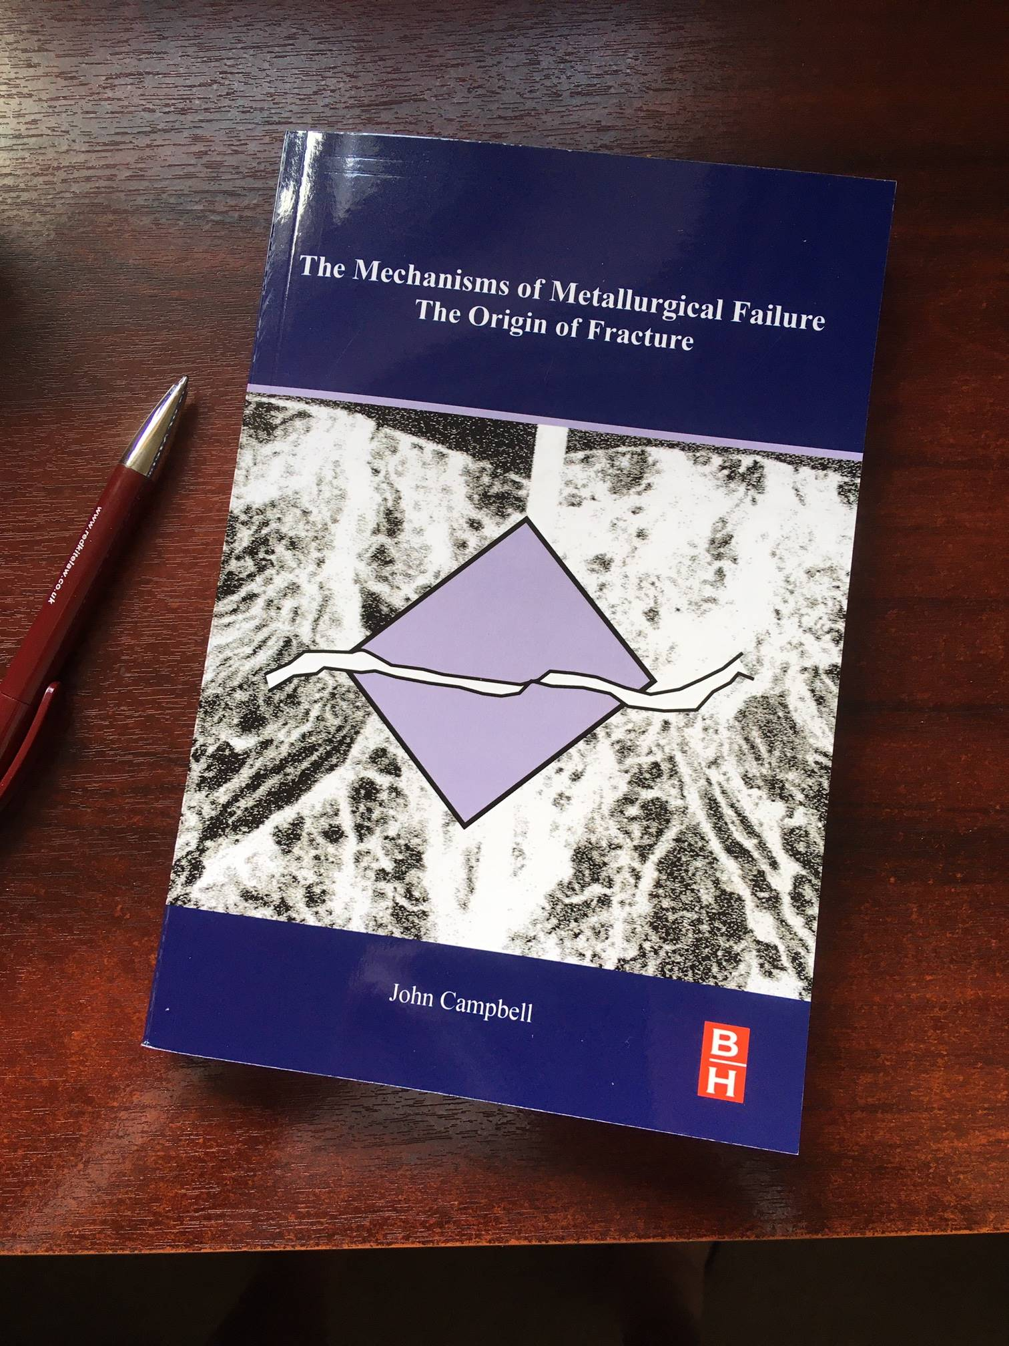

Slide 57
The Ductile / Brittle Behaviour of Engineering Metals
Ductile Brittle
 | Liquid | Pb | Au | Nb | Pt | Pd | Hf | Ag | Al | Cu | Zr | Ti | Ni | Co | Fe | Mg | Mo | Nd | W | Re | Ir | Cr | Be
μ/B | 0 | 0.12 | 0.15 | 0.22 | 0.22 | 0.23 | 0.27 | 0.29 | 0.35 | 0.35 | 0.39 | 0.42 | 0.43 | 0.45 | 0.48 | 0.49 | 0.48 | 0.50 | 0.52 | 0.54 | 0.56 | 0.72 | 1.42
ν | 0.50 | 0.44 | 0.42 | 0.40 | 0.39 | 0.39 | 0.37 | 0.37 | 0.34 | 0.34 | 0.33 | 0.32 | 0.31 | 0.30 | 0.29 | 0.29 | 0.29 | 0.28 | 0.28 | 0.26 | 0.26 | 0.21 | 0.02
μ/B = Ratio of elastic modulus to bulk modulus
ν = Poissons Ratio

