Slide 1
Thermal Analysis Introduction
John Hughes
AFI National Conference 27/10/23
Notes:
Hello everyone. My name is John. I am the technical director of Elkem Asia Pacific. I am very happy to meet you all. Today we will talk about the thermal analysis of molten iron

Slide 2
Thermal Analysis
Why use thermal analysis?
Limitations of the spectrograph
Hypoeutectic, eutectic and hypereutectic phase diagrams
Interpretation of the cooling curve and the major influences
Notes:
Today we will discuss the advantages of thermal analysis, and how it can compliment the spectrograph, to provide a fuller picture of the metallurgy of cast irons. We will explain a little about hypoeutectic, eutectic and hypereutectic phases in the iron-carbon diagram. Finally we will demonstrate how to interpret the most important points on the cooling curves.

Slide 3
Why Use Thermal Analysis?
Day 1
C = 3.4 %
Si = 2.1 %, 1380°C
Scrap rate = 2.0 %
All measured data OK!
Day 2
C = 3.4 %
Si = 2.1 %, 1380°C
Scrap rate = 12.0 %
All measured data OK!
Notes:
Why use thermal analysis? All foundries can relate to the message of this slide. According to all of the measured data, the metallurgy is identical from one day to the next, but the real experiences are very different, resulting in variable scrap rates. This is because the control of chemical analysis and pouring temperature doesn’t reflect all of the metallurgical changes, which are connected to the multitude of interactions between the major and minor elements.

Slide 4
Limitation of Spectrograph
Weight % of each element
No info about compounds
No info about oxides, silicates or nitrates
No info about amount or size of graphite
No info about interactions
No info about behaviour during solidification
Notes:
The spectrograph only informs us about the total quantity of each element in the iron, yet we cannot observe all of the important interactions between those elements. The formation of compounds, such as oxides, silicates and sulphides have a huge influence on the metallurgy and the subsequent solidification pattern. Although thermal analysis doesn’t specifically identify the interactions between the major and minor elements, it does show us the integrated effect of them.

Slide 5
Traditional Metallurgical Control
Spectrograph does not show how the various elements combine
Only part of the metallurgical picture is provided
Treatment 1 (Mg 0.04%) SPECTRO |  | Treatment 2 (Mg 0.04%) SPECTRO
95% nodularity |  | 80% nodularity
0.020% | Mg (dissolved) | 0.015%
0.005% | MgO | 0.009%
0.008% | MgS | 0.10%
0.006% | MgSiO4 | 0.005%
0.001% | Mg₃N₂ | 0.001%
Notes:
Here is an example of spectrograph-measured residual Mg between two ductile iron treatments. Despite having the same residual Mg content, the two treatments have different levels of nodularity. This is because the amount of dissolved Mg varies, due to the formation of compounds, such as magnesium oxide, magnesium sulphide and magnesium silicates. A foundry using purer charge materials with an efficient nodularisation process can achieve fully nodular structures at lower residual magnesium levels.

Slide 6
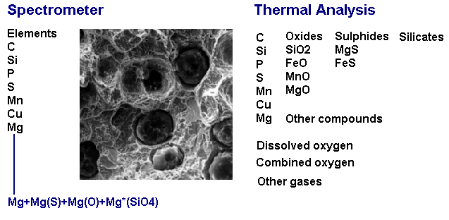
Thermal Analysis
Notes:
Thermal analysis can detect even the smallest variations in nucleation chemical compounds that are formed from preconditioning, nodularisation and inoculation, whereas the spectrograph is completely blind to these changes.

Slide 7
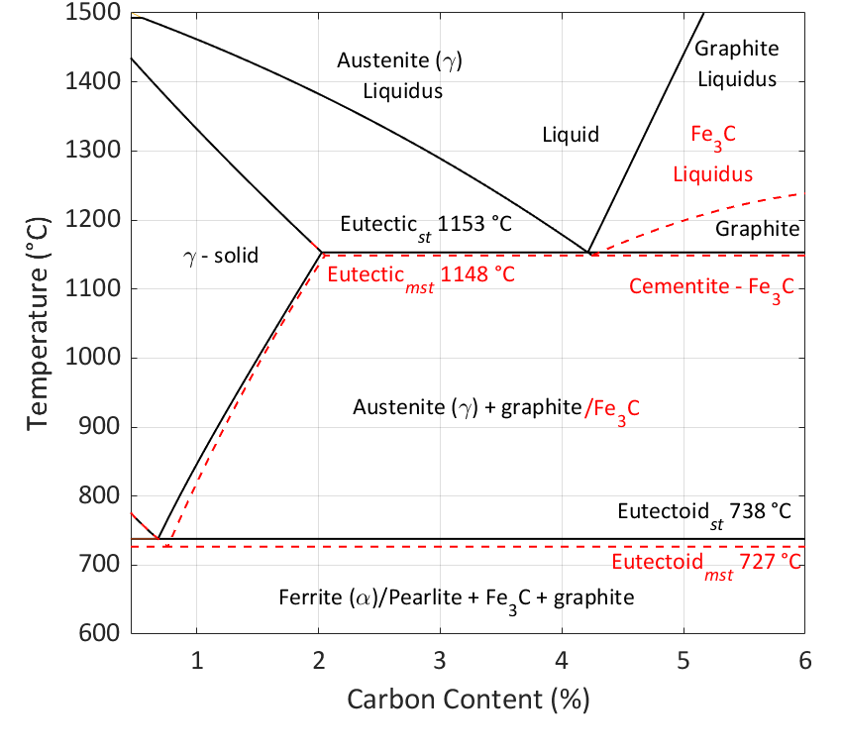
Iron-Carbon Phase Diagram
Solidification
Transformation
Notes:
Here is the iron-carbon phase diagram. Grey iron is mostly hypoeutectic, whereas ductile iron is more commonly around the eutectic composition. SiMo and SSF grades are generally hypereutectic, which require accurate control of chemical analysis, due to the steepness of the graphite liquidus line. Pearlite and ferrite are formed much later after solidification, during the transformation of austenite at the eutectoid temperature. At this point, carbon that has hitherto remained within the austenite crystal structure is deposited on the existing graphite network, which is already fixed during solidification. Additionally, the carbon contributes towards the formation of pearlite, which is layers of ferrite (pure iron) and Fe3C iron carbide.

Slide 8
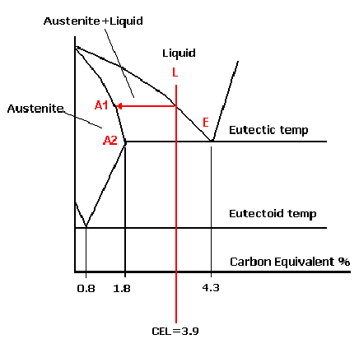
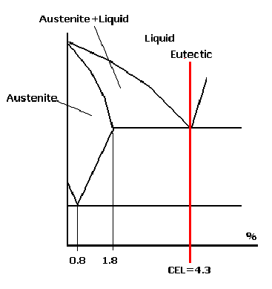
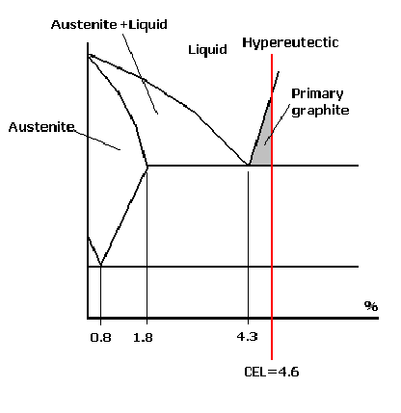
Hypoeutectic, Eutectic and Hypereutectic
Hypoeutectic
Eutectic
Hypereutectic
Notes:
Eutectic is a Greek term that means melts easily. This is the lowest liquidus point of an alloy, which makes it easier for casting production, due to lower melting points and shorter freezing ranges. Hyper and hypo are also Greek words, meaning more than and less than, respectively. In grey iron, the interconnected network of graphite flakes are the weak points in the structure, leading to lower hardness and lower tensile strength. Producing increasingly hypoeutectic grey irons, whilst proving better mechanical properties, creates more challenges for the foundry, in avoiding porosity, forming the right type of graphite shape (A, B, C, D and E), eliminating chill and controlling the matrix. Eutectic range analysis is preferred for ductile iron, as the individual graphite nodules do not lower the mechanical properties.

Slide 9
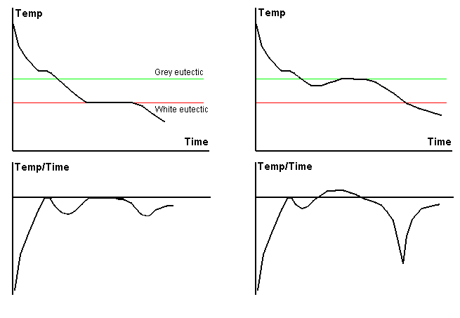
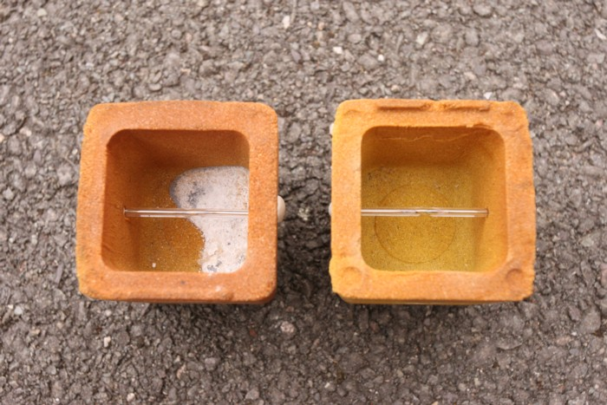
White and Grey Curves
White and Grey Curves
Tellurium and Grey Cups
Notes:
It is important to understand the two different types of cooling curves. Tellurium-containing cups force the iron to solidify fully chilled, which allows us to measure the white temperature that is linked closely to chill tendency. The thermal analysis cups that don’t contain tellurium generate cooling curves that are more representative of what happens in the sand mould. We can extract much more useful information from the grey sample.

Slide 10
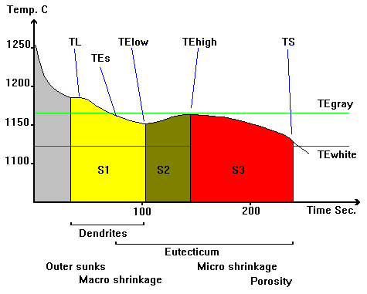
The Important Elements
Notes:
Understanding the important points of the cooling curve is vital for controlling the consistency of the metallurgy. What happens between the liquidus and solidus determines the quality of the casting. Outer sunk shrinkage defects are formed during the early stages of solidification, in some cases, even before the liquidus temperature is reached. It is important to moderate the pouring temperature, and not to allow the liquidus to climb unknowingly. Macro shrinkages are formed during the middle of solidification, when the correctly designed feeders should be functioning well. Micro porosity is formed during the end of the solidification, after the feeders are no longer active. A sufficient amount of graphite expansion is required at the end of solidification, highlighted red in the chart, to offset the continued contraction of the iron.

Slide 11
Liquidus Temperature (LT)
LT is the beginning of solidification.
LT is at its lowest temperature at the eutectic analysis.
Grey irons tend to be hypoeutectic irons.
Higher LT values
Longer freezing range
More prone to shrinkage (outer sinks and macro)
Better mechanical properties (UTS, hardness)
Ductile irons are around eutectic analysis (low LT).
Poor control of LT can lead to shrinkage porosity.
SSF and SiMo are hypereutectic (high LT).
Notes:
The liquidus temperature signifies the beginning of solidification. Grey iron usually has high LT values, which increases shrinkage tendency, due to longer freezing ranges and reduced graphite precipitation. LT is even more sensitive in hypereutectic irons, such as SiMo and SSF grades, due to the steep gradient of the graphite liquidus.

Slide 12
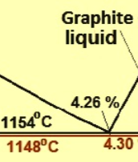
Liquidus Temperature (LT)
Hypo
Hyper
Element | CEL | 0.1%
C | 1 | -11.2°C
Si | 0.25 | -2.8°C
P | 0.5 | -5.6°C
S | 0.4 | -4.5°C
Al | 0.22 | -2.5°C
Sb | 0.115 | -1.3°C
Sn | 0.11 | -1.2°C
Cu | 0.074 | -0.8°C
Ni | 0.053 | -0.6°C
Mn | -0.027 | 0.3°C
Element | CEL | 0.1%
C | 1 | 58.2°C
Si | 0.25 | 14.6°C
P | 0.5 | 29.1°C
S | 0.4 | 23.4°C
Al | 0.22 | 12.9°C
Sb | 0.115 | 6.8°C
Sn | 0.11 | 6.2°C
Cu | 0.074 | 4.2°C
Ni | 0.053 | 3.1°C
Mn | -0.027 | -1.6°C
Notes:
This slide shows the effect of the elements on the liquidus temperature. Other than the main three elements of carbon, silicon and phosphorus, you can see that minor elements also influence the liquidus temperature. It is clear that poor liquidus control can cause problems with metal fluidity, shrinkage and poor graphite shape. Lowering the CEL by 0.1% in hypoeutectic iron raises the liquidus temperature by about 11C, as the austenite eutectic line is not perfectly straight. Increasing the CEL by 0.1% in hypereutectic iron raises the liquidus temperature by almost 60C, which can heighten the risk of exploded and chunky graphite defects, as nodules have a longer time to grow, explode and disintegrate.

Slide 13
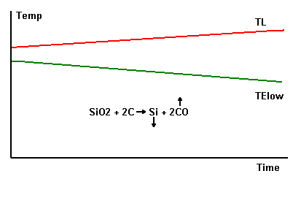
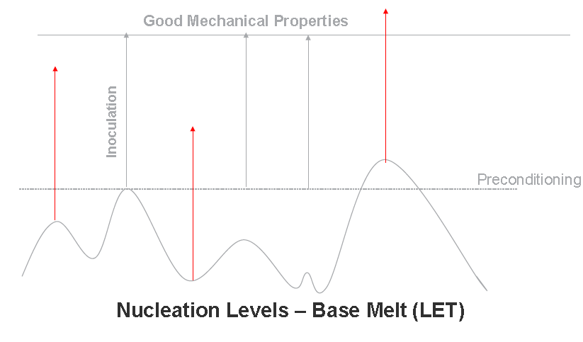
The Effect of Long Holding Time
Loss of carbon and nucleation
Preconditioning
Notes:
Here we can see the effect of holding time on the liquidus and the low eutectic temperature in hypoeutectic iron. Holding the iron at elevated temperatures increases the liquidus and reduces the low eutectic temperature, through the loss of carbon and oxygen. Replacing the lost carbon alone, through recarburiser addition, will not recover the lost nucleation. This is why preconditioning is sometimes required, to stabilise the metallurgical conditions.

Slide 14
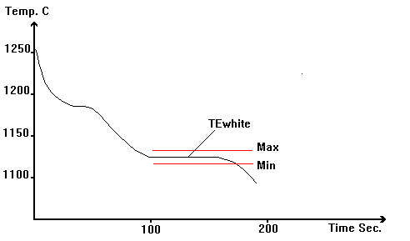
Eutectic Temperature WHITE (LET WHITE)
LET White is measured with the tellurium cup.
High LET White temperature increases the risk of iron carbide formation (chill─Fe₃C).
It is controlled by the chemical analysis of the iron.
1% Si reduces white temperature by 12°C.
1% P reduces white temperature by 30°C.
1% Cr increases white temperature by 27°C.
Typically LET should be more than 20°C above LET White.
LET = 1140°C, LET White = 1120°C (20°C gap)
For thinner sections, the gap should be increased to avoid carbide formation, by increasing Si and improving inoculation.
LET = 1145°C, LET White = 1115°C (30°C gap)
Notes:
The white eutectic temperature is measured with the tellurium cup. Silicon is very effective at lowering the white eutectic temperature, which reduces the risk of chill. Chromium acts in the opposite direction, by raising the white eutectic temperature, thus promoting iron carbide formation. For thin section castings, its is necessary to increase the gap between the white eutectic temperature (LET white) and low eutectic temperature (LET), to eliminate chill and undercooled graphite in grey iron. Increasing the silicon by 0.4%, will lower the white eutectic temperature by 5C.

Slide 15
Low Eutectic Temperature (LET)
LET is the point at which the temperature starts to rise temporarily, due the energy released from graphite formation.
A big difference between LT and LET requires more feeding.
For eutectic grades, LT and LET have the same values.
Dissolved oxygen and oxides influence the LET value.
LET is a good indicator for the nucleation level.
Well nucleated iron will have a higher LET value.
Preconditioning increases LET.
Inoculation always increases LET by varying degrees.
LP inoculant Vaxon ~+6°C. HP inoculant Ultraseed Ce ~+12°C
Notes:
The low eutectic temperature is the point at which energy is released, due to the initial precipitation of graphite. High liquidus values and reduced low eutectic temperature values require more feeding. These two values come together at the eutectic analysis. Preconditioning and inoculation increase the low eutectic temperatures. Thermal analysis is a useful tool for identifying the most suitable inoculant for a particular casting. Complex castings will often require increased low eutectic temperatures. For example a simple Vaxon ferrosilicon inoculant could be suitable for certain simple parts and metallurgies, whereas a high potency inoculant, such as Ultraseed Ce, would be needed in more challenging cases.

Slide 16
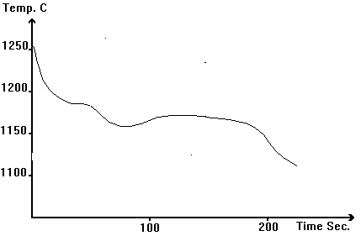
Low Eutectic Temperature (LET)
Grey Iron
Holding the iron in furnace for long periods at elevated temperatures reduces LET. E.g., Base iron could reduce from 1135°C to 1125°C.
Cupola iron has higher LET values than induction melting, due to the natural formation of MnS and SiO₂ nuclei.
High LET reduces chill tendency and promotes type A graphite.
Low LET increases undercooling, leading to types D and E graphite.
SG
High LET reduces carbides.
High LET improves nodularity and nodule count.
Notes:
As mentioned previously, the low eutectic temperature reduces, if the molten iron is held in the furnace at elevated temperatures for long periods of time. Cupola-melted grey iron exhibits good values for LET, due to stimulation from the coke bed and from the natural formation of manganese sulphide and silica nuclei. High values for LET are desirable in ductile iron, indicating a lower risk of carbide formation and improved nodule count.

Slide 17
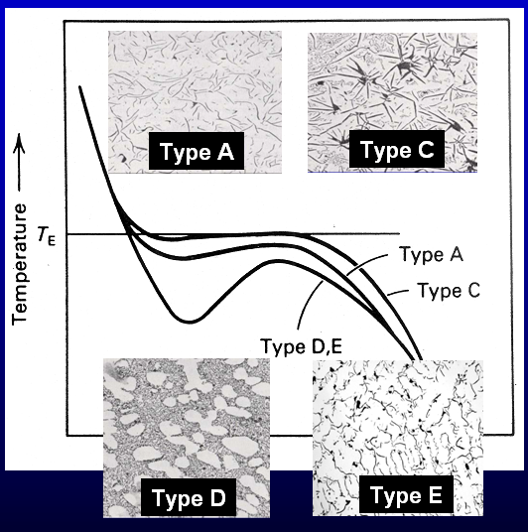
Undercooling in Grey Iron
Notes:
In grey iron, type A graphite is usually the preferred graphite structure, with a small amount of undercooling. Type C graphite is found in hypereutectic grey iron, which typically has low undercooling, due to the early formation of primary graphite. Types D and E are both categorised as undercooled graphite. Strontium is very effective at increasing LET, thereby reducing undercooling.

Slide 18
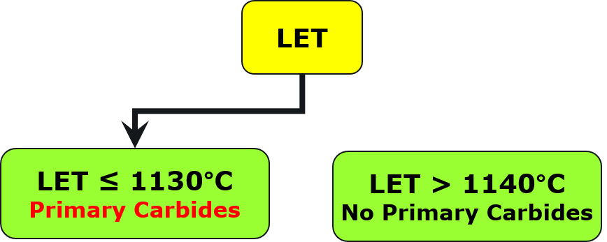
Low Eutectic Temperature (LET)
Notes:
Here we see two ductile iron structures. The microstructure on the left has a lot of iron carbide, due to poor inoculation. By increasing the LET value by 10C, the primary carbides are eliminated.

Slide 19
High Eutectic Temperature (HET)
HET is the 3rd point on the curve, after the initial precipitation of graphite, the iron continues to cool.
HET signifies the end of recalescence.
Notes:
The high eutectic temperature is the third point on the cooling curve that signifies the end of recalescence. After this point, the iron continues to cool slowly until the end of solidification.

Slide 20
Recalescence (R)
Recalescence is the temperature increase between LET and HET.
R values are typically between 2-6°C.
High R can mean more graphite is precipitated at the beginning of solidification.
High R can cause mould dilation in greensand moulds, due to excessive expansion.
If more graphite is formed during the first part of solidification, less carbon will be precipitated during the last part of solidification, leading to micro-porosity.
Notes:
Recalescence is the temperature increase between LET and HET, with typical values varying between 2C and 6C. If recalescence is excessively high, too much graphite is precipitated at the early stages of solidification, which can cause mould dilation in greensand moulds and shrinkage porosity defects.

Slide 21
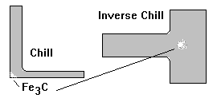
Solidus Temperature (ST)
ST is the end of solidification.
The graphite structure does not change after ST.
The remaining carbon held within the austenite crystal structure is expelled to the existing graphite structure, or as pearlite (Fe₃C/Fe/Fe₃C layers) at the eutectoid transformation temperature.
Higher ST indicates lower risk of inverse chill.
Notes:
The solidus temperature indicates the end of solidification. Certain elements, such as Mn, Cr and P segregate to the intercellular region in ductile iron, lowering ST, which indicates an increased the risk of inverse chill. Excessively high residual Mg can also lower ST values.

Slide 22
G1, G2 and G3 Phases
G1, G2 and G3 are the percentages of the 3 phases, during solidification, between LT and ST.
G1 is observed in hypoeutectic irons, where austenite is precipitated. In eutectic irons, G1 is 0, as LT and LET are the same.
G2 shows the precipitation of first phase eutectic graphite between LET and HET. G2 values increase in compacted graphite iron.
G3 shows the precipitation of second phase eutectic graphite. High G3 values indicate that graphite is precipitated for longer and later, offsetting micro porosity.
G1
G2
G3
Notes:
G1, G2 and G3 are the percentages of the 3 phases during solidification between liquidus and solidus. G1 is observed in hypoeutectic iron, where primary austenite is the first phase to solidify. G1 is zero at 4.3% CEL, where eutectic graphite and eutectic austenite are precipitated at the same time. G2 and G3 are the first and second phases respectively of graphite precipitation. G2 values are generally higher in compacted graphite compared to ductile iron. High values for G3 indicate good resistance to micro porosity formation.

Slide 23
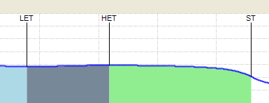
LET– ST (Total Graphite Precipitation Time)
LET–ST is the total graphite precipitation time.
Longer precipitation times indicate controlled graphite growth and better feeding characteristics.
High purity charge materials, preconditioning and good inoculation all extend this time.
Notes:
LET to ST, which can also be considered as G2 + G3, is the total graphite precipitation time. The longer this time, the better are the feeding characteristics of the iron. Whilst high purity pig iron does not assist with nucleation in ductile iron, it does enhance the graphitisation time, thereby reducing shrinkage tendency. For better feeding characteristics, LET-ST should be extended beyond 120 seconds.

Slide 24
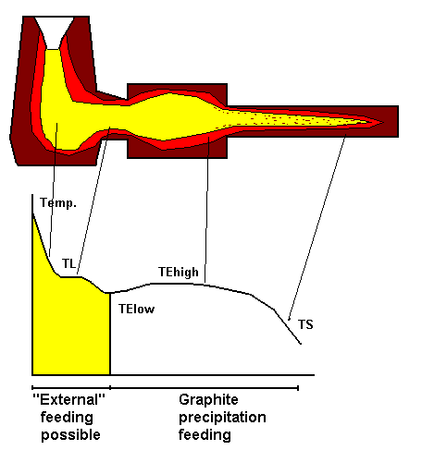
Graphite Precipitation - Feeding
Notes:
It is important to understand that feeders are only functional, during the first part of solidification, when there is an open feedpath between the feeder and casting. After the low eutectic temperature, there should be sufficient amount of graphite precipitated, to compensate for liquid contraction of the iron.

Slide 25
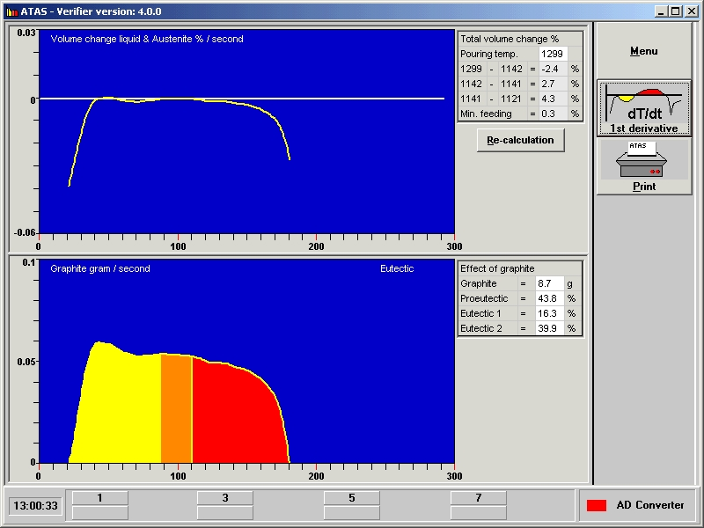
Graphite Precipitation
Notes:
Here we can see the precipitation of graphite. The vertical axis shows the amount of graphite precipitation in grams per second, and the horizontal axis indicates time. With a high recalescence, there is preferential early precipitation of graphite, shown by the peak in the yellow-shaded area of the chart. This means that there is less late precipitation of graphite in the red-shaded area, which can result in micro porosity.

Slide 26
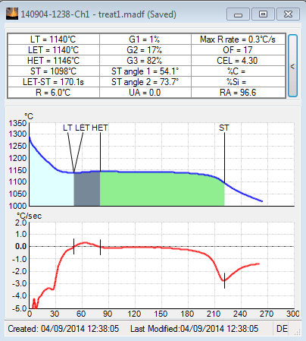
Angles ST1 and ST2
ST1 measures late stage graphite and grain boundary activity.
A sharper angle at ST1 indicates a lower risk of micro porosity.
ST2 measures thermal conductivity of the iron. Graphite flakes have better thermal conductivity than nodules, leading to a sharper a deeper angle.
A sharper angle at ST2 indicates a higher cell count.
ST1
ST2
ST
Notes:
The angles at the solidus temperature are measured from the first derivative curve, which is the red line. This curve indicates the rate of temperature change in degrees per second. A sharper deeper angle at ST indicates increased late stage graphite precipitation, meaning a lower risk of micro porosity. A sharper angle at ST is evidence of a higher cell count in both grey iron and ductile iron. ST1 and ST2 values are generally lower in grey iron than in ductile iron.

Slide 27
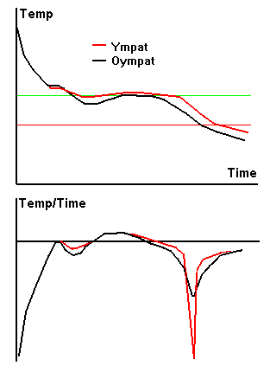
The Effects of Inoculation
INOCULATED – UNINOCULATED
Reduce LT = less shrinkage
Increase LET = less chill
Increase ST = less inverse chill
Reduce R = less macro-shrinkage
Increase LET-ST = less micro-porosity
Sharper angles ST1 and ST2 = higher cell count
--- Inoculated
--- Uninoculated
Notes:
More than any other metallurgical product group, inoculants have the single biggest influence on the cooling curves. The red lines show the inoculated curves. The liquidus temperature reduces, due to the slight increase in Si in hypoeutectic irons, and through the deoxidising effect of the inoculating elements, such as strontium and barium. LET always increases with inoculation to varying degrees, reducing the risk of iron carbide formation. Increasing the solidus temperature reduces the risk of inverse chill. Recalescence is reduced through inoculation, which lowers the risk of micro shrinkage. The time from LET to ST is extended by inoculation, improving the feeding characteristics of the iron. Inoculation sharpens and deepens the angle at ST, indicating refined type A graphite in grey iron and higher nodule counts in ductile iron.

Slide 28
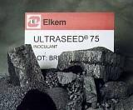
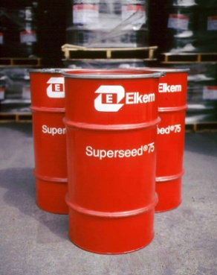
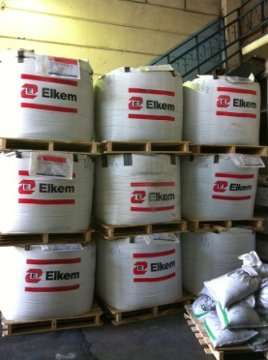
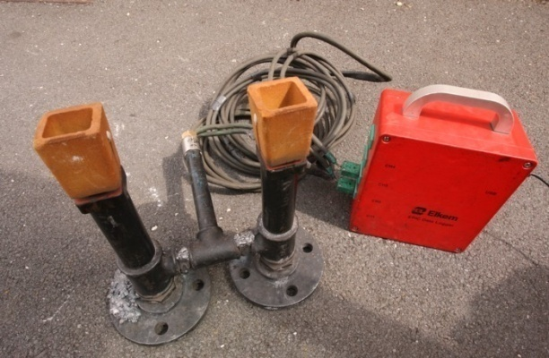
ELKEM’S WELL KNOWN GLOBAL PRODUCT BRANDS
Nodularisers: Elmag ®, Lamet ®, CompactMag ®, Remag ®
Inoculants: Alinoc ®, Barinoc ®, Foundrisil ®,
Reseed ®, SMZ ®, Superseed ®, Superseed ® Extra, Tenbloc ®, Ultraseed ®, Vaxon ®, Zircinoc ®
Preconditioner: Preseed ®
Conditioner: Topseed ®
Pipe Powders: Pipeinoc ®

Slide 29
DO YOU HAVE ANY QUESTIONS?
Notes:
DO YOU HAVE ANY QUESTIONS?

