Slide 1
CAD DESIGN
AND
3D PRINTING FOR CASTING
Shane Corish
Racecast & Quicksand

Slide 2
INTRODUCTION
Shane Corish
BE - Manufacturing and engineering management - RMIT
Design engineer behind the worlds largest mobile bar
Automotive design engineer for Volgren - 8 years
Founder of RaceCast Pty Ltd
Co-founder of Quicksand Pty Ltd

Slide 3
Quicksand
CSIRO transition Voxeljet to industry
RaceCast and Hasco had been the 2 largest users of the machine while operated by CSIRO
Quicksand is co-founded and set up to provide the 3D sand printing service to the Australian foundry industry

Slide 4
Repco Brabham engines
Jack Brabham - F1 driver
F1 championship win in 1966
Engines designed and manufactured in Australia
Some Brabham V8’s still run Today in the historic race series

Slide 5
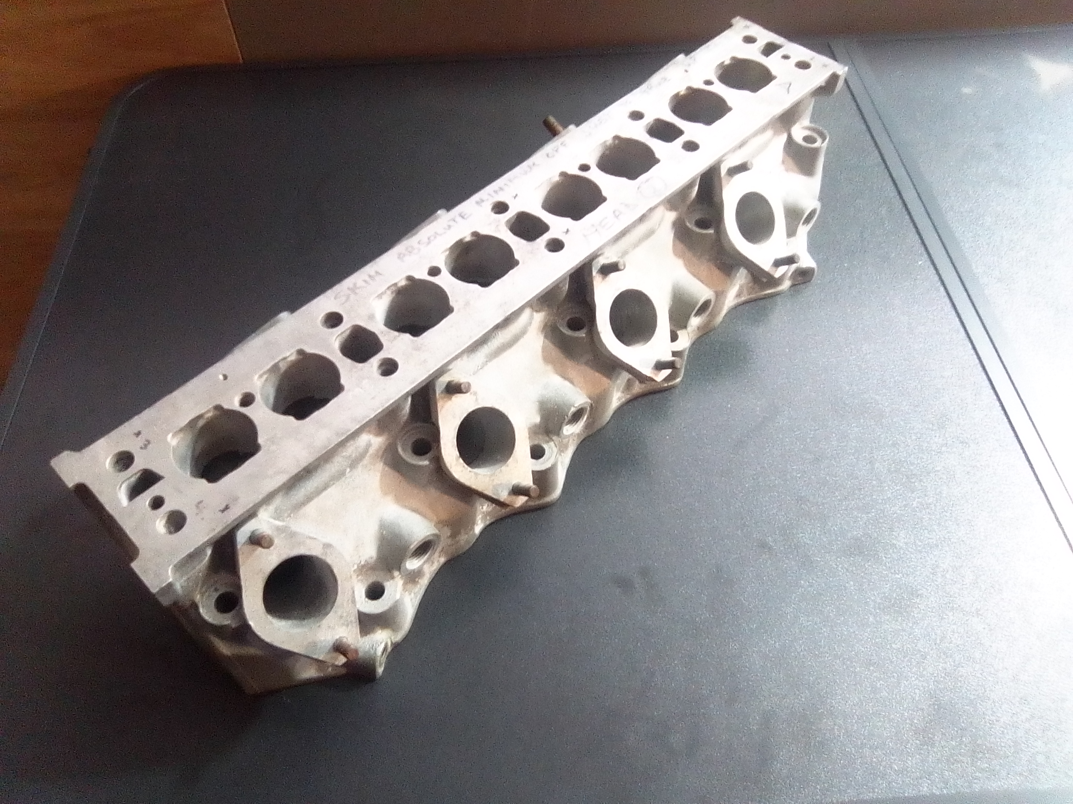
Parts availability
Over time parts have worn out or failed
No new parts are available
Re-conditioning old parts extends life of parts, but only for a limited time
Re-manufacture is now becoming the only option

Slide 6
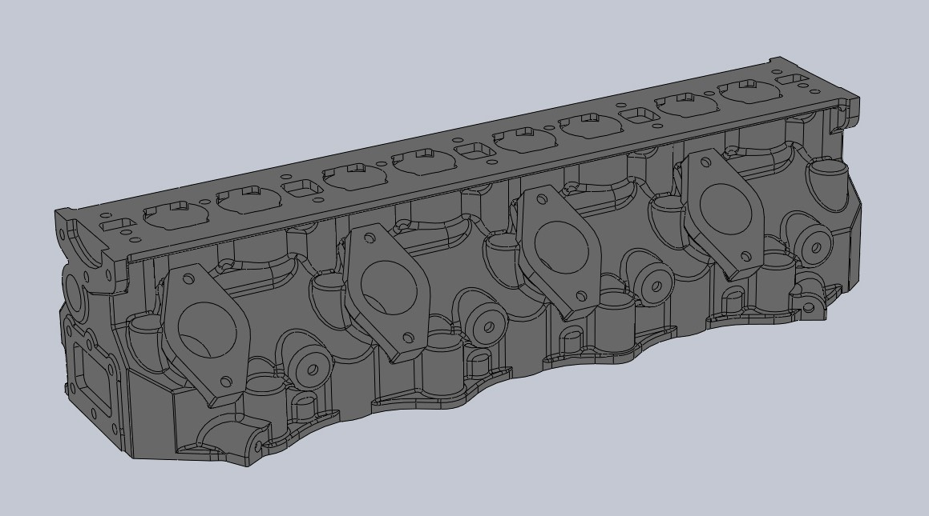
Reverse engineering
Existing head probed and scanned to ensure correct exterior geometry

Slide 7
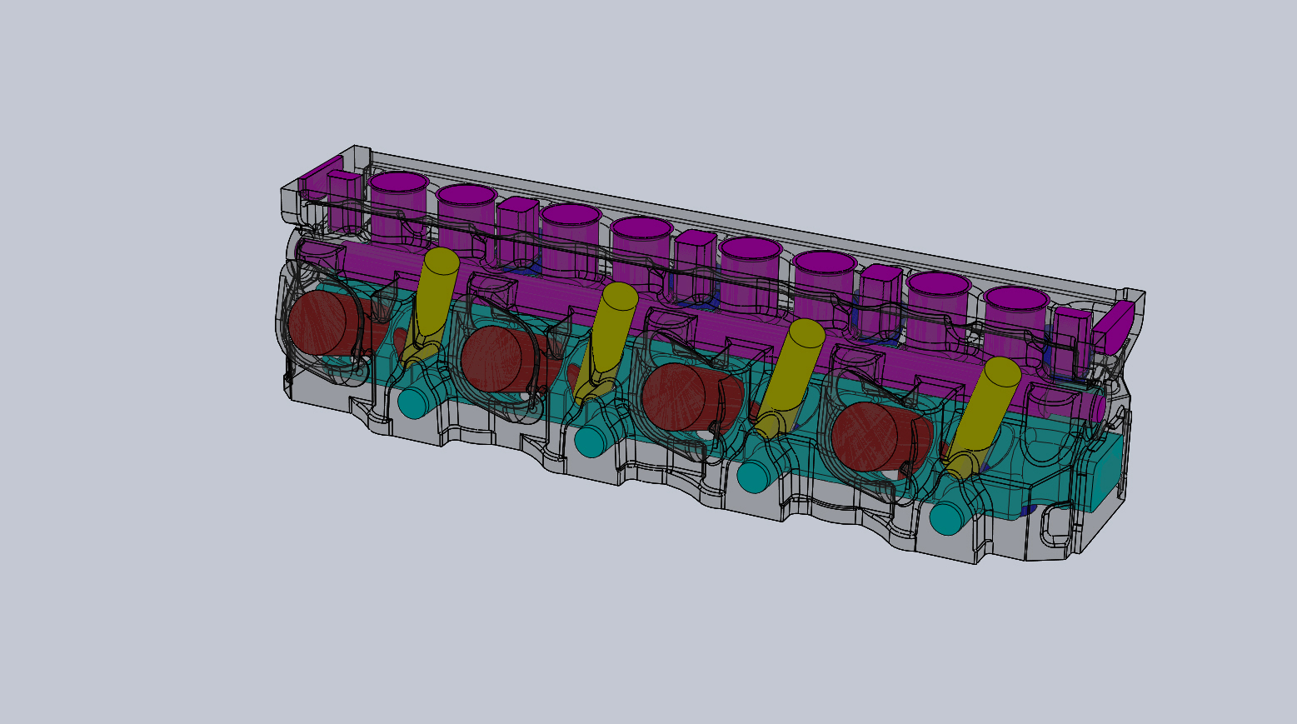
Core design
Maintain exterior shape
Design water jacket to maintain consistent wall thickness
Core out spark plug holes to reduce srinkage cracking

Slide 8
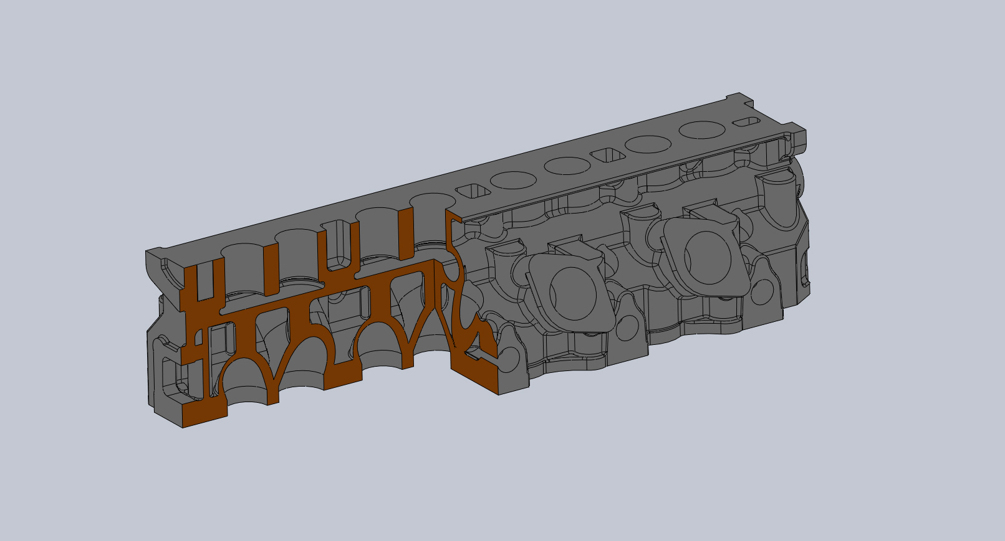
Design improvements
Deck face thickness
Valve guide holes
Replicated port geometry
Consistent water jackets

Slide 9
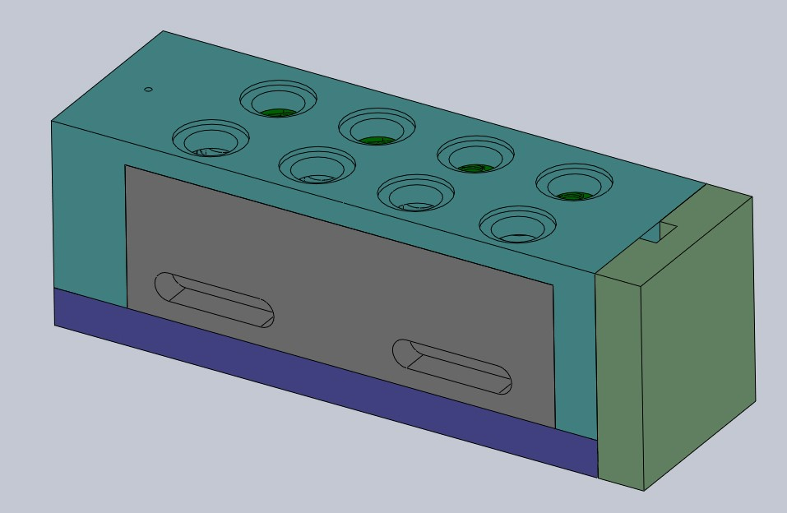
Mold design - Breif
Extract solid body and cores from solid block
Decide how to devide bolck up into managable sizes
Join cores to cope or drag if possible
keep complex or fragile parts together
Add methoding system
Add lifting and handling detail
Seperate mold parts for printing
1mm seperation is acceptable
Create STL (3° and 0.1mm res)
Print mold
Clean, assemble and cast

Slide 10
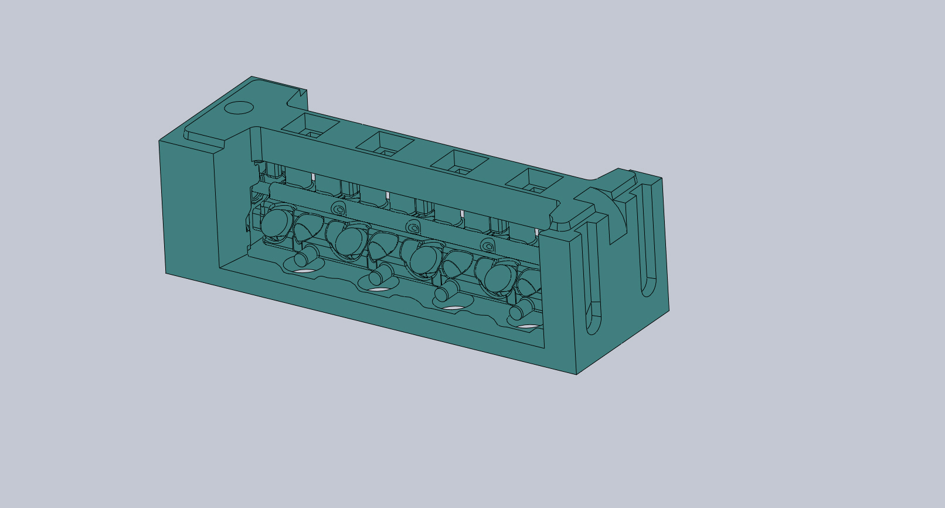
Mold design
Joined all cores to end caps
Assemble upside down
incorperate filters and in gates

Slide 11
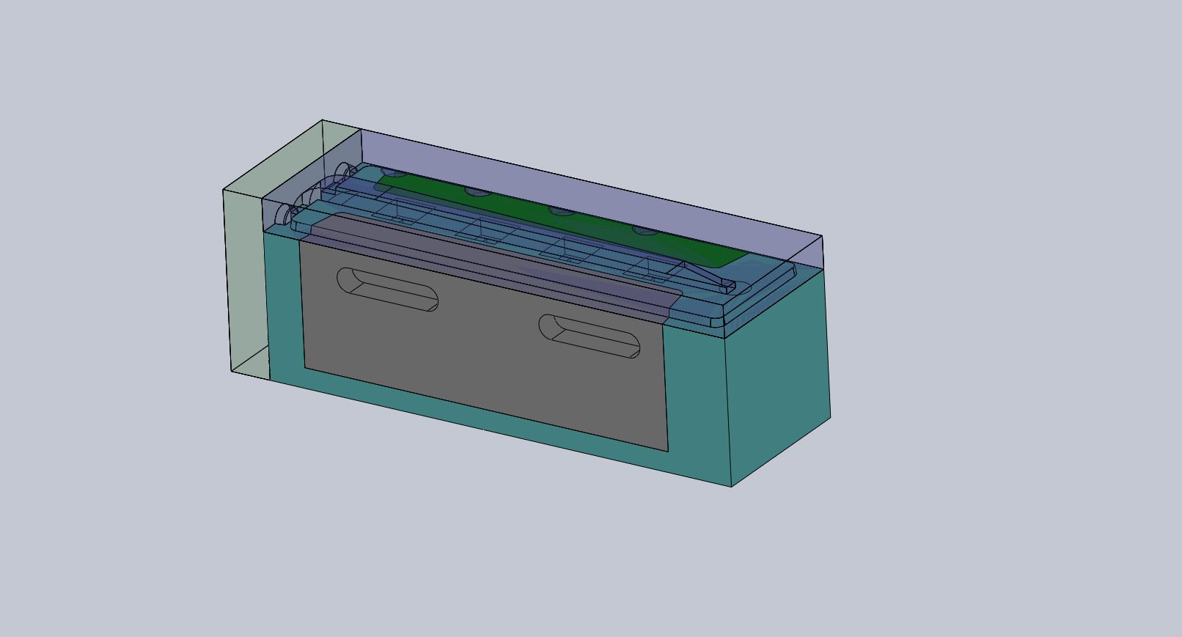
Mold design
Add sides and drop in spark plug cores
Add base plate and end cap - note the runner system included here

Slide 12
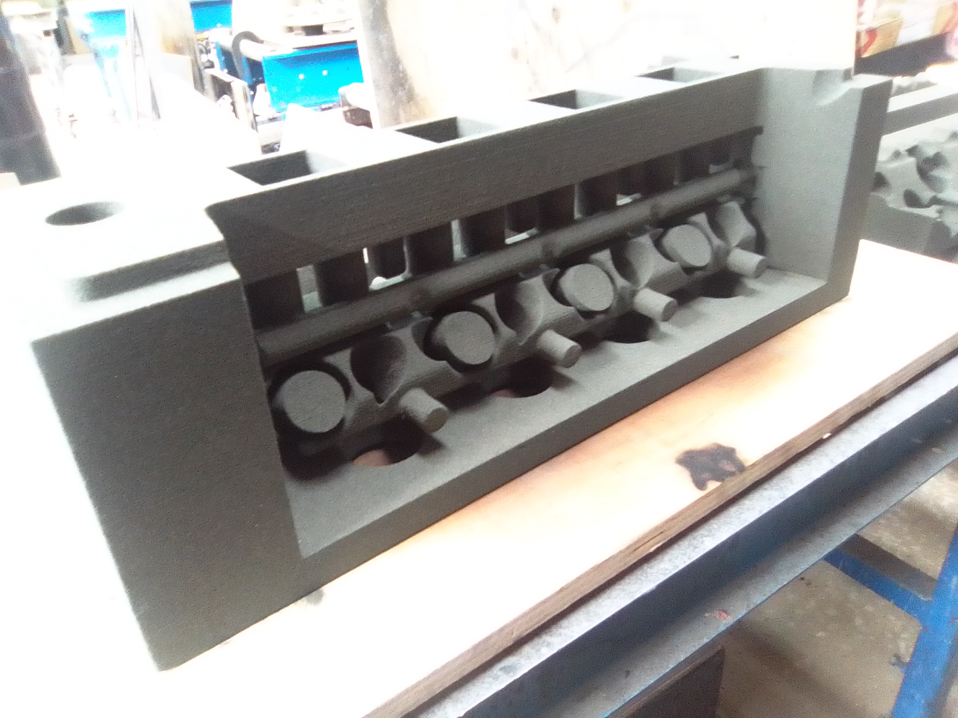
Printed molds

Slide 13
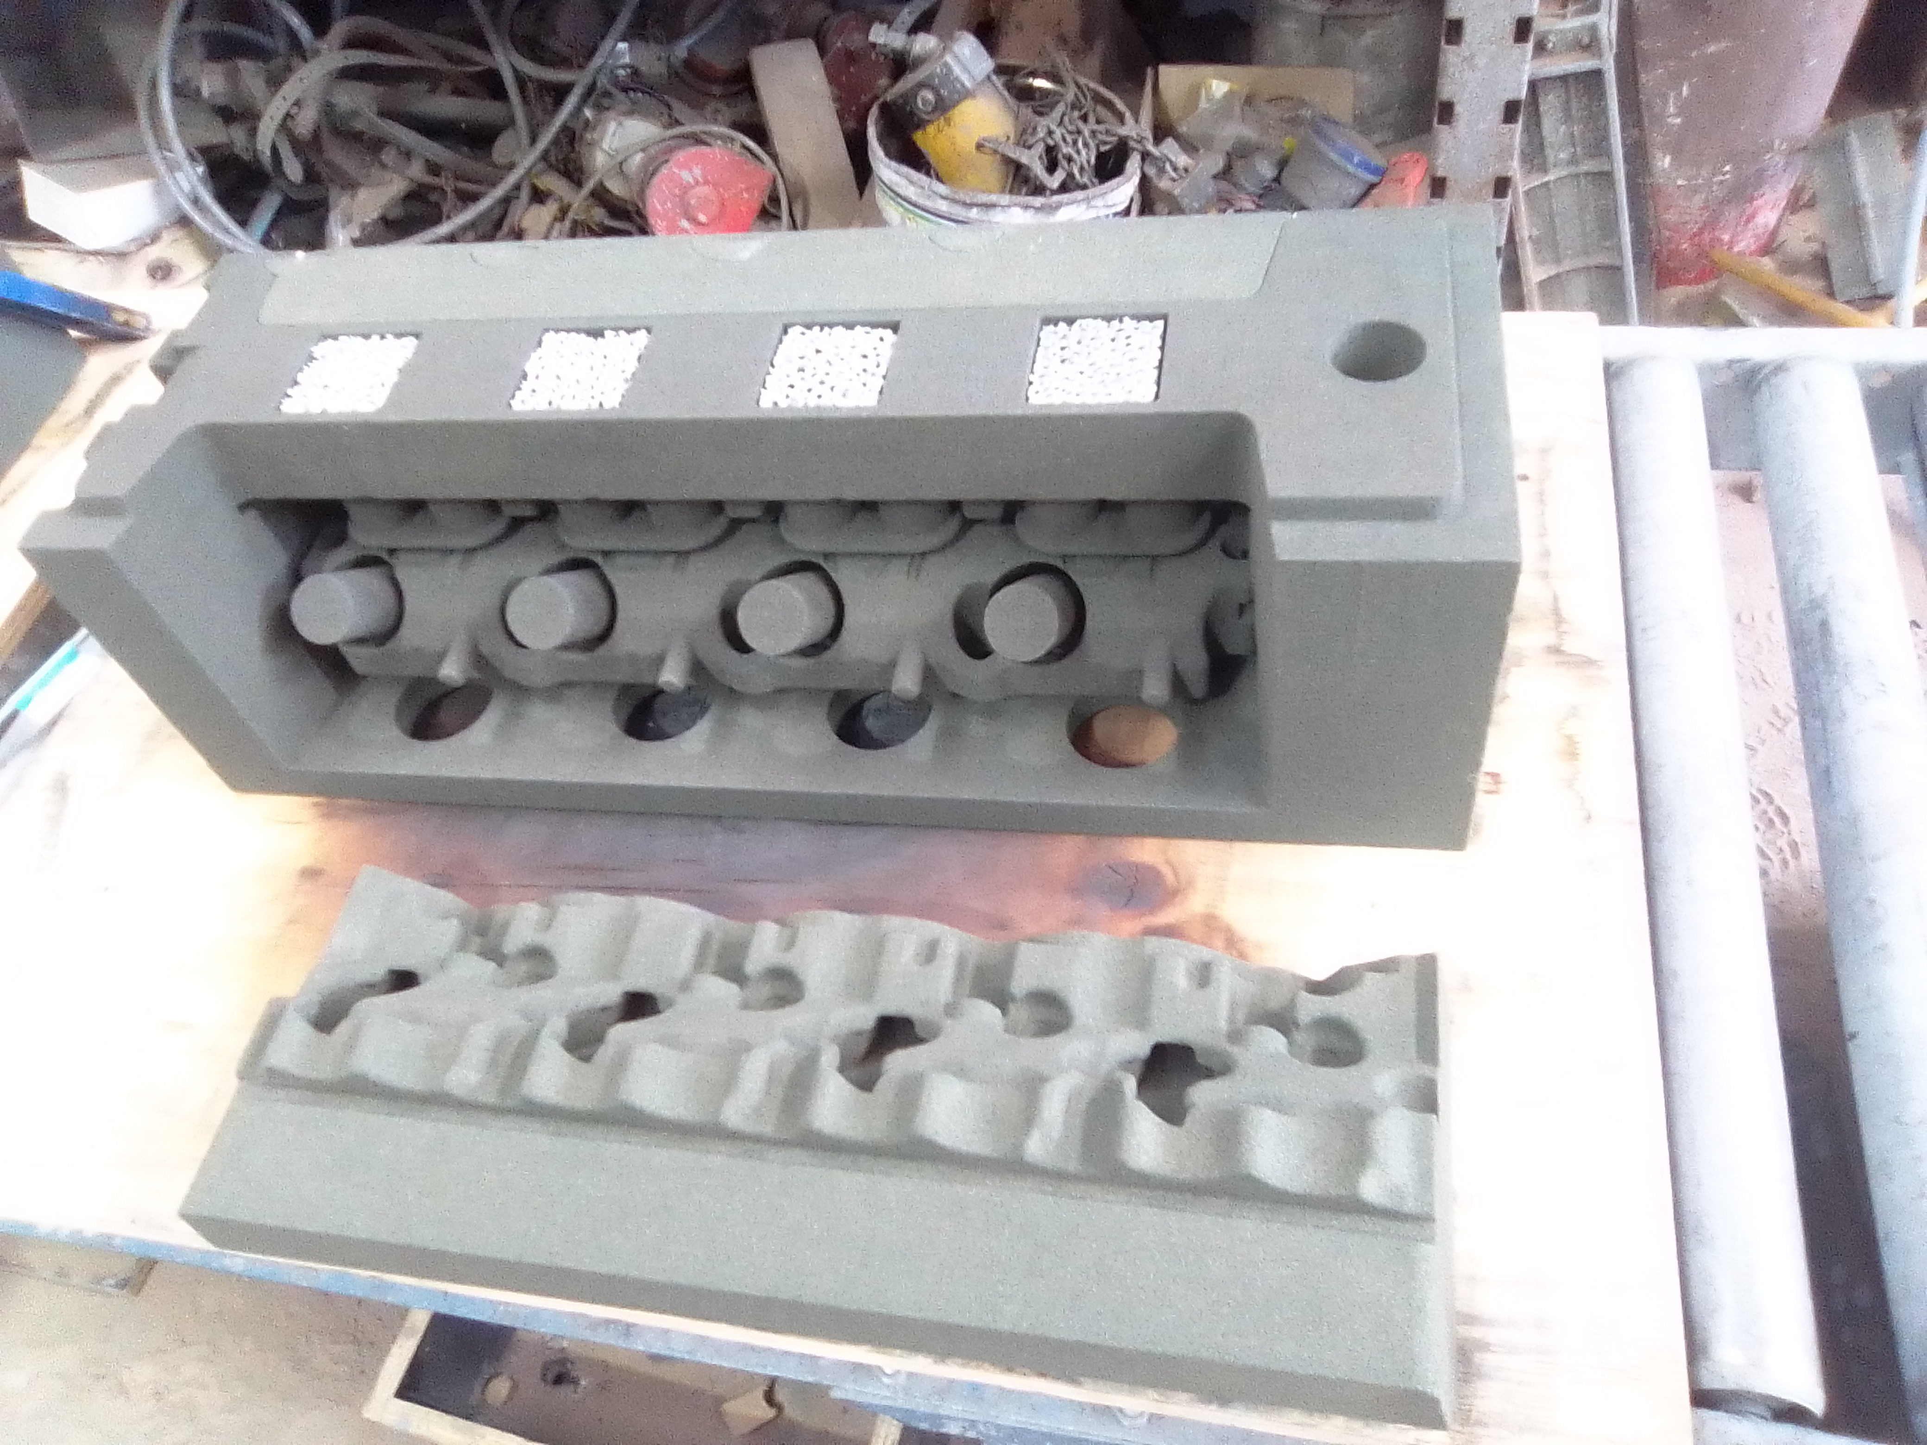
Printed molds

Slide 14
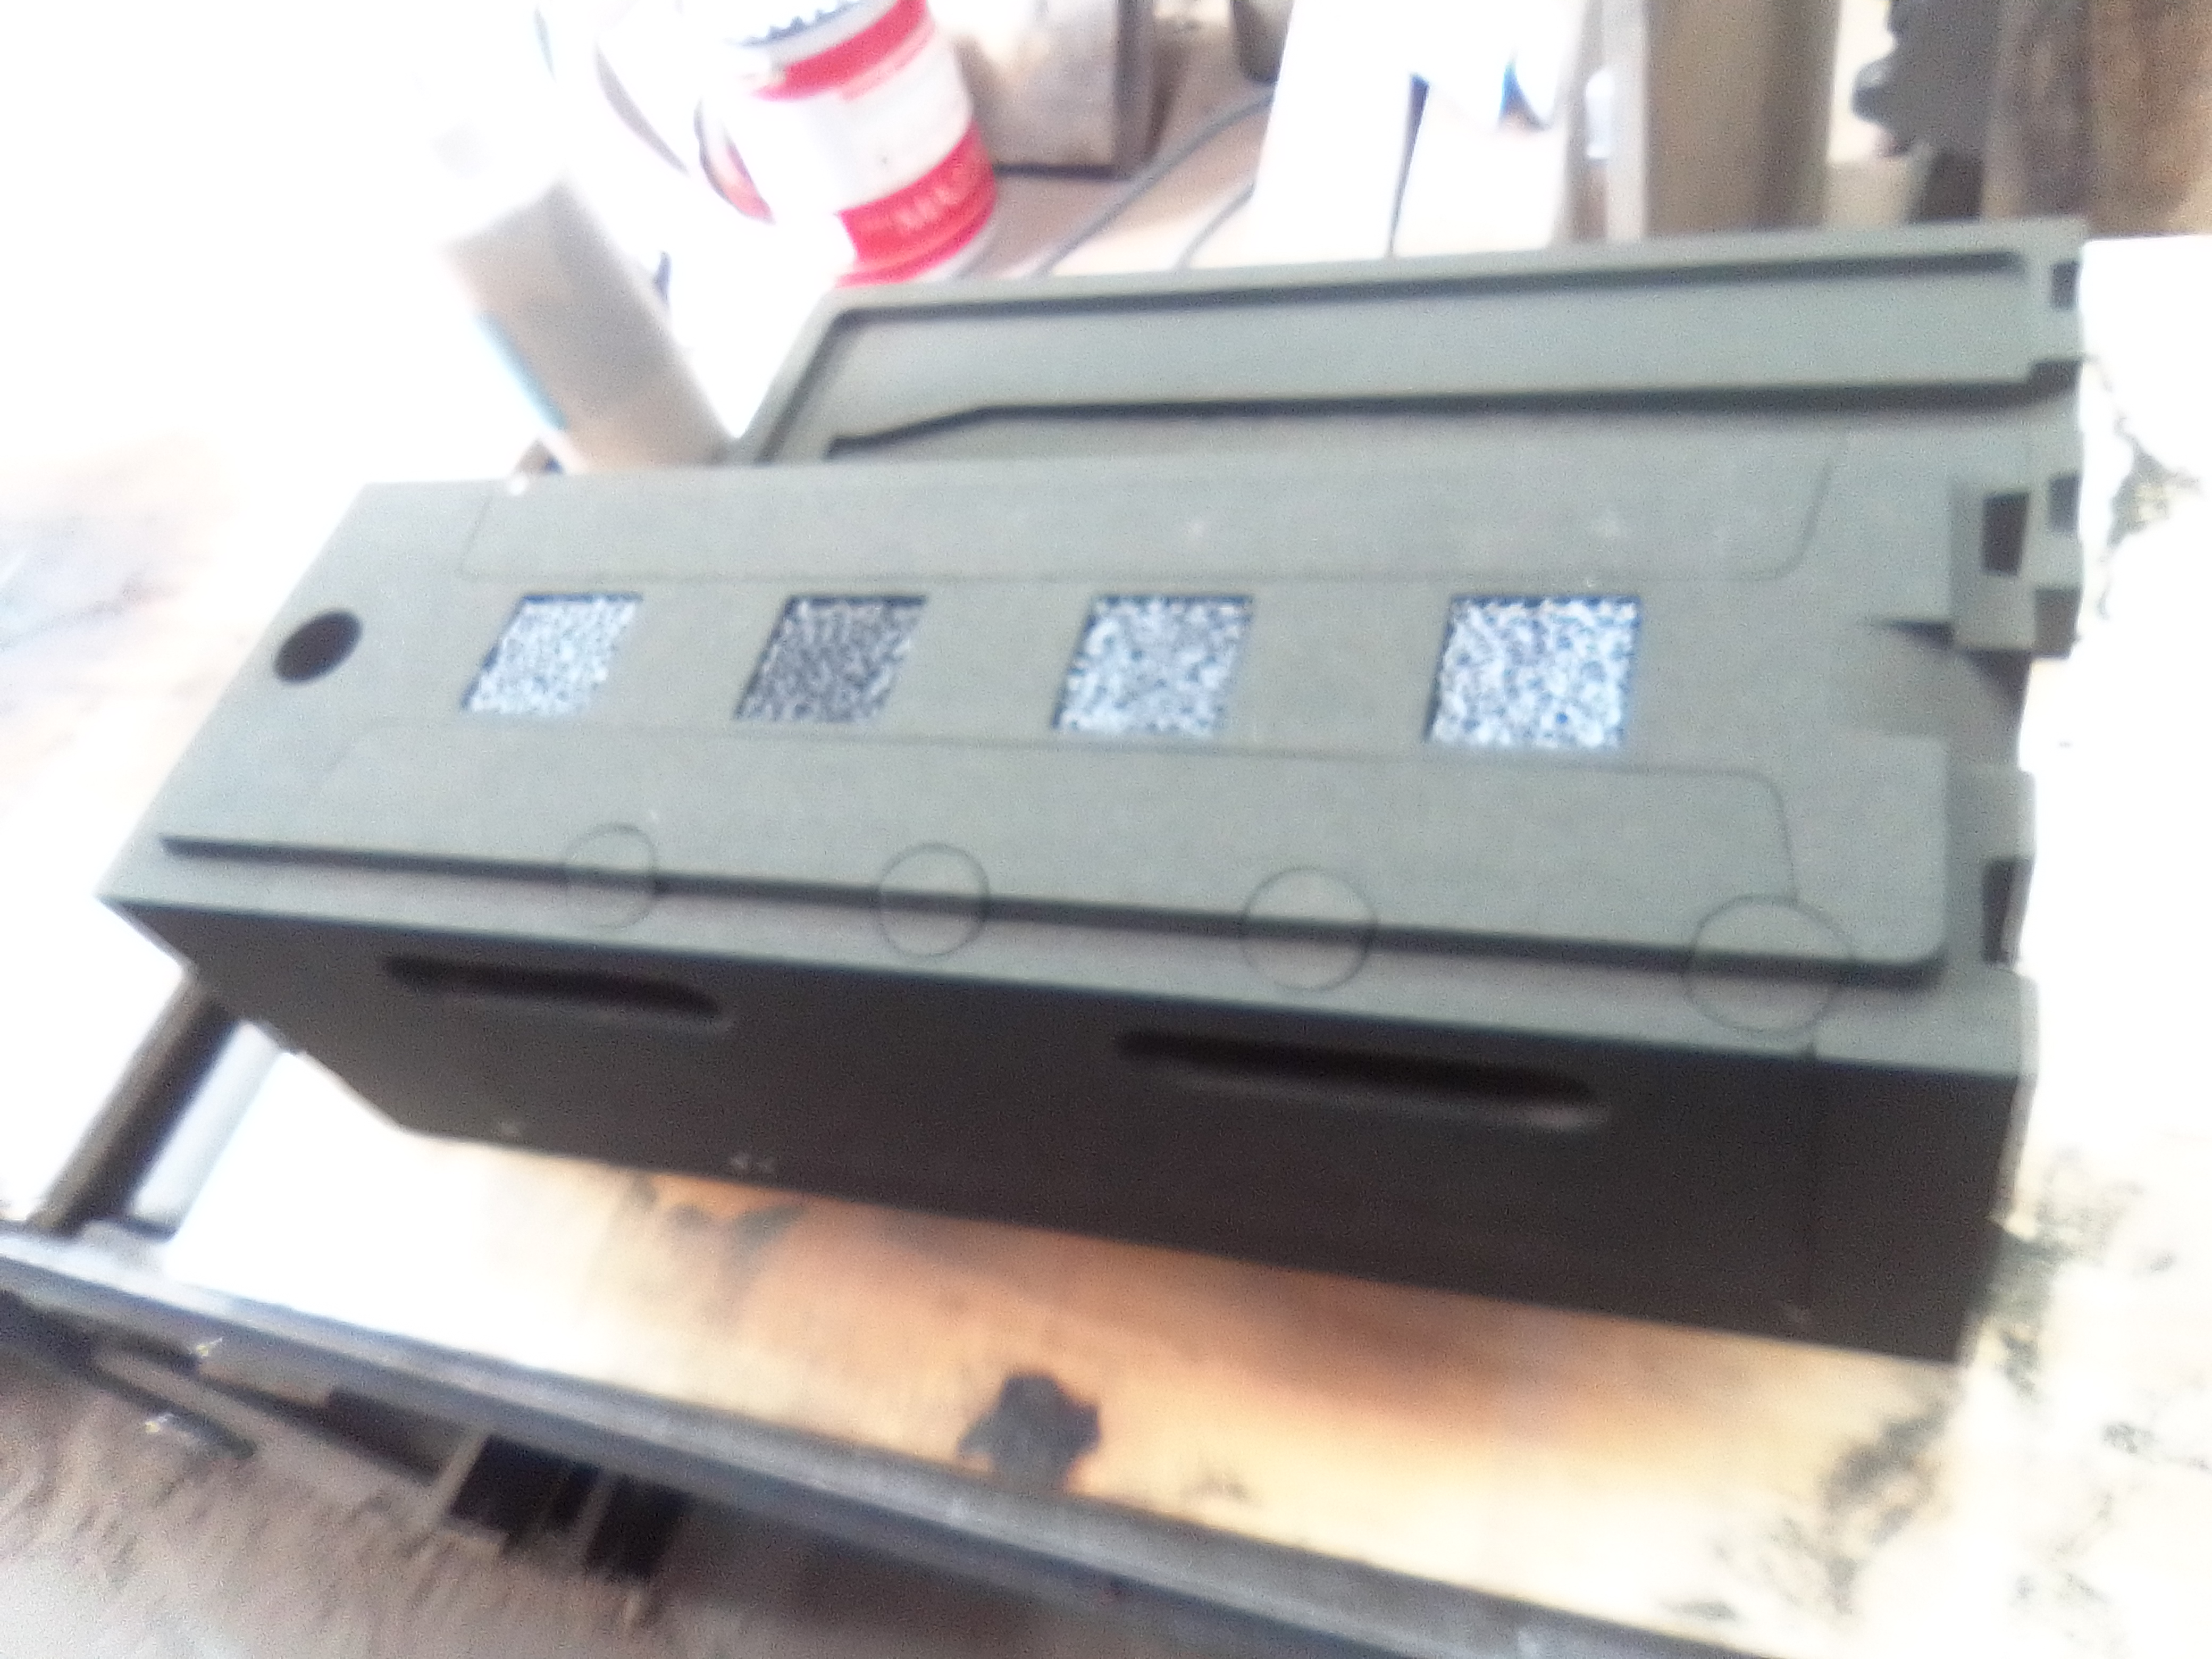
Printed molds

Slide 15
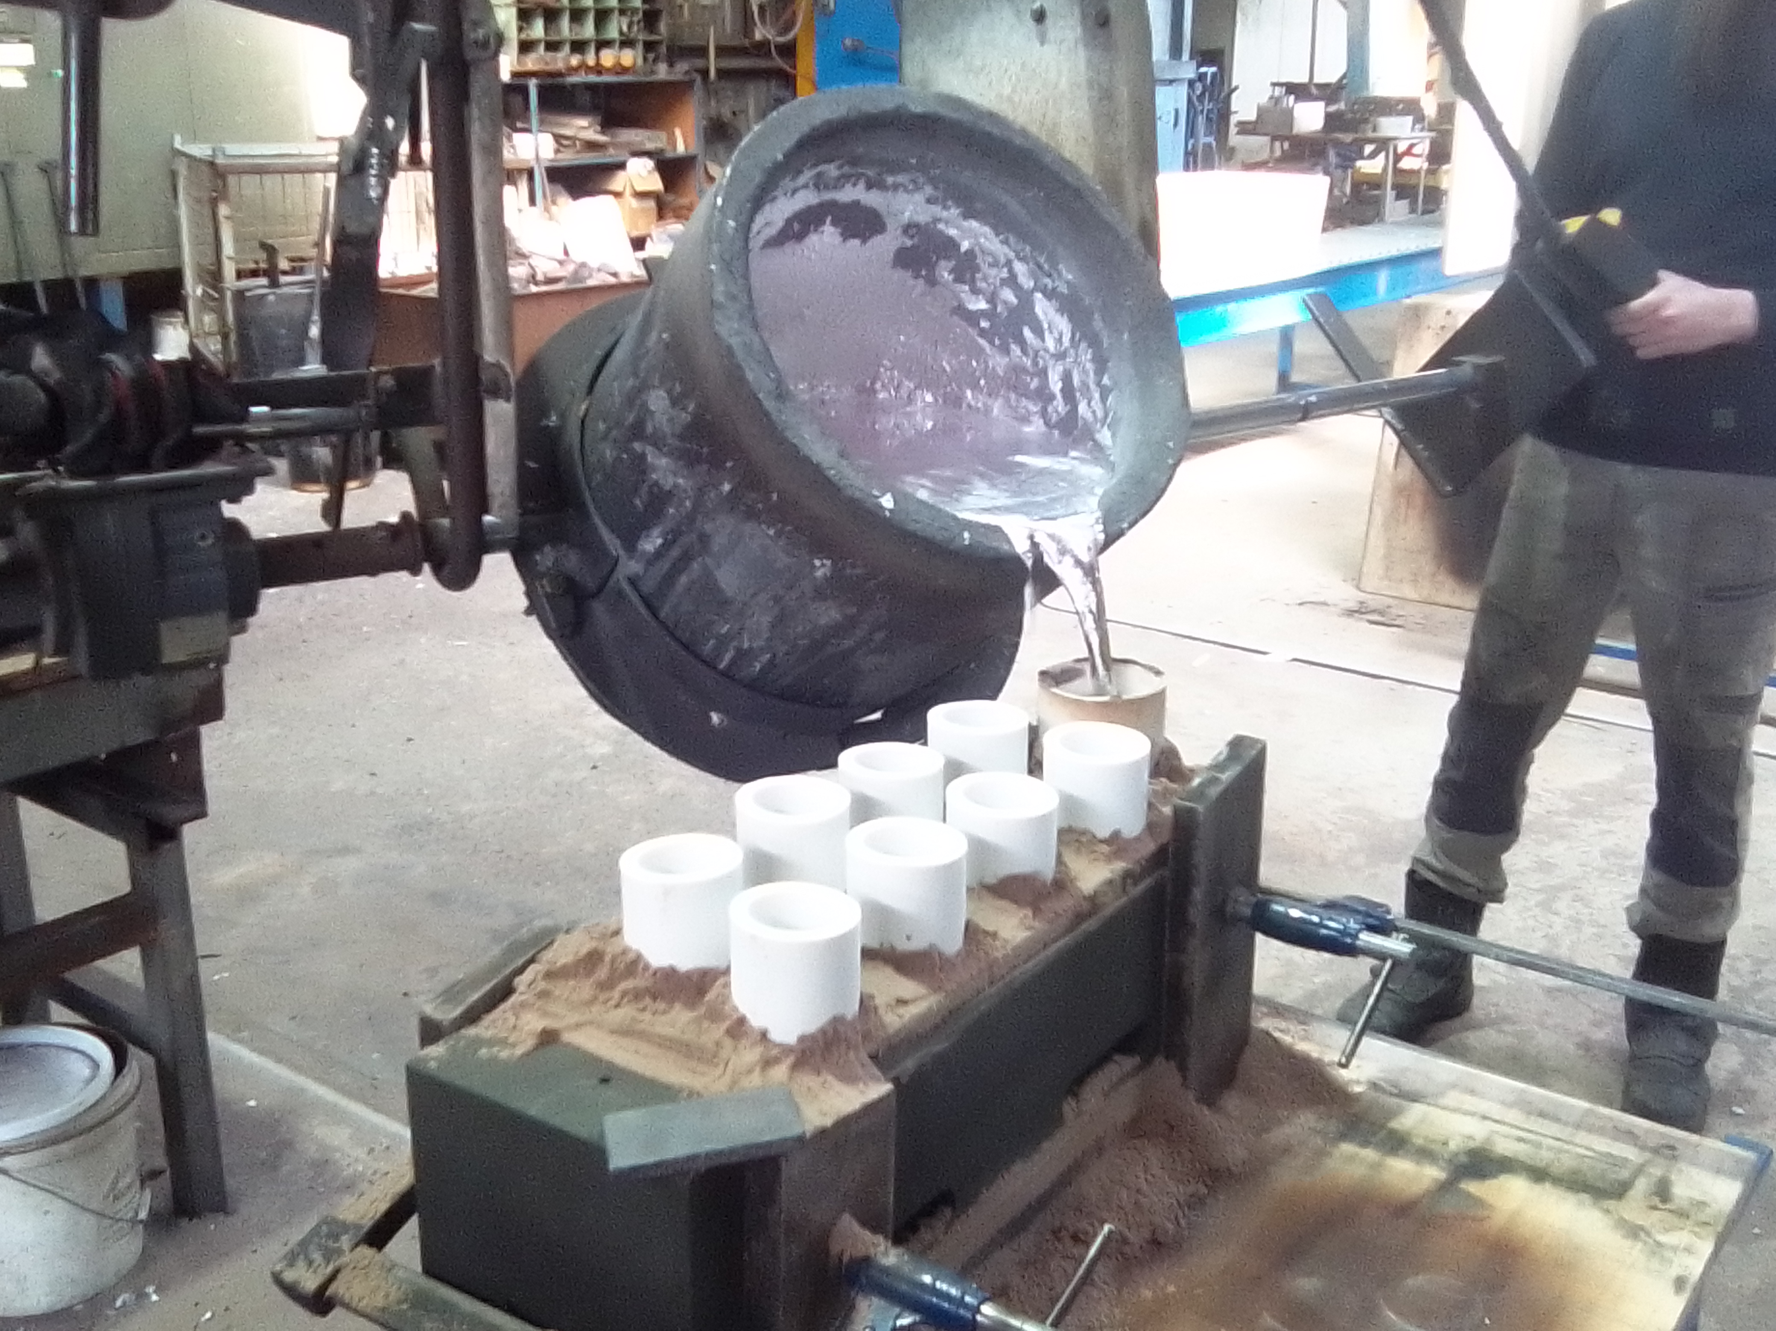
Printed molds

Slide 16
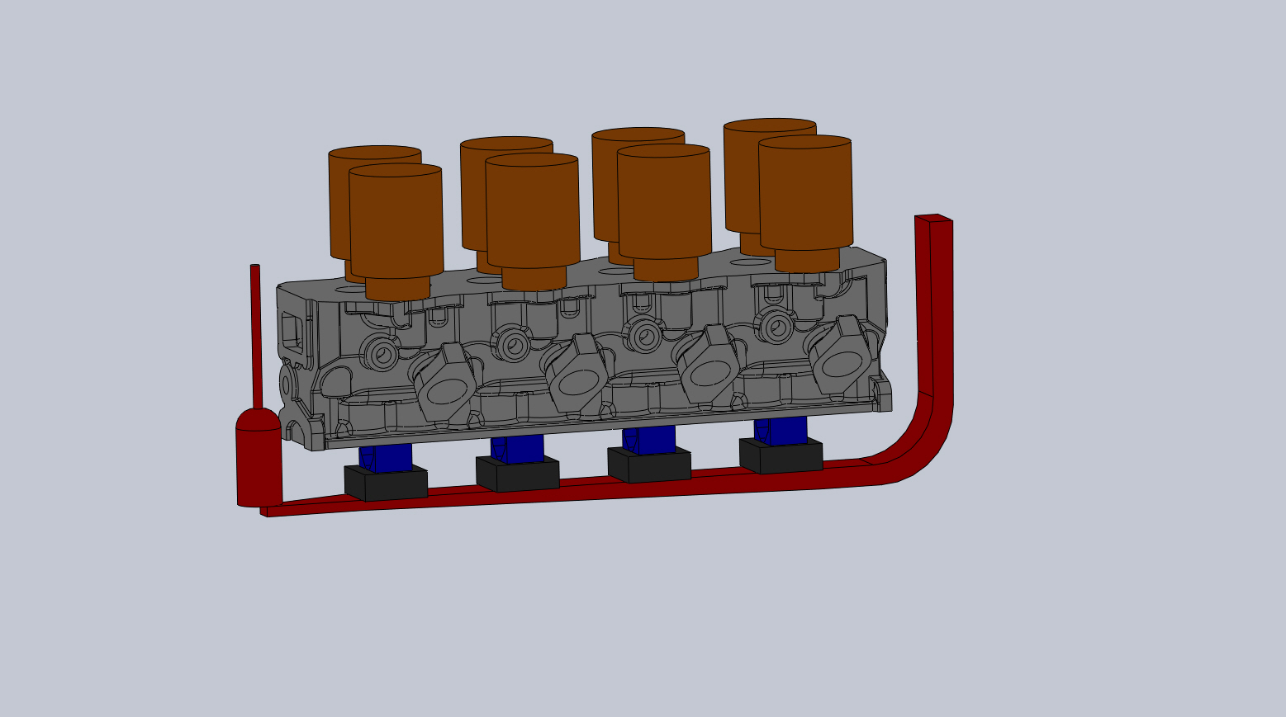
Raw casting

Slide 17
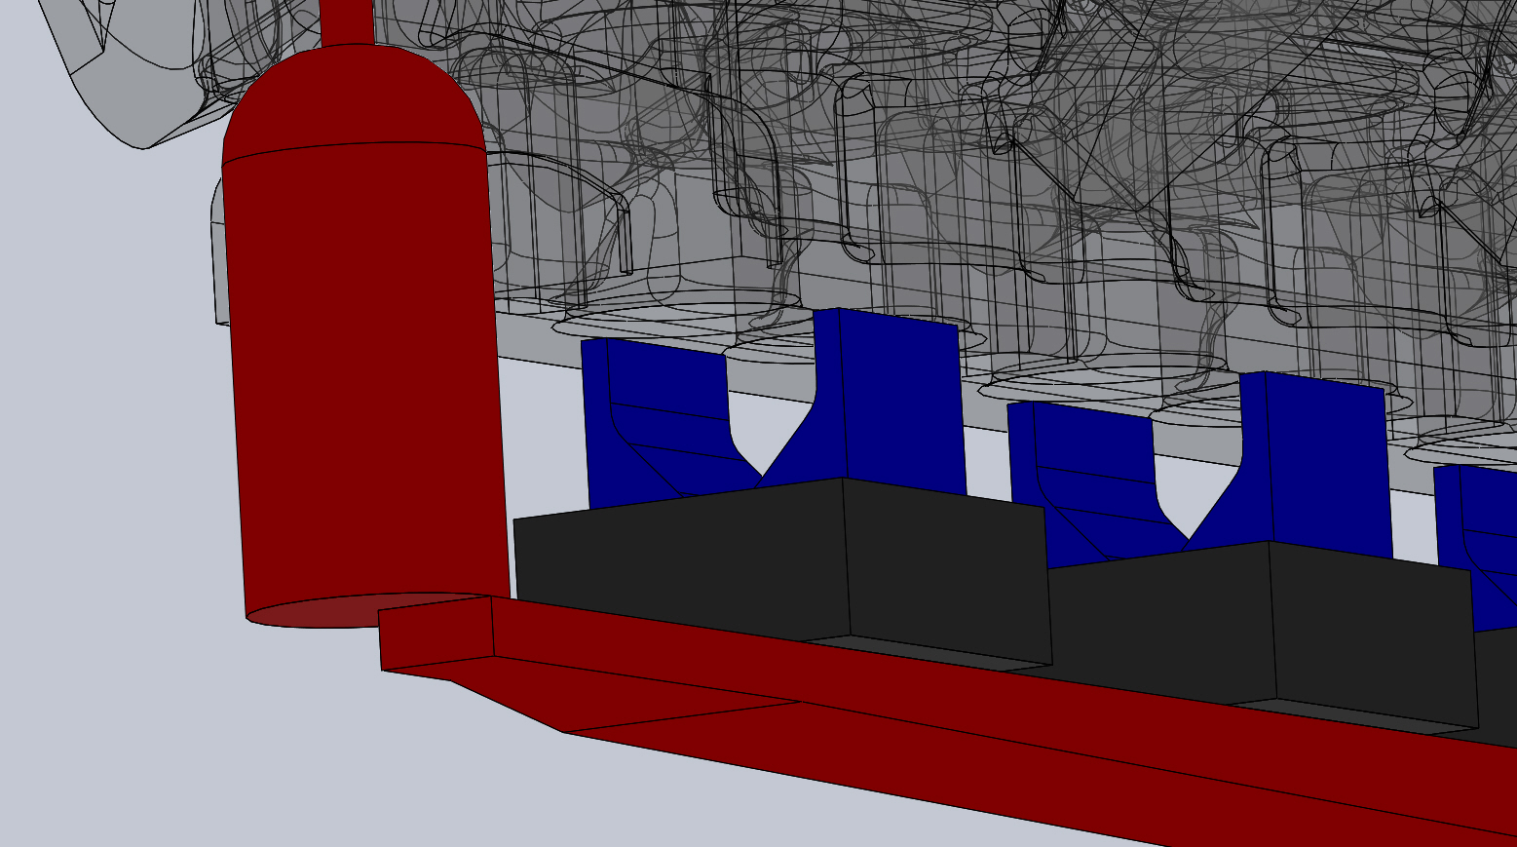
Raw casting
note: Tapered sprue, spinner and thin in-gates to gently introduce metal to the mold

Slide 18
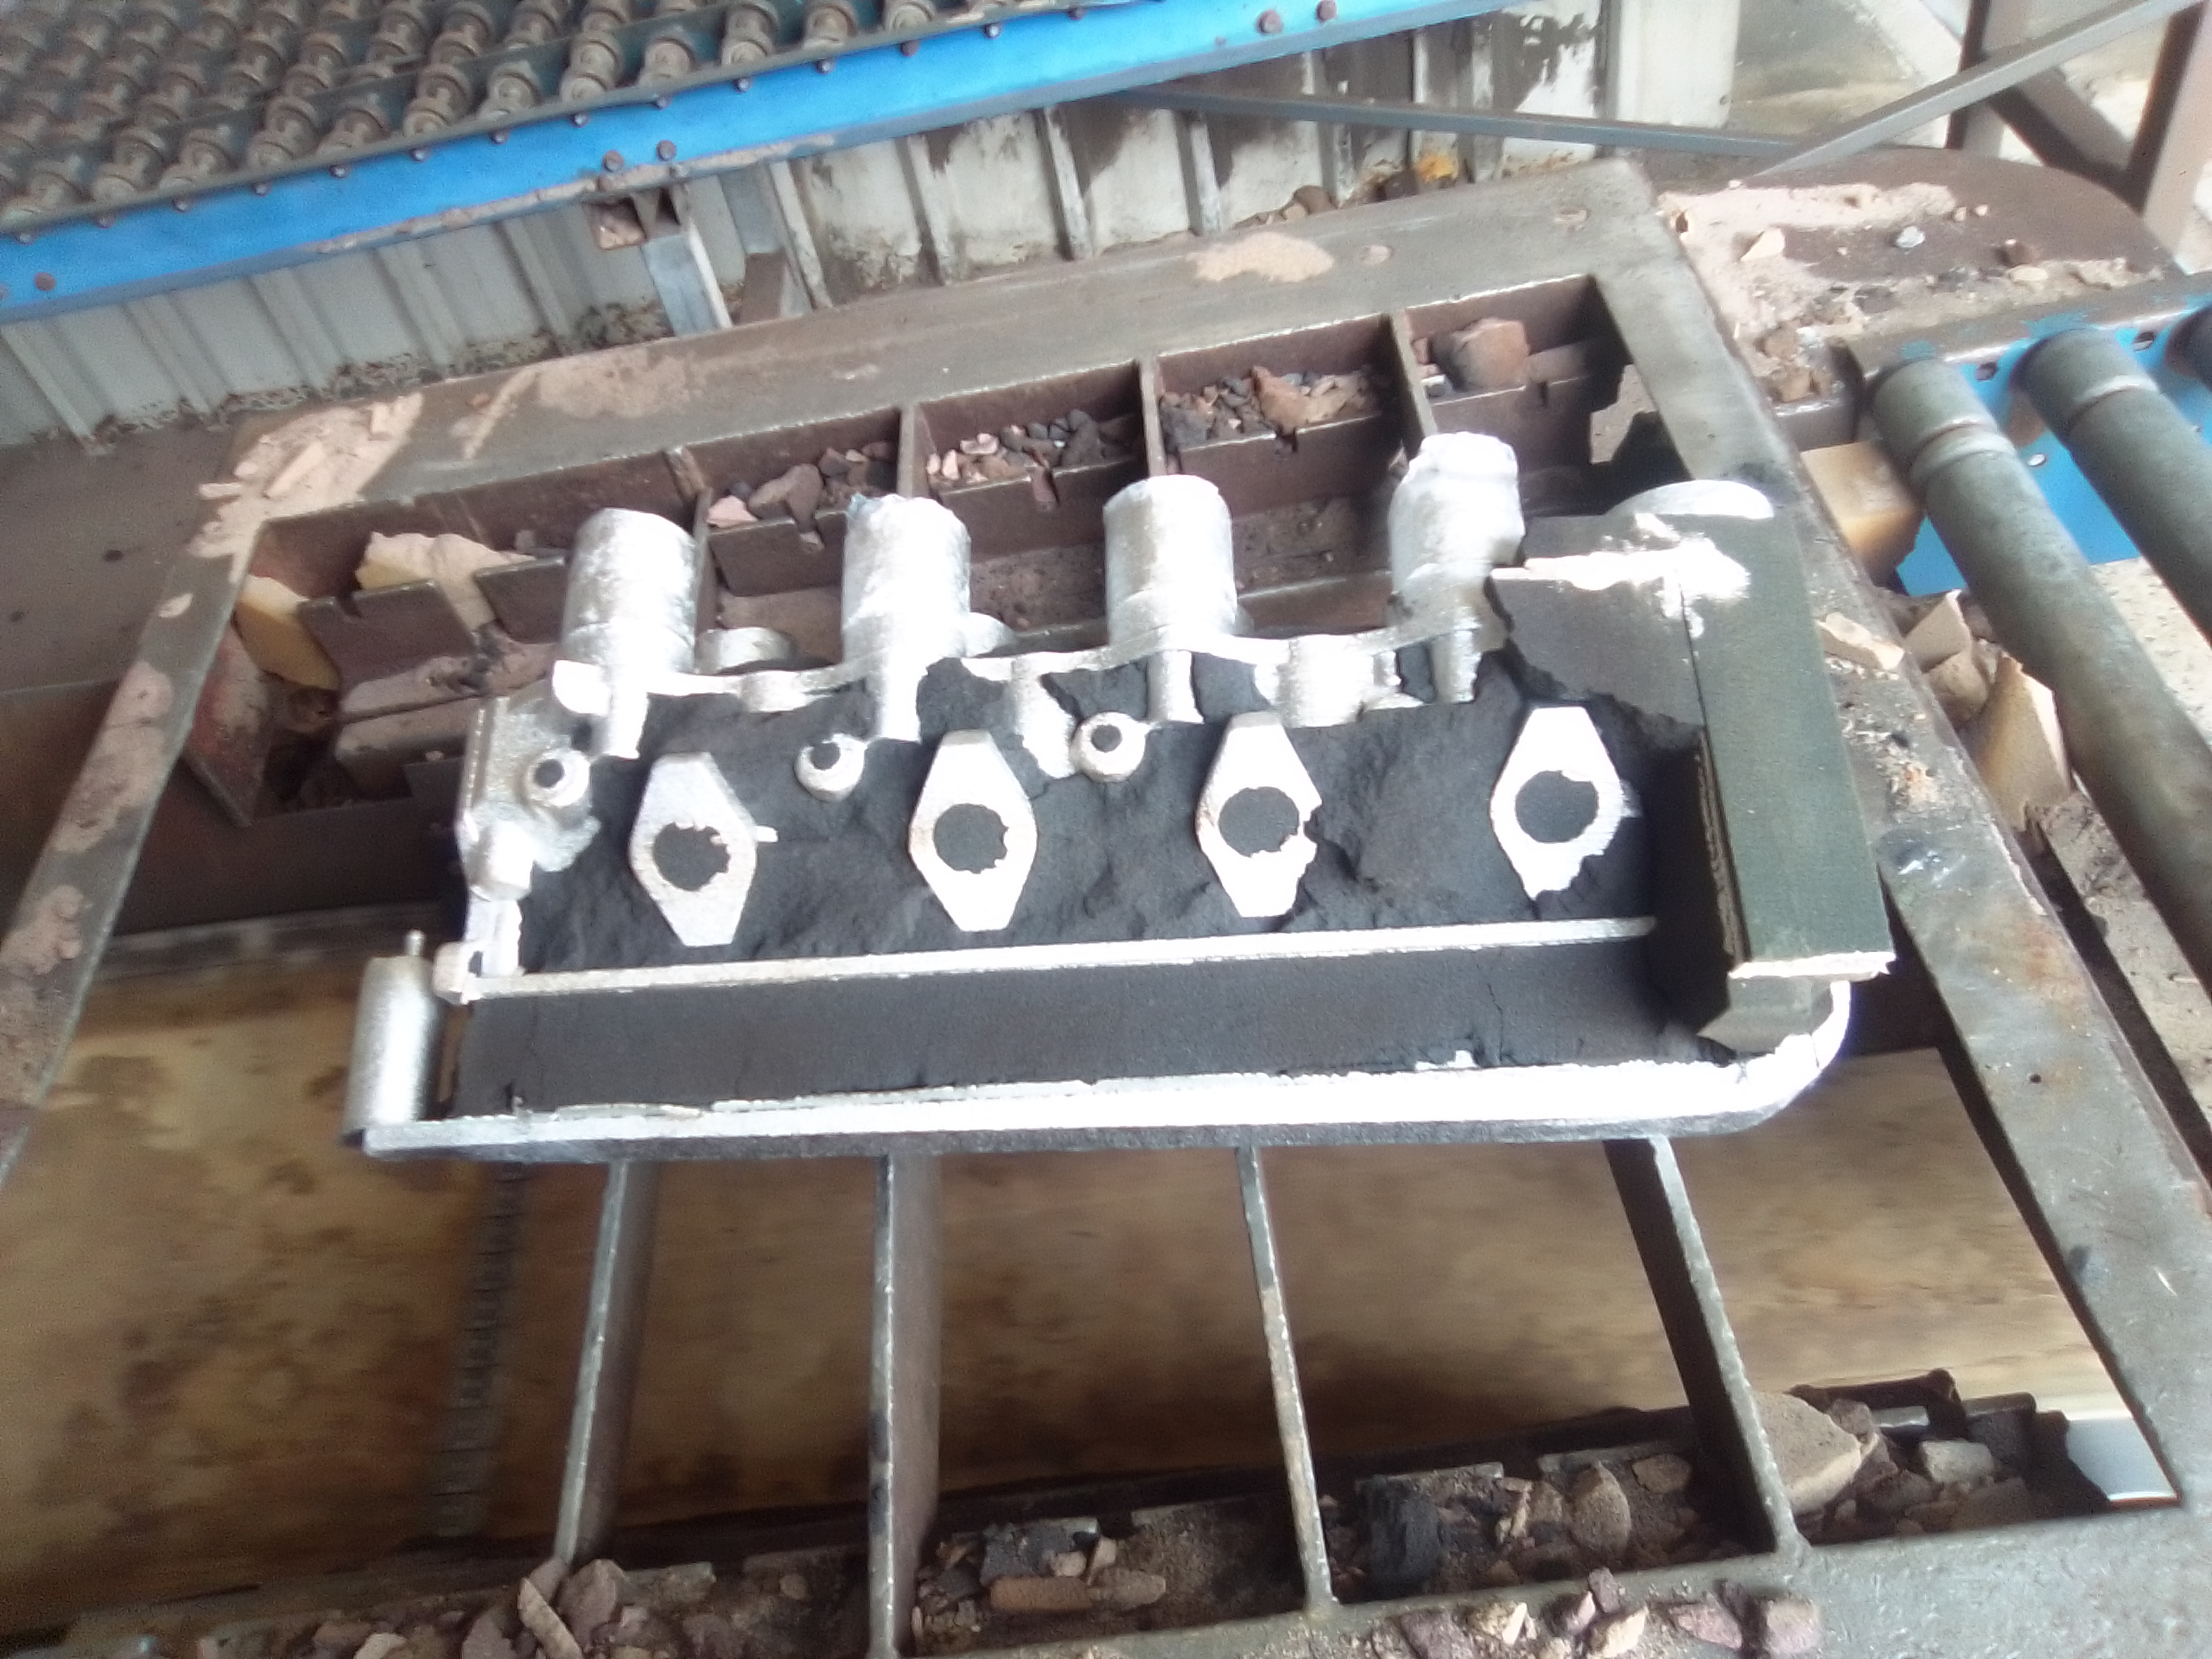
Raw casting

Slide 19
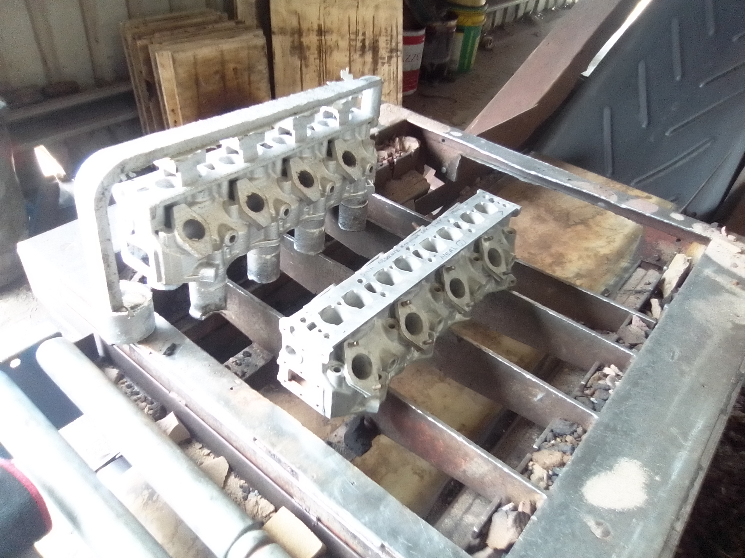
Raw casting

Slide 20
Summary
Short lead time
Low cost for short runs
Accurate parts
Easily modified
CNC ready CAD model

