Slide 1
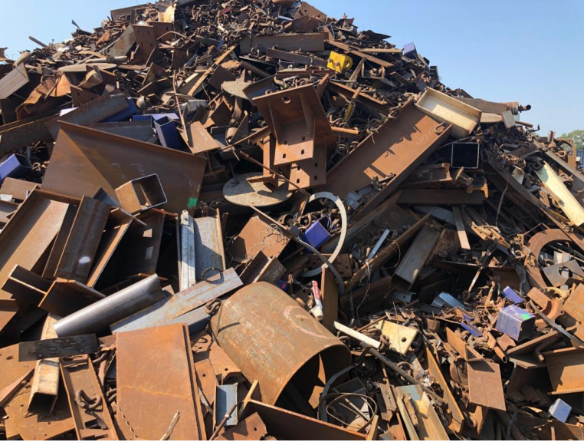
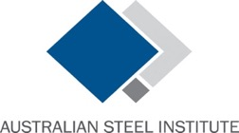
Steel
Scrap
Export
Restrictions
October 2023

Slide 2
NWRIC is a not for profit industry association, funded by major waste and recycling businesses operating Australia wide. It brings together national waste and recycling business leaders and affiliated state waste and recycling associations to formulate policies that will advance waste and recycling services in Australia.
The Australian Steel Institute is Australia's peak body representing the entire steel supply value chain from the steel manufacturing mills through to end users in building and construction, heavy engineering and manufacturing.
Australian Economic Advocacy Solutions (AEAS) was engaged by NWRIC and ASI to analyse the economic and environmental benefits from a national ban on the export of unprocessed ferrous scrap metal.

Slide 3
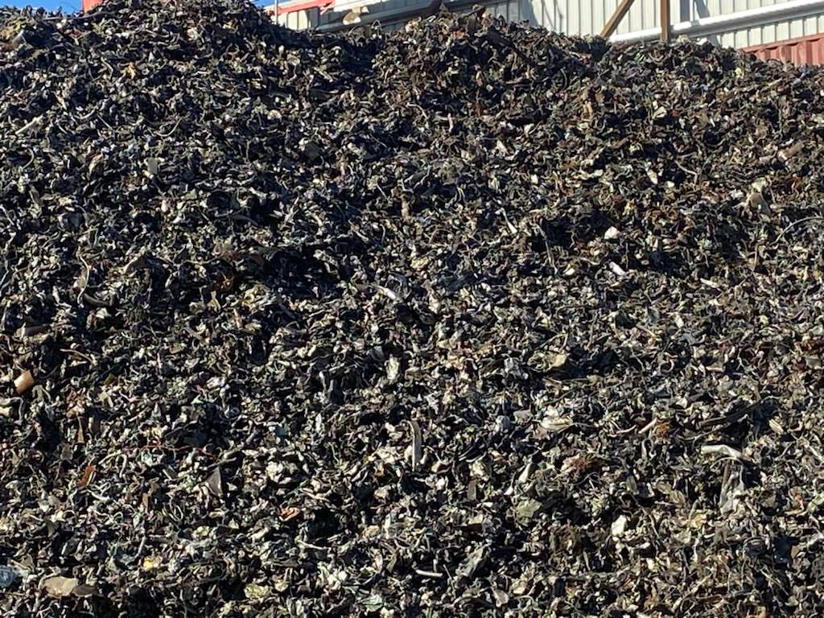
Last Year, NWRIC and the ASI called for a national ban on the export of unprocessed scrap metal.
The call for change:
Onshoring of Australian processing of ferrous scrap metal
Why:
Economy - creating both direct & indirect jobs & other economic benefits
Environmental - superior environmental benefits
Social responsibility – sending our waste to others
The arguments for are far reaching:
Increase industry capacity
Security of locally made steel supply
Economy and jobs
Carbon footprint reduction
Eliminate environmental impacts on others
Local Industry reduction in GHGe
Positive budgetary impacts
Purpose & Reason

Slide 4
The largest processors of scrap metal in Australia include:
Sims Metal;
Sell & Parker;
Nortstar; and
Infrabuild.
Metal recycling businesses can be broken down into two key areas of function:
Acquisition – collection / transfer
Consolidation – processing metals to end market specification
Scrap metal in Australia is either baled and exported unprocessed (sold to overseas pre-processors) or alternatively it is domestically processed into furnace ready materials sold to either domestic or foreign steel manufacturers
Scrap Market Summary:

Slide 5
Current Ferrous Scrap Processing / Supply Situation
Export:
Light gauge materials are baled, loaded in to shipping containers and exported to overseas processors inclusive of non-metallic contaminants: eg glass, plastics
Heavier grade materials are size reduced by large industrial shears
Materials are then loaded either in bulk marine cargos or containerised & exported to OS steel mills.
Processed within Australia:
Light gauge materials are processed locally, with ferrous and non-ferrous metals separated by industrial shredders equipped with sophisticated & best practice downstream separation plants
Heavier grade materials are size reduced by large industrial shears
Processed ferrous scrap metal is then used as furnace ready feedstock in large EAF or Integrated BF steel mills
Non-ferrous metals are separated by metal type, consolidated and sent to secondary non-ferrous smelters for refining and re-use
All waste contaminants are treated according to Australian and State laws.

Slide 6
Ferrous scrap metal is a critical input:
Critical input in both BF/BOF & EAF production
Higher scrap % inputs = lower GHGe
Global regions / mills are consolidating supply
Aust domestic market shortages occur often
Critical to support sovereign steel capability
The ban supports increase in mill ready tonnes
Industry is having to import processed steel scrap metal to meet its needs as it moves to decarbonise manufacturing processes. In FY21, Australia imported nearly 100,000 tonnes of scrap metal
The 1,070,575 tonnes of unprocessed scrap steel being exported annually could be processed and used locally by Australia’s steel mills.
Following the removal of non-recyclable materials this would result in a net 749,375 to 802,975 tonnes of additional feedstock for Australian steel mills.
Ferrous Scrap Supply Super Critical to Australian Steel Producers:
Capacity: Australian Steel Industry – Major Steel Mills & Production Methods
Company | Manufacturing Locations | Typical Production | Production Process
BlueScope | Port Kembla, NSW | 3.2 million tonnes | Integrated steel mill. Iron ore / coal / scrap metal feedstock.
InfraBuild | Laverton, VIC | 0.7 million tonnes | EAF steel mill - ~90% scrap metal feedstock
 | Rooty Hill, NSW | 0.6 million tonnes
Liberty Primary Steel | Whyalla, SA | 1.2 million tonnes | Integrated steel mill. Iron ore / coal / scrap metal feedstock.
Molycop* | Waratah, NSW | 0.25 million tonnes | EAF steel mill - ~90% scrap metal feedstock

Slide 7
AEAS modelling : scrap metal processing industry is already a significant contributor to our economy
The direct output of ferrous scrap metal processing businesses in Australia is $1.096 B
The net contribution to the Australian economy after removing the cost of input goods and services used in producing the scrap metal measured in ‘value added’ is estimated at $339 million
The indirect economic activity created is estimated at $1.22 billion with a total economic contribution towards the Australian economy of $1.55 billion.
As a consequence of this economic activity and the valuable role the industry sector plays in the processing of ferrous scrap metal 2,171 FTE jobs are directly created with a further 9,780 indirect jobs and total employment of 11,951 persons.
Economic Benefits – Ferrous Scrap Sector:
Economic Benefits - Scrap:
Ferrous Scrap Metal Processing Industry & Employment Economic Contribution ($ millions and persons)
 | Direct | Indirect | Total
Output ($ millions) | 1,096.0 | 3,927.5 | 5,023.5
Value Add ($ millions) | 339.0 | 1,215.6 | 1,554.6
Employment (FTE jobs) | 2,171 | 9,780 | 11,951

Slide 8
A comparison between processed versus unprocessed ferrous scrap metal indicates that processing the metal in Australia provides a higher value add and employment contribution to the Australian economy than the unprocessed export of the same ferrous scrap metal.
For every 10,000 tonnes of ferrous scrap metal, local scrap metal processors create $4,840,358 in value add and 37.2 jobs.
By contrast unprocessed ferrous scrap metal exporting business only create $1,344,544 in value and 10.3 jobs.
As a consequence of the smaller value add and employment contribution, unprocessed scrap exports leads to a foregone $374.3 million of value add to the Australian economy and 2,877 fewer Australian jobs.
Processed vs Unprocessed Ferrous Scrap:
Economic Benefits - Scrap:
Economic Activity & Employment created for 10,000 tonnes of ferrous scrap metal
 | Processed | Unprocessed (exported overseas)
Value Added ($ millions) | $4,840,358 | $1,344,544
Employment (FTE jobs) | 37.2 | 10.3

Slide 9
Primary areas of environmental benefit that will arise from an export ban on unprocessed ferrous steel are significant for nationally, internationally, and for our steel producers.
Our steel industry will use greater recyclable materials as feedstock – reducing GHGe
Unprocessed ferrous scrap will no longer be shipped considerable distances – avoidance of transport emissions
Australia will no longer be sending waste residuals to countries with lesser environmental standards
Based on AEAS modelling the level of transport CO2e emissions saving from an export ban on unprocessed ferrous scrap metal would be 81,110 tonnes of CO2e global emissions.
Recycling 802,975 tonnes of ferrous scrap metal would save 1.2 million in Australian GHGe for the Aust steel mills.
Environmental Benefit:
Environment:
Transport GHG emissions comparison Processed vs Unprocessed
 | Processed | Unprocessed (exported overseas)
Total Tonnes Transported | 1,070,575 | 1,070,575
Average kms travelled | 100 | 7,370
kgCO2e/tonne.km | 0.86407 | 0.86407 & 0.016142
Tonnes of CO2e | 92,505 | 173,615
Difference / Saving |  | 81,110 GHGe
Other savings: recycling one tonne of ferrous metal scrap into steel making saves 1.5 tonnes of CO2e, 1.4 tonnes of iron ore, 740kg of coal & 120kg of limestone. Based on the above environmental benefit, recycling 802,975 tonnes of ferrous scrap metal would save 1.2 million in Australian GHGe.

Slide 10
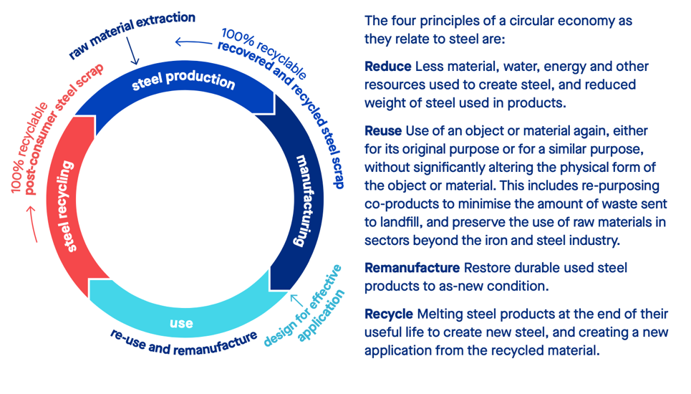
Utilisation of processed Australian ferrous scrap metal increases the recyclable material availability to reduce our steel producers GHGe intensity
The Australian steel industry has well stated goals to further decarbonise the industry through the production of ‘low carbon steel’ – availability of scrap is a critical enabler
For EAF producers high scrap input
Integrated BF – whilst R&D progresses; reduces other raw material needs: iron ore, coal
International governments and global steel producers are looking to strategically shore up scrap supply
Important to take advantage of Steel & the Circular Economy:
Steel & the Circular Economy:
Steel is the most recycled construction material globally - The Circular Economy: Recycling, Re-use & Reduce is a great sustainability enabler for steel:

Slide 11
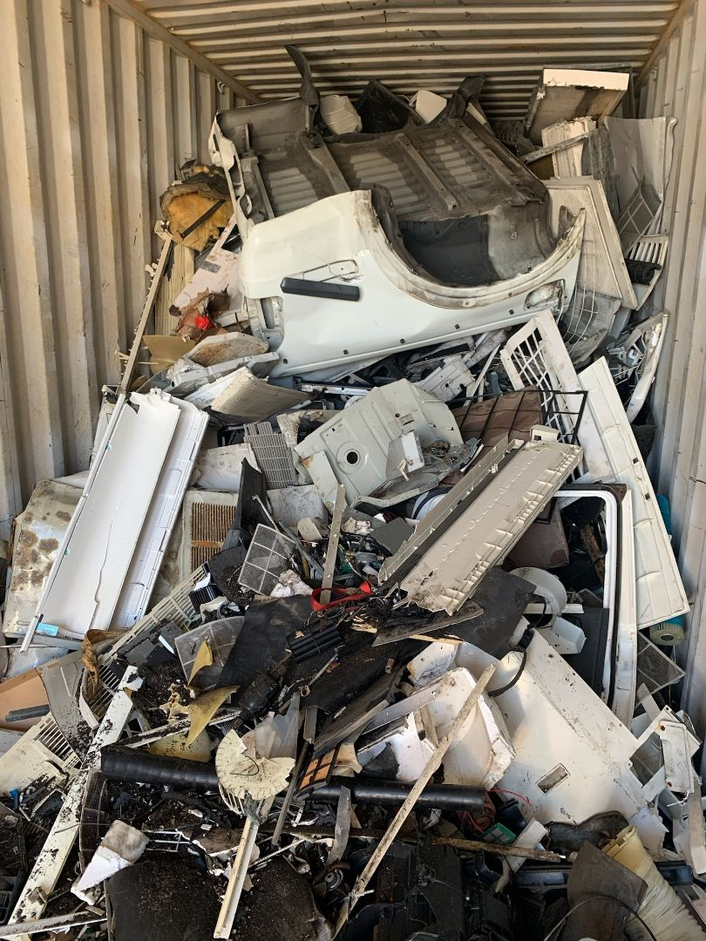
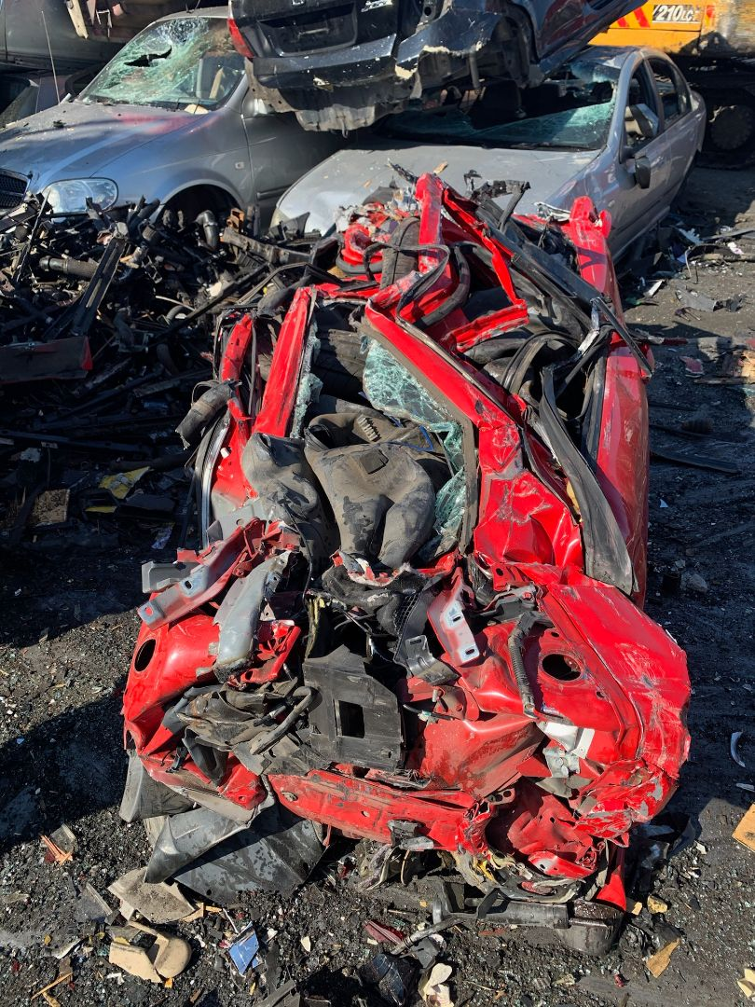
Significantly reduces natural resources – mining inputs
Ferrous scrap metal residual or ‘floc’ will no longer be disposed in developing countries with low environmental regulations / controls.
Residuals include as glass, plastics, textiles, tyres, oil, fuel and coolant and potent greenhouse gases including HFCs and CFCs;
This may include uncontrolled burning of floc, illegal dumping of floc, uncaptured leachate entering the broader environment; and floc used as a domestic fuel alternative
Floc contains many hazardous substances that may be released when burnt, including chlorine and arsenic.
Other Environmental Benefits:

Slide 12
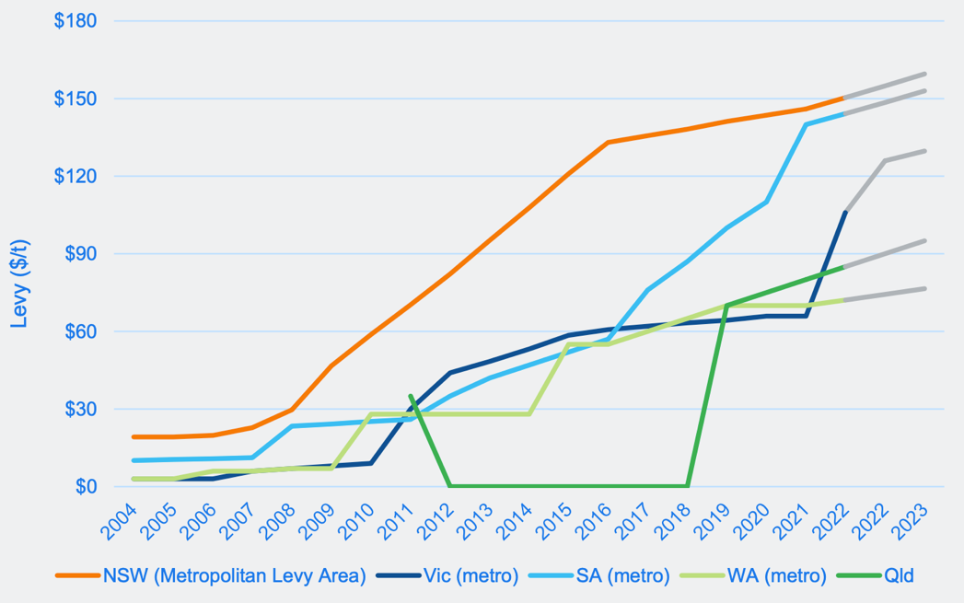
The 1,070,575 tonnes when processed in Australia are estimated to have a residual ranging between 267,600 and 321,200 tonnes that would need to be landfilled in Australia.
Assuming waste levies ranging between $125.90 (Victoria Metro) and $151.60 (NSW metro) this would incur additional $33.7 million to $48.7 million in waste levy revenue that would otherwise be available for reinvestment in environmental initiatives.
These amounts can also be described as the extent of levy avoidance by exporters of unprocessed scrap metal and the extent of an unfair competitive advantage in shifting their environmental compliance offshore.
Levy Avoidance, Landfill Revenue – which could be put to other environmental causes:
State Landfill Levies
Source: State EPA’s

Slide 13
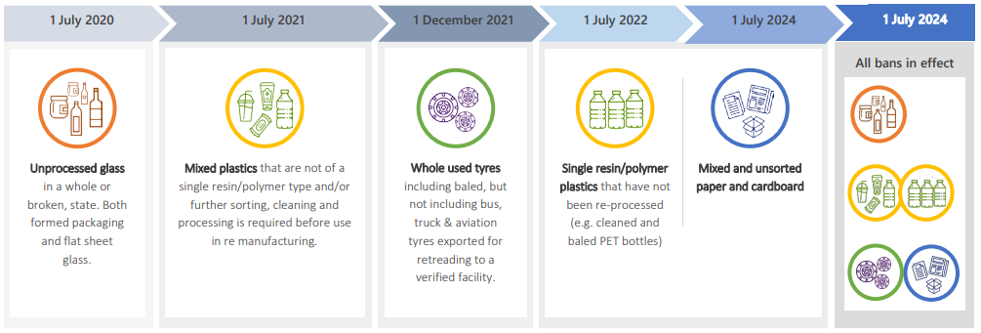
The Australian Labor Party’s plan is to reduce waste, boost recycling, improve the health of the environment, through underwriting innovative manufacturing and creating sustainable jobs.
A ban on the export of unprocessed ferrous scrap metal would directly align with the new Australian Government’s waste and future made in Australia election policies.
Direct Fit with Commonwealth Government Policy
Significant Alignment with Commonwealth Government Policy:
ALP Election Policy includes the following statement:
“Australia must be a country that makes things. After almost a decade of sending manufacturing offshore and neglecting Australian workers, we’ve seen the consequences: fewer jobs, missed opportunities, and a nation left exposed when coronavirus hit. An Albanese Labor Government will rebuild our proud manufacturing industry, and build a future made right here in Australia. Australia is blessed with natural resources, but under this government we’re missing out on an opportunity to value add and employ Australians in manufacturing.”
Source: https://www.alp.org.au/policies/a-future-made-in-australia
Australian Waste Export Ban Timetable
Source: COAG Waste Response Strategy

Slide 14
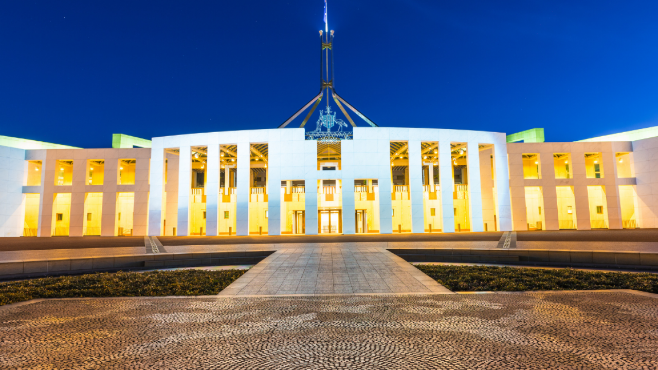
A policy solution to realise greater economic and environmental benefits of the Act
To action this change, the Commonwealth’s Recycling and Waste Reduction Act allows the Environment Minister to prescribe rules & types of waste material for the purposes of the Bill
Accordingly the Environment Minister has the power without legislative change to include unprocessed ferrous scrap metal in the Australian Waste Export Ban and its full application by July 2024
Banning the export of unprocessed ferrous scrap – Recycling and Waste Reduction Act
Under the Act, the Minister has the power to generate very positive economic and environmental change…

Slide 15
Summary of Proposal Benefits – Banning the Export of Unprocessed Ferrous Scrap:
Economic:
Steel, scrap recycling & construction jobs
Industry, government $rev; GDP impacts
Government $revenue
Steel industry – security of local supply
Increases local industry capacity
Industry efficiency, supply chain management
Local industry growth supported
Environmental:
GHGe benefits to local steel producers
Supports Aust GHGe target reduction
Supports hard to abate sector, GHG reduction
Transport footprint reduction for scrap
Hazardous waste management security
Reduces risk of env impacts - other OS communities
Corporate Social Responsibility

Slide 16
Further Information:
 | Sulfianda Soeleiman State Manager Vic-SA-Tas Australian Steel Institute Mobile 0437 594 571 sulfiandas@steel.org.au

