Slide 1
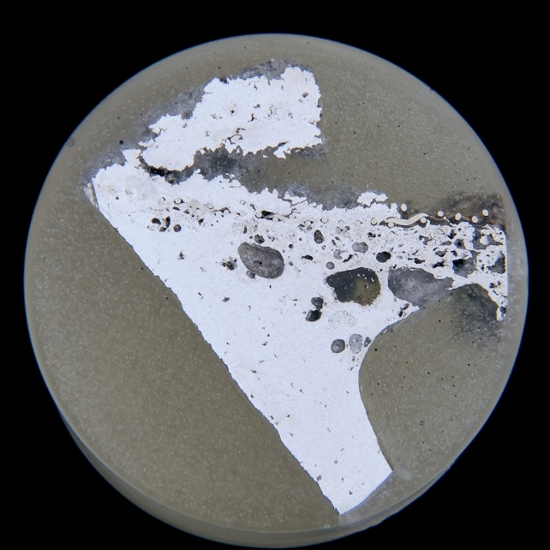
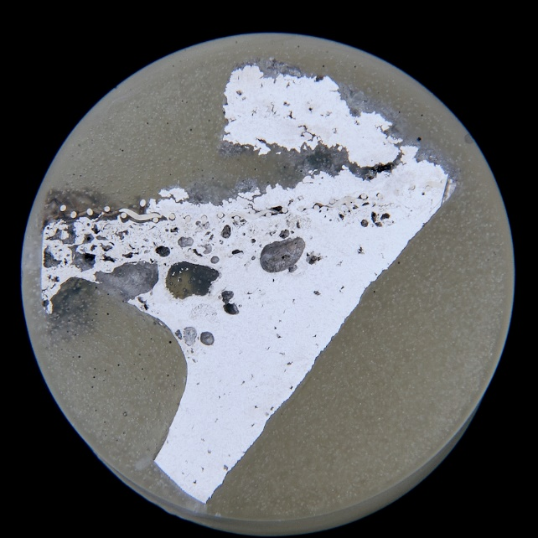
10 Rules for Casting Applications in a Real World Environment
Australian Foundry Institute Conference 2023
Richard Seymour-Wright

Slide 2
Content
Intro & Disclaimer!
The Ten Rules
Key Considerations for Casting Design
Case Studies
Tanker Lid Casting – Gravity Die Casting – CA401 Aluminium
Turbo Exhaust Collector Casting – Sand Casting - SiMo
Base Casting – Sand Casting – Ni-Resist
Closing Summary & Questions

Slide 3
Intro
Richard Seymour-Wright
BEng (Phys Met)
GDE (Ind Eng)
Disclaimer - No formal training or qualifications in methoding!!
Foundry IT (1998)
Pro/Engineer
AFSolid – now SolidCAST / FlowCAST / OptiCast
“Technical Manager” – Alliance Connect
Since 2017
Responsible for New Product Development & Casting Processes (~50%)

Slide 4
The 10 Rules
Achieve a good quality melt
Avoid turbulent entrainment (critical velocity)
Avoid laminar entrainment of the surface film (no stopping / reversal of flow)
Avoid bubble damage
Avoid core blows (core venting)
Avoid shrinkage damage (7 feeding rules)
Avoid convection damage
Minimise segregation
Minimise residual stresses
Provide location points

Slide 5
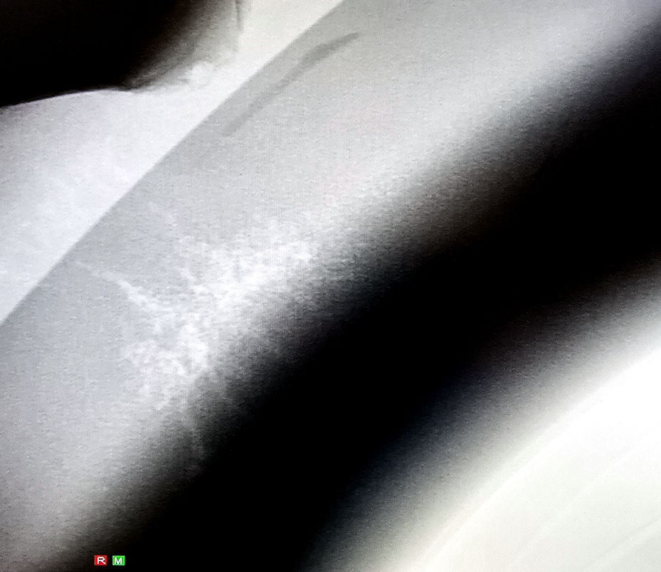
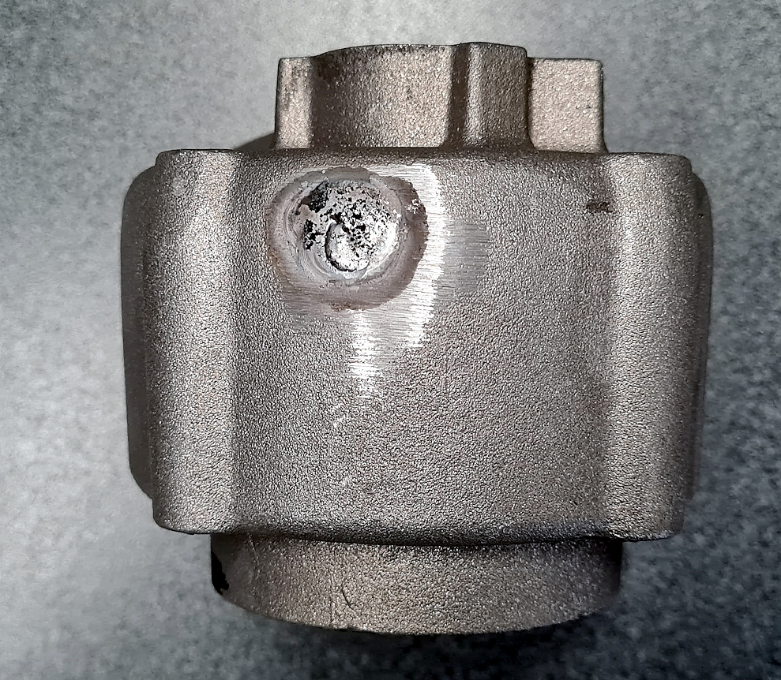
Key Considerations – Casting Layout Design
Can the part be cast in our plant?
Feeding
Feeder sizing is critical
Required metal available for feeding – volume & efficiency considerations
Modulus
Feeding paths
Gating
Gating sizing is critical
Gates < 1/2 wall thickness
Gate area to meet flow requirements - <0.5m/s through gate
Meet requirements of fill rate – can the casting fill?
Venting!!!
Short runs / non-fills / cold shuts
Castings Practice (2004), Campbell, J, Pg 18, Fig 2.3.1

Slide 6
Concessions
Convention – “The way we do things”
Experience – not always theory / scientifically based
Established with a single objective in mind
Established systems – e.g. pouring cups, runner systems
Some features may not be easy to implement
Pattern / die manufacturing
Moulding / casting constraints
Aftercast processing
Increasing tooling complexity
Commercial considerations

Slide 7
Case Studies
Aluminium Permanent Mould X 1
Ferrous Sand X 2

Slide 8
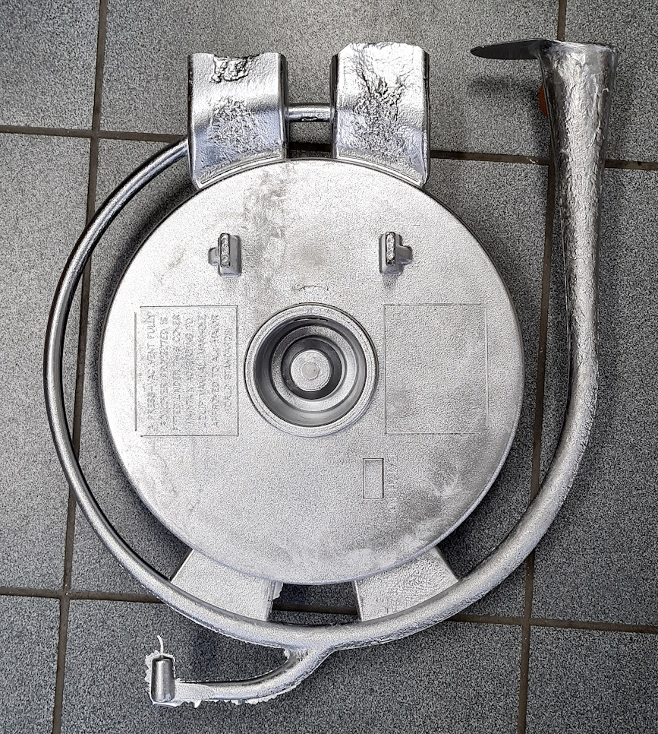
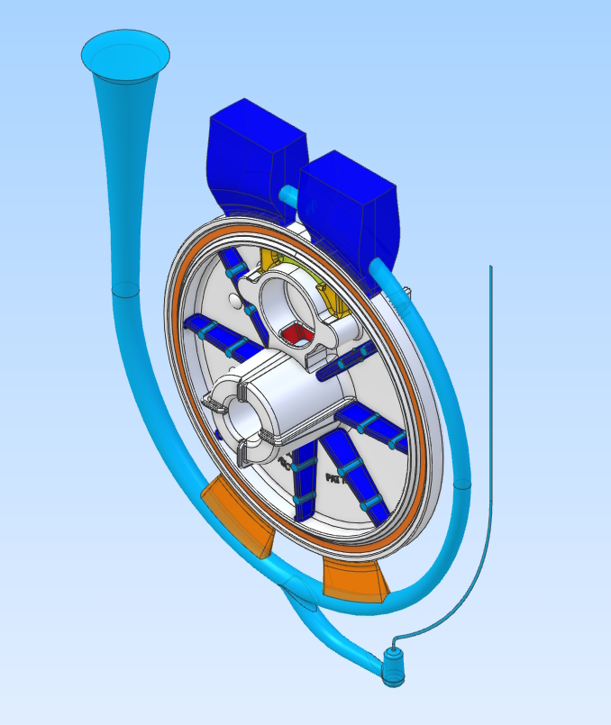
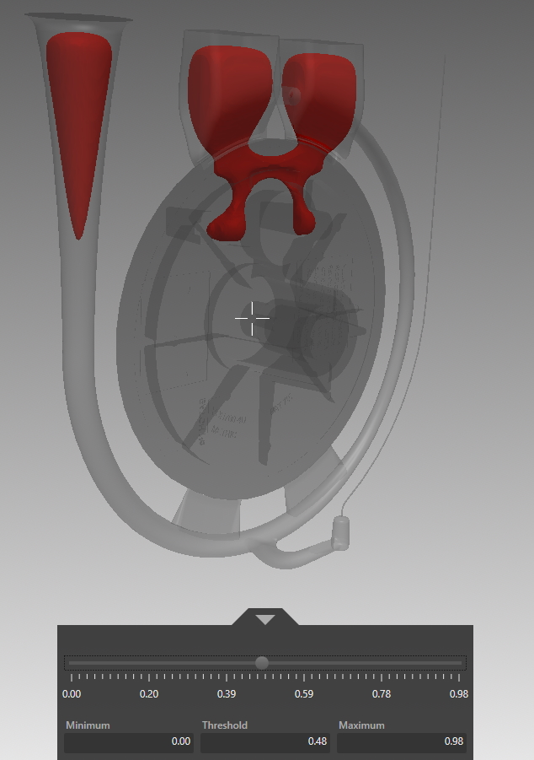
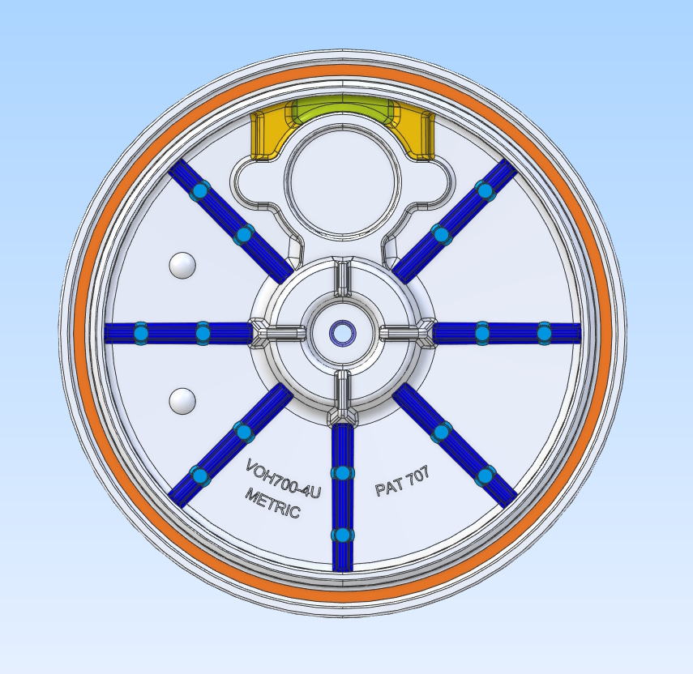
Tanker Lid Casting – Gravity Die Casting – CA401

Slide 9
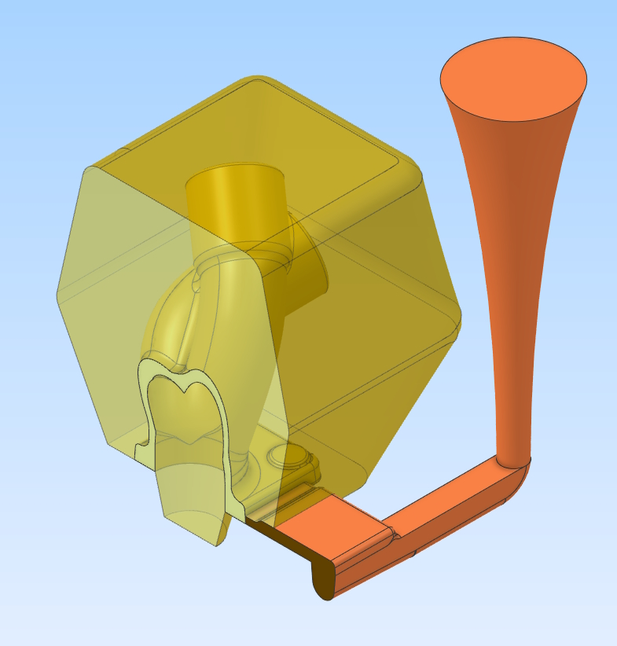
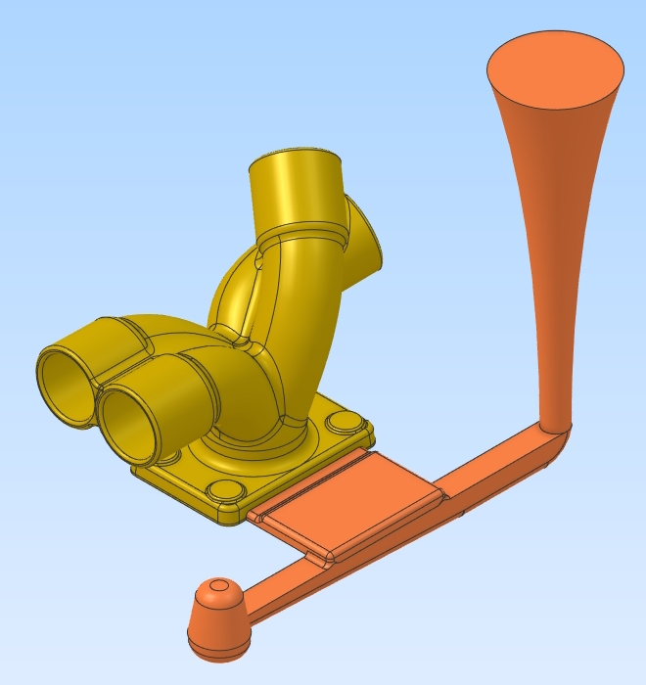
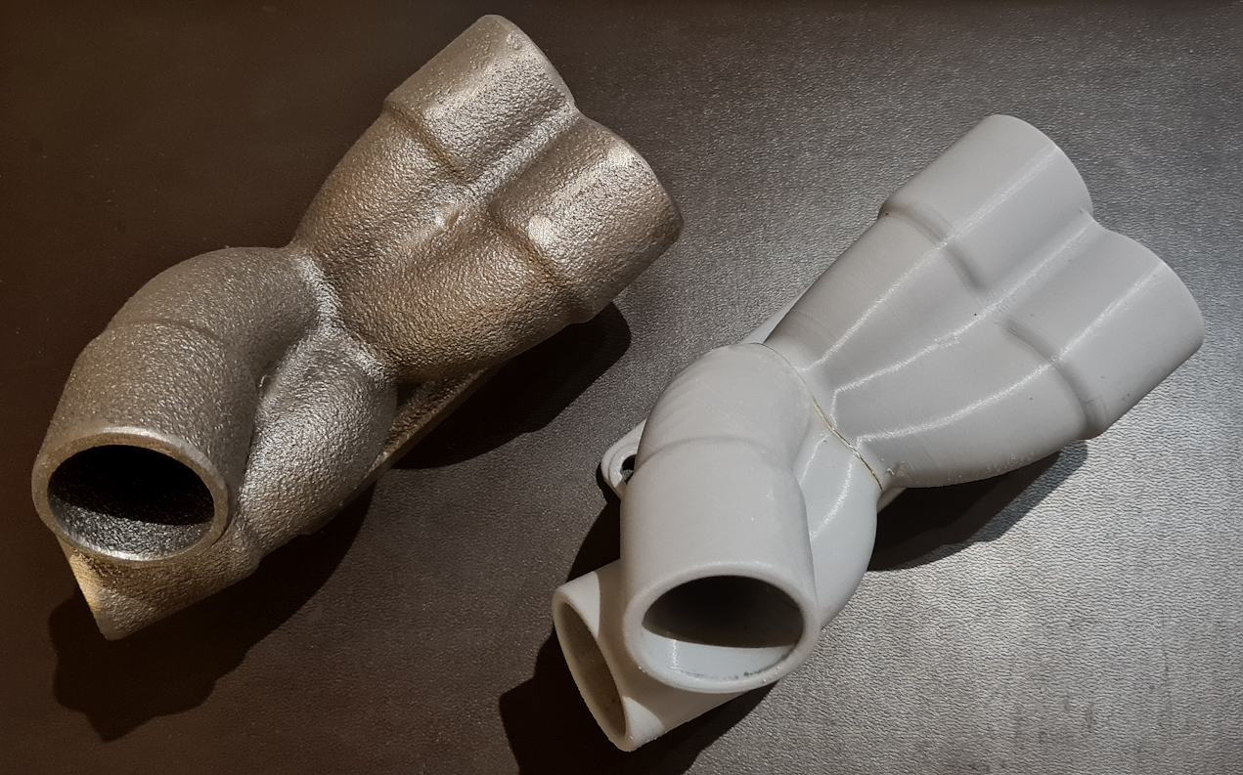
Turbo Exhaust Collector Casting – Sand Casting - SiMo

Slide 10
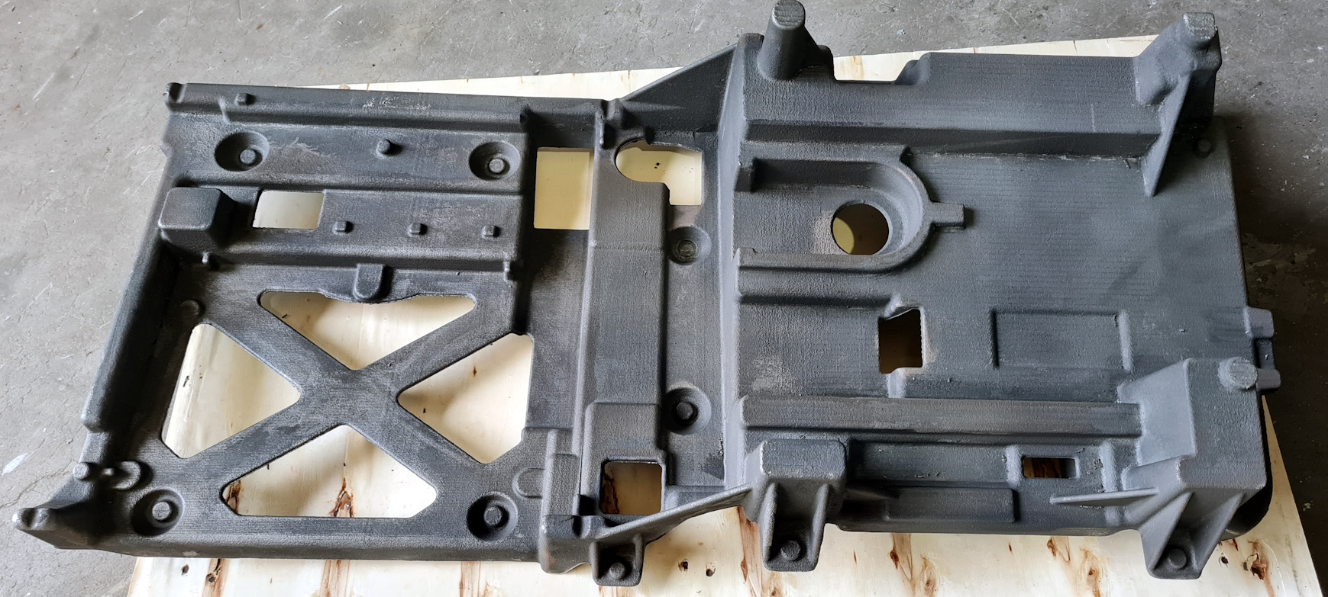
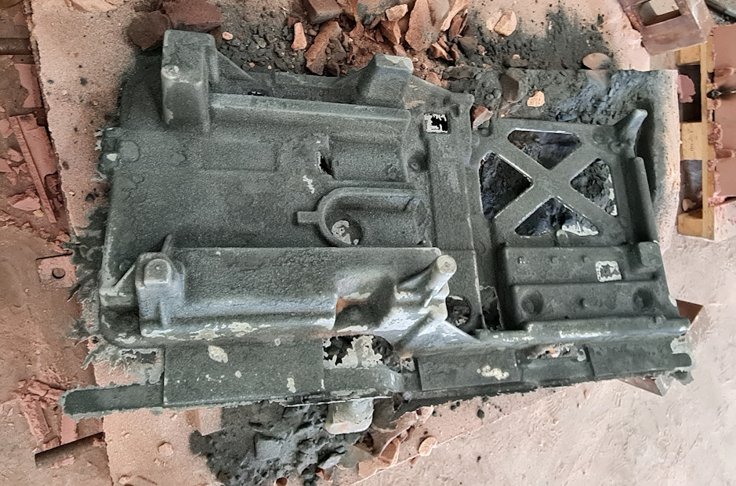
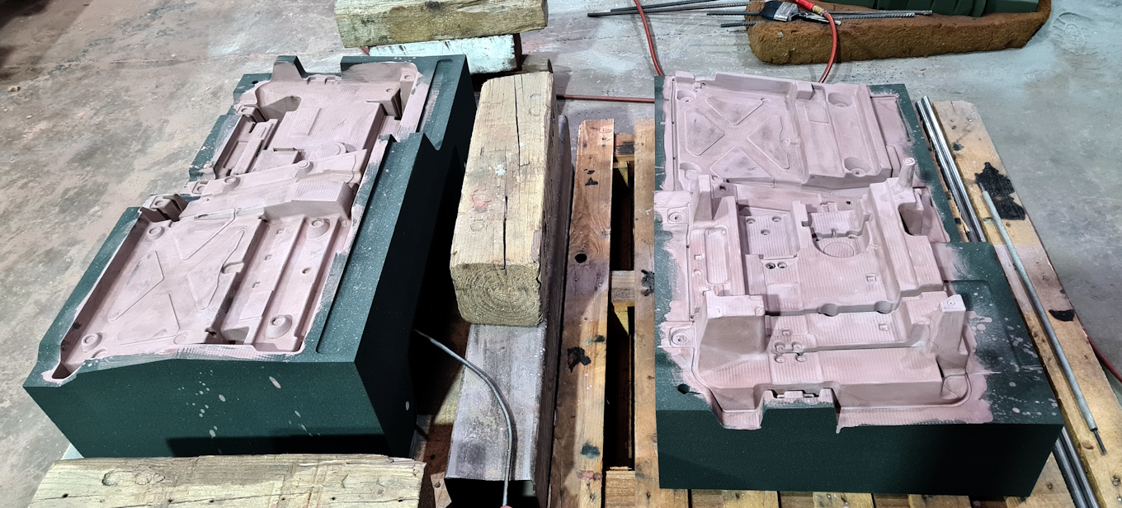
Base Casting – Sand Casting – Ni-Resist

Slide 11
Underway

Slide 12
Summary
The theory works and is applicable
There are difficulties with design
Implementing key requirements => better results
Still some way for us to go, but we’re on a journey!
Questions?

